Slide 1
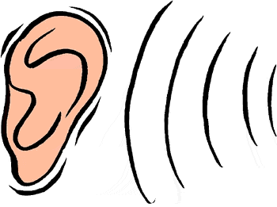
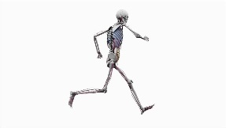
Ways to practise my spelling words…
Visual
Auditory
I can listen to how many syllables are in a word, e.g. Sep-tem-ber
2. I can find the base/root word, e.g. smiling = smile + ing
Analogy – I can use spellings I already know to help me, e.g. could, would, should.
Mnemonics – Make up a sentence to help e.g C OU Lucky Duck: People eat omelettes, people like eggs.
Handwriting – practise the direction and movement of a word.
Spelling fun – squiggle writing/ bubble writing/ rainbow writing (vowels in blue/ alternate colours/ in alphabetical order)
Don’t forget good old Look, Say, Cover, Write, Check!
Kinaesthetic
Memory

