Slide 1
PHONEME –
A single unit of sound
SOUND TALKING –
Breaking a word down into its component sounds, this is often done orally and using fingers as an aid
CVC WORD –
A word made up of a consonant phoneme, then a vowel phoneme then another consonant phoneme
F –i-sh (Fish)
C-a-t (cat)
Sh – ee – p (sheep)
Phase 1 key vocabulary

Slide 2
GRAPHEME – the mark on the page that represents a letter sound – like ‘graphic’
Phase 2 key vocabulary
MNEMONIC – An action to support a sound
TRICKY WORDS – Words that do not make phonological sense
BLENDING – Children will see the word ‘cat’ and say each component sound to read the word
SEGMENTING – A child may want to write the word ‘cat’ so they have to think of each sound in the word individually
GRAPHEME / PHONEME CORRESPONDENCE – when a child is able to see the mark on the page and say the correct sound

Slide 3
6 phases of Letters and Sounds Phase 3
Children are introduced to letter names
Taught another 25 letter sounds most of which comprise of two letter digraphs
SET 6 – j, v, w, x
SET 7 – y, z, zz, qu
Consonant digraphs – ch, sh, th, ng
Vowel digraphs – ee, oo, ai, oa, ar, ow, oi, igh, air, ear, er, ur, ure
Notes:
Phase 3 is when we have double letter sounds. For some children they reach phase 3 by Christmas others by the end of the year.
Reading at this point extends to 3 or 4 word sentences. We will be doing guided reading sessions where we combine listening to indivudal children with book talk.
Writing now is taught by reducing the lines gradually. Talking a sentence out loud first and encourage children to say it back then children making phonetically plausible attempts at words. Eg scooll school
Letter names are taught with analogy of animals eg cat has name and a sound

Slide 4
DIGRAPH – 2 letters that make 1 sound
SOUND BUTTONS & DIGRAPH LINES – This is the mark adults put under letters to support children to say the sounds
Phase 3 key vocabulary
CONSONANT DIGRAPH – at least one of the letters in the digraph is a vowel
VOWEL DIGRAPH – at least one of the letters in the digraph is a vowel

Slide 5
6 phases of Letters and Sounds Phase 4
Phase 4 is a consolidation of the previous 2 phases, no new sounds are introduced
Words are extended to CVCC and CCVC words
Children are encouraged to get to grips with the tricky words learnt so far:
The, to, no , go, I, he, she, we, me, be, was, my, you, her, they, all, are, some, one, said, come, do, so, were, when, have, there, out, like, little, what
Notes:
No new sounds are taught at phase 4.
Reading at this point we would hope that children start to internalise sounding out. Reading is a bit more fluent. But when reading with children at home, if they get stuck go back to sounding out.
We would focus on recognising the tricky words.
Writing also focuses on the tricky words, learning them off by heart and extending writing through the use of describing words and full stop and capital letter. We would focus on formatting our writing eg starting in right place.

Slide 6
Phase 4 key vocabulary
CVCC WORDS –
A word made up of a consonant phoneme, a vowel phoneme, then 2 more consonant phonemes
B-e-n-ch (Bench)
Th – i – n – k (Think)
T – e- n – t (Tent)
CCVC WORDS –
A word made up of two consonant phonemes, then a vowel phoneme, and then a final consonant phoneme
T-r-ai-n (train)
S – t – o – p (stop)
Th – r – I – ll (Thrill

Slide 7
6 phases of Letters and Sounds Phase 5
Introduces sound families and alternative pronunciations for reading
Introduces alternative spellings of some sounds
Notes:
Phase 5 is a phase that only a small number get to in FS, this is where year 1 take over.
Reading will be around 3 or 4 sentences at a time, usually sight reading, and then making sensible guesses about the context of the story.
Writing should be more accurate. Children will have built up a bank of common words they write with. They may use more punctuation eg common, question, marks, speech marks
Sounds are about alternative spellings

Slide 8
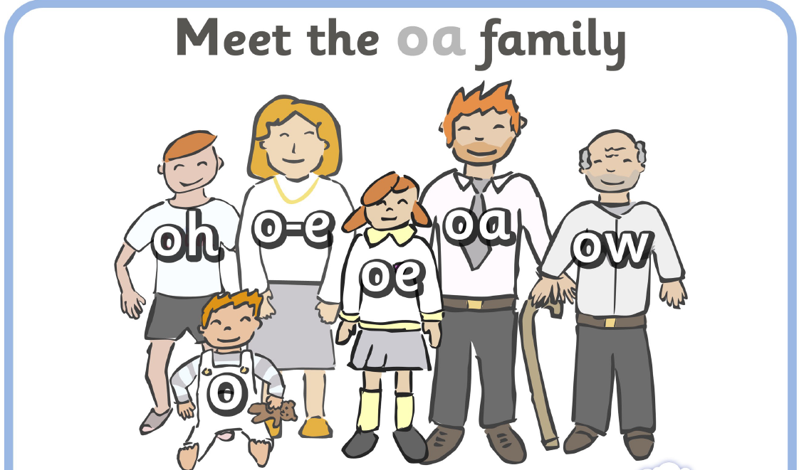
Sound families
Notes:
Task – what is ai sound family
ai - rain
a - bacon
ay - ray
ey – they
eigh – eight
ae – name

Slide 9
Assessing children’s progress
Class teacher will receive daily evaluations from letters and sounds groups teacher
Regular 1 to 1 assessments
Children’s reading also closely monitored by class teacher through home reading scheme and guided sessions
As a result of assessment children move between groups where appropriate
Assessment is of a similar structure to the statutory end of Year 1 National Phonics Screening check
Notes:
Groups are lead by teachers and TAs across Foundation Stage, so that children fit into letters and sounds at a point which suits them best.
Try to have daily sessions
We will talk to parents at consultations and via My Unique Story
If we find that children need additional support or need extension and challenge then this will be done via small group intervention that will be discussed at parent consultations.

Slide 10
Pseudo words (nonsense words)
There is now a much bigger emphasis on pseudo words
Children must identify component sounds
Children know they are nonsense words by the ‘alien’
This should help children with selecting the right sounds for writing
Notes:
This has come from the statutory assessment in year 1 that, showing the children words in alien words is one of the only ways to assess their knowledge of sounds. As many children will just sight read.

Slide 11
Ideas for supporting writing
Giving children responsibility – shopping lists, notes for family members, cards and letters, diaries
Using paper like mummy and daddy
Role play – cooking recipes, menus, signs on small world toys
Finger games – lacing, threading, tweezers and pasta and seeds
Patterns and tracing
Writing in sand, flour or glitter
Anything that wipes clean to alleviate fear of getting it wrong
Notes:
Have resources available.
Praise any attempt. ‘thank you for helping me with shopping lists when we see the word bread in asda it will be written like this…..’
Don’t panic with things like b and d reversal, q and p muddling, w and m,letters facing the wrong way, mirror writing these are all common developmental stages for our young children.

Slide 12
Fab resources to have at home
Shaving foam
Gloop (cornflour, food colouring and water)
Chalking
Foam letters in the bath
Biros and real pens
Chunky pencils, crayons and pens
Playdough and cutters
Bucket of water, paintbrush and dry surface
Notes:
Children really like to do these activities alongside a grown up. Children’s first instinct is to play and so if we make writing similar to playing eg fun they are likely to be more receptive to it.

Slide 13
Any questions??

