Slide 1

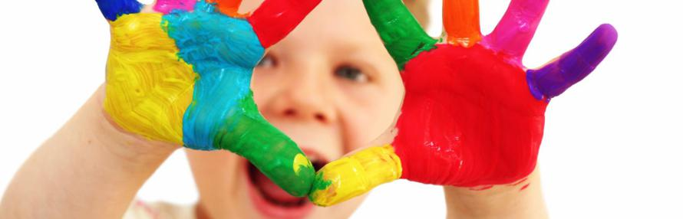
Welcome to eyfs at the discovery school
Notes:
Nicolle

Slide 2
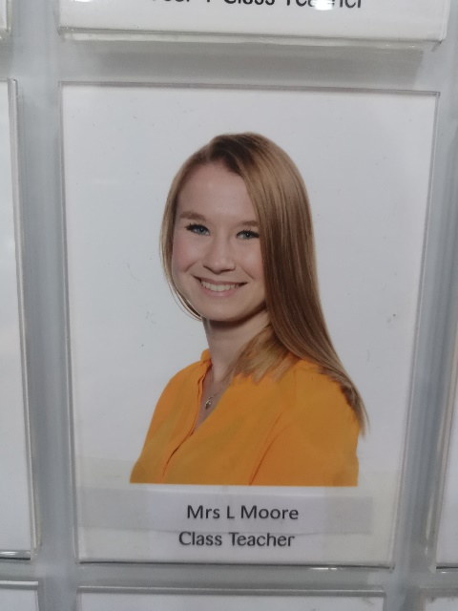
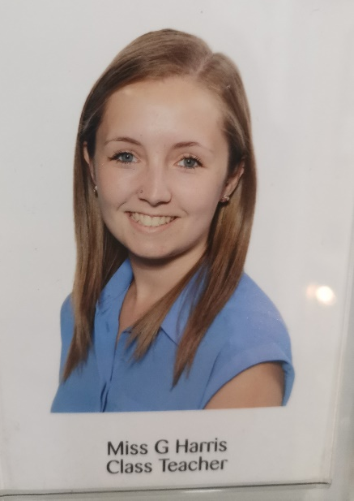
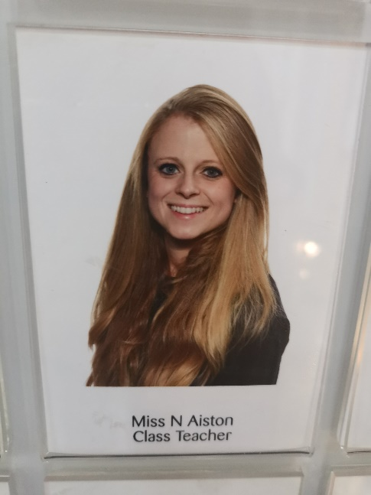
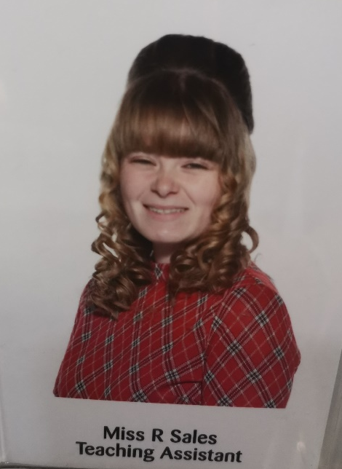
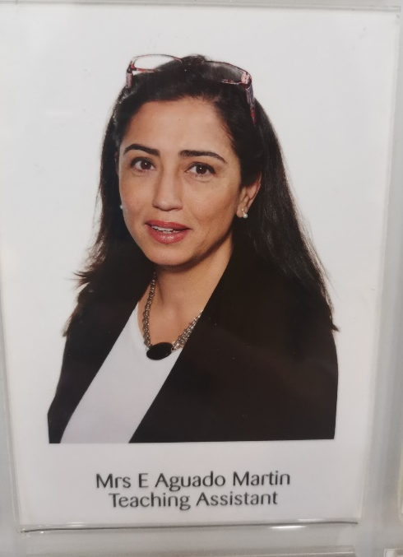
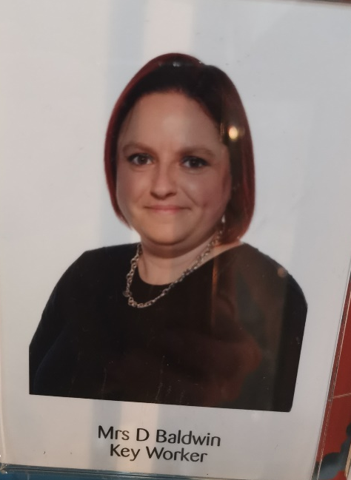
Newton
Jenner
einstein
Notes:
Nicolle

Slide 3
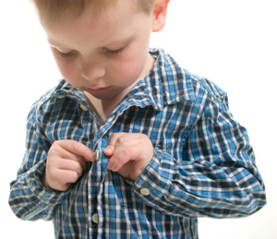
Is my child ready for school?
Mythbusters!
My child should be able to read and write before starting school.
My child needs me for...
My child won’t like English/Maths because I didn’t.
Real expectations
Your child can get dressed by themselves.
They can put on their shoes and coat.
They can carry their own things.
They can use a knife and fork.
Be positive! (Smile even though your heart is breaking)
Be prepared to separate quickly at the gate. (Try separating at the transition dates)
Your child comes to school with the correct equipment.
You read something everyday with your child.
Notes:
Gemma

Slide 4
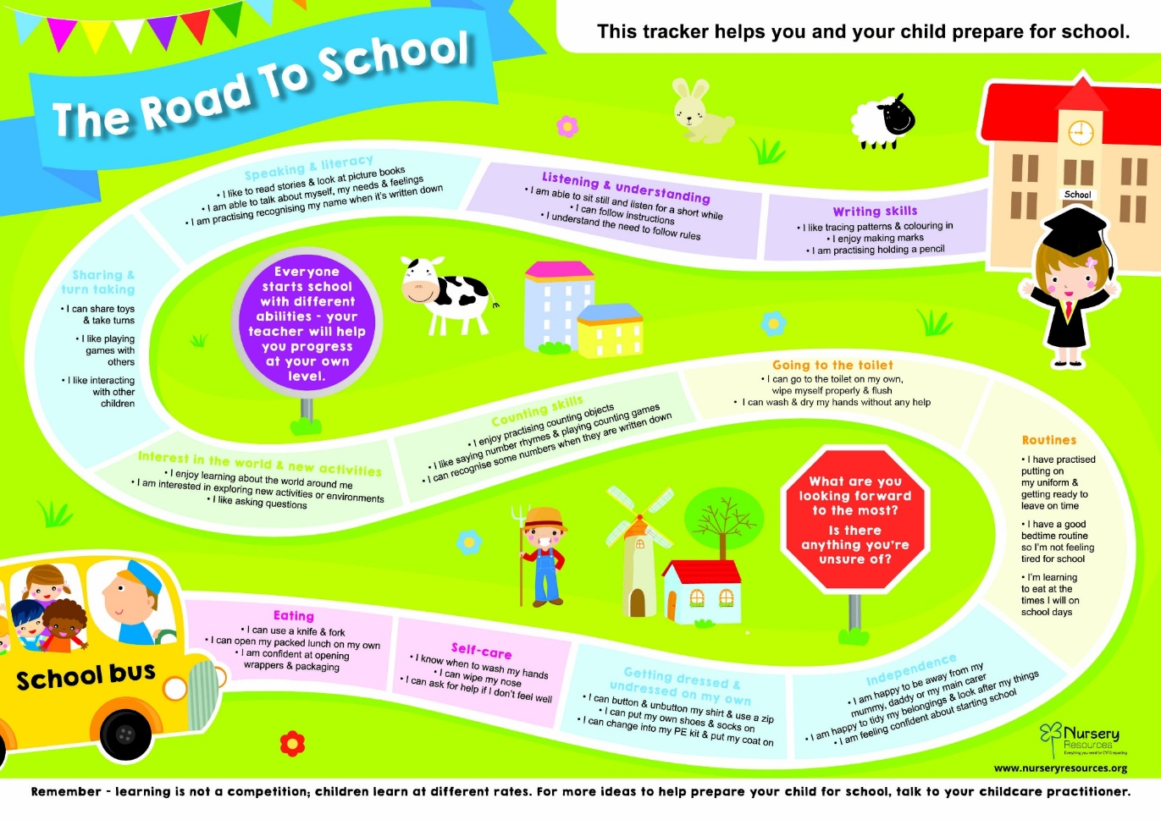
Notes:
Gemma

Slide 5
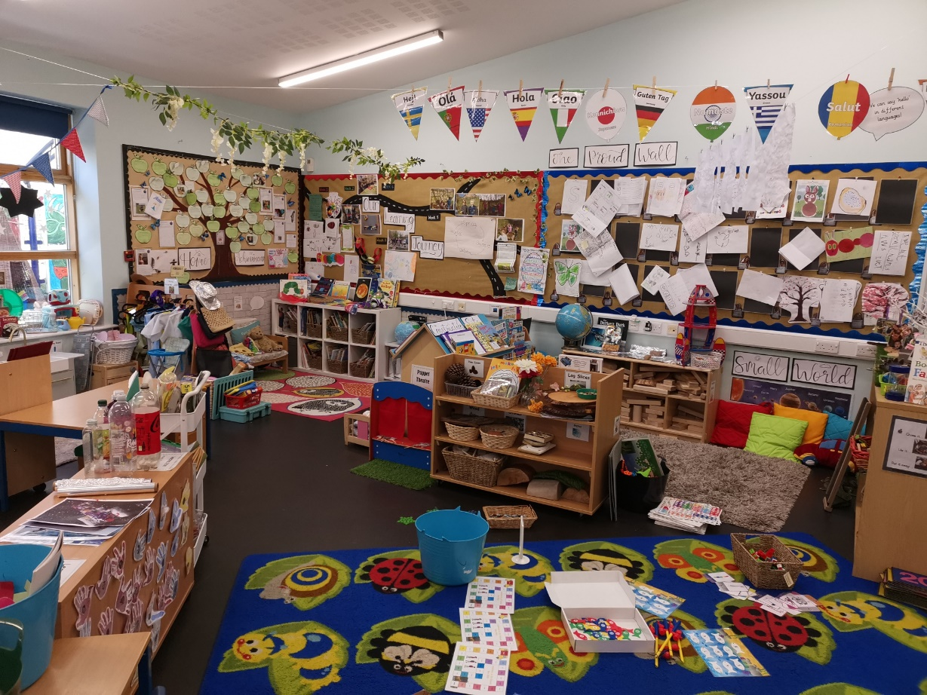
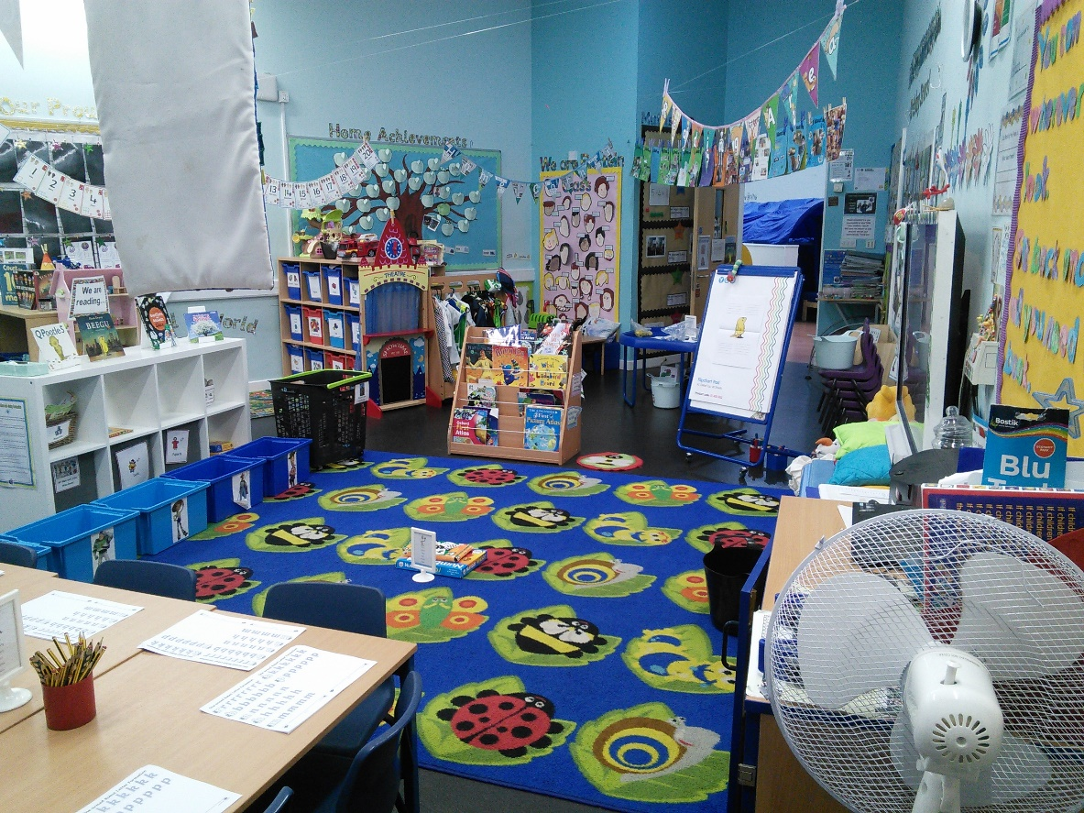
Classrooms
Notes:
Leah

Slide 6
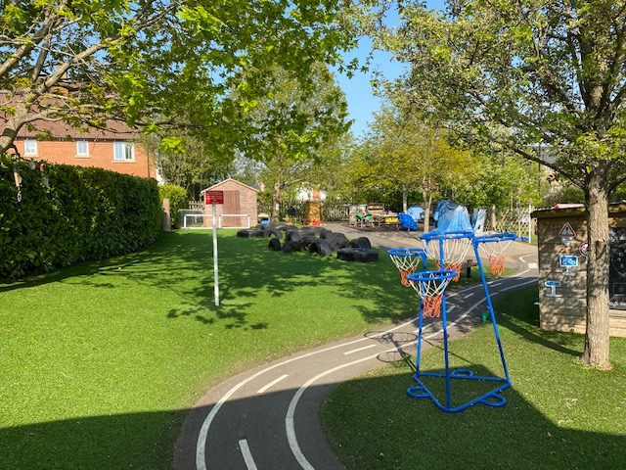
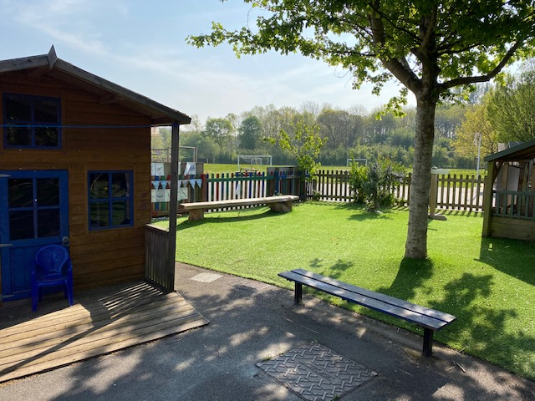
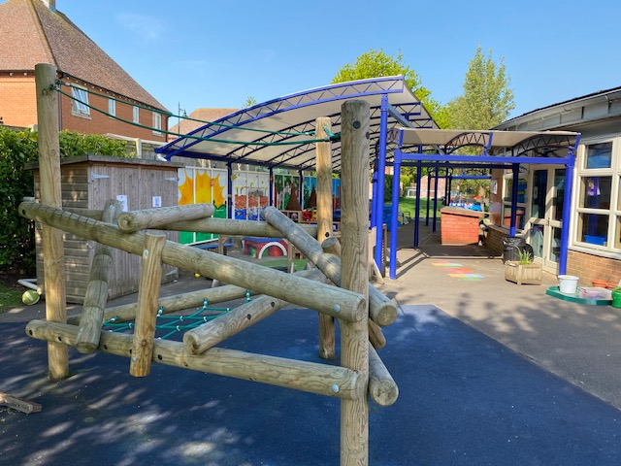
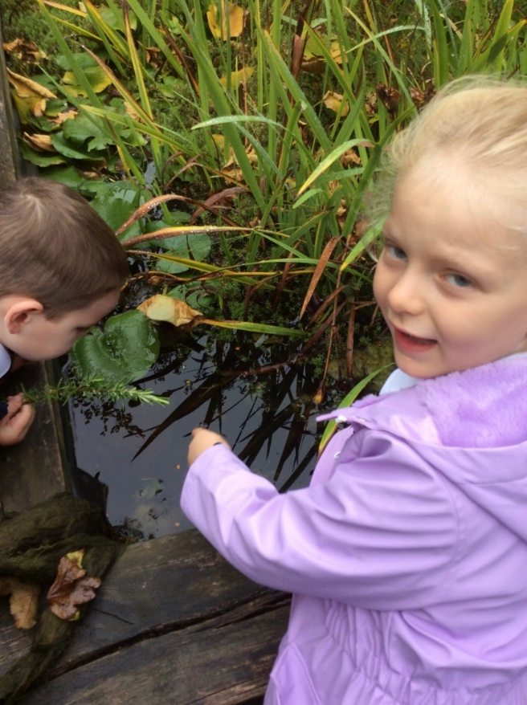
Outside area
Notes:
Leah

Slide 7
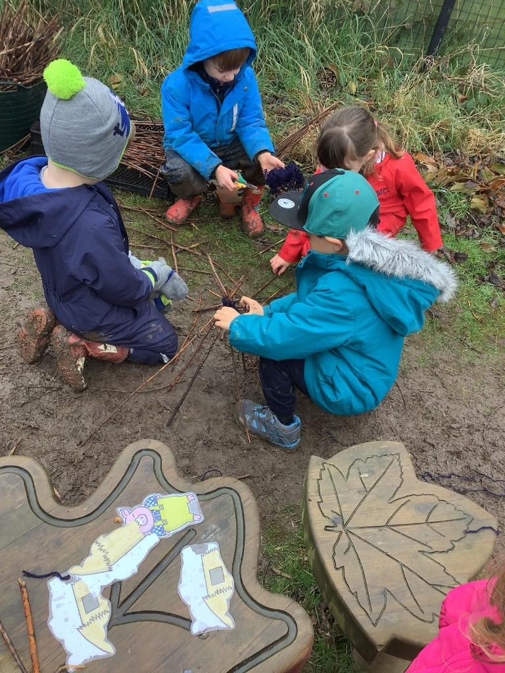
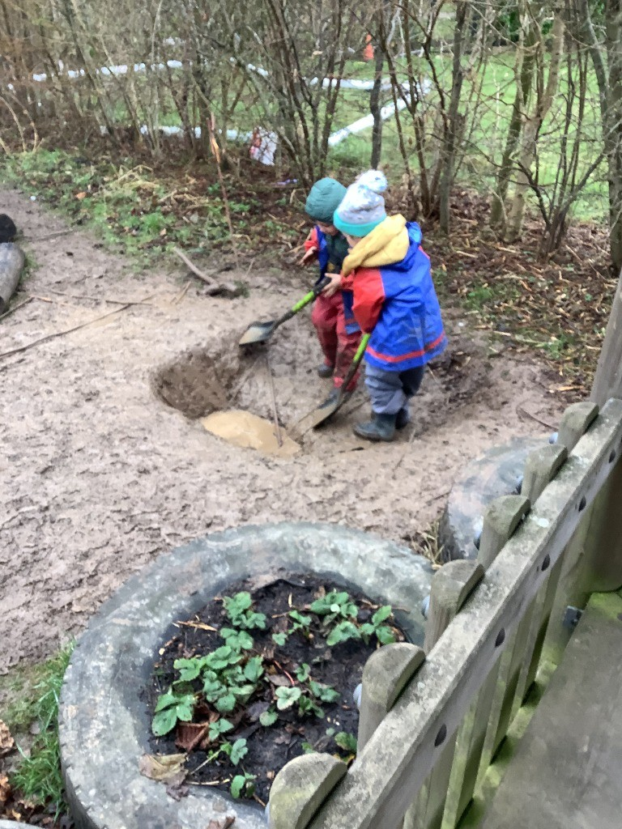
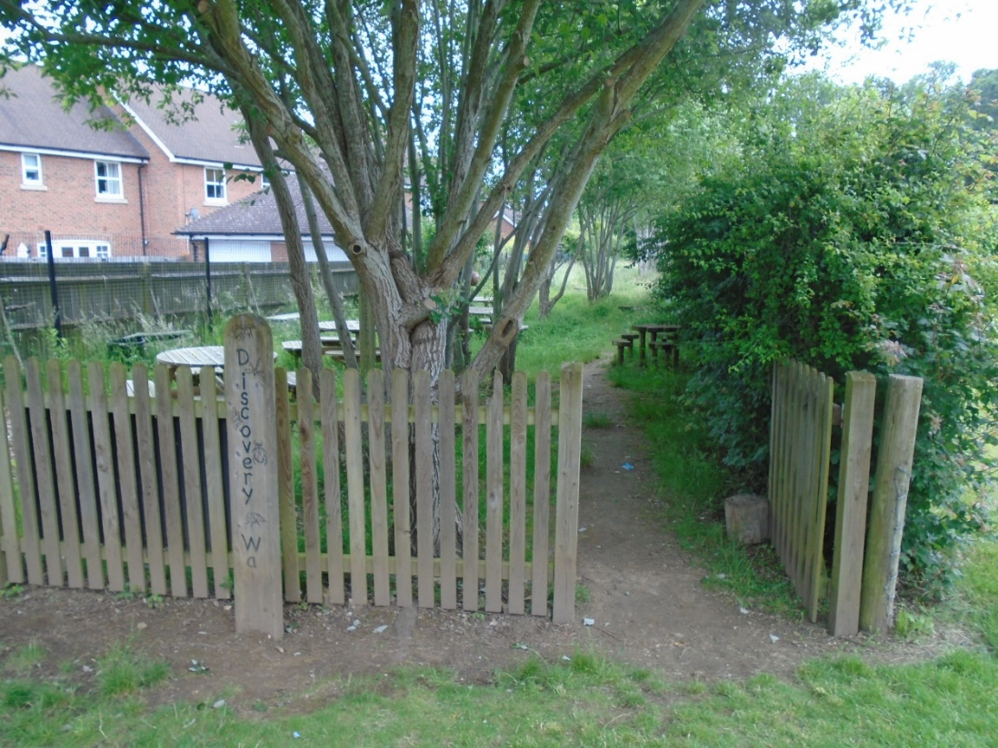
Forest school
Notes:
Leah

Slide 8
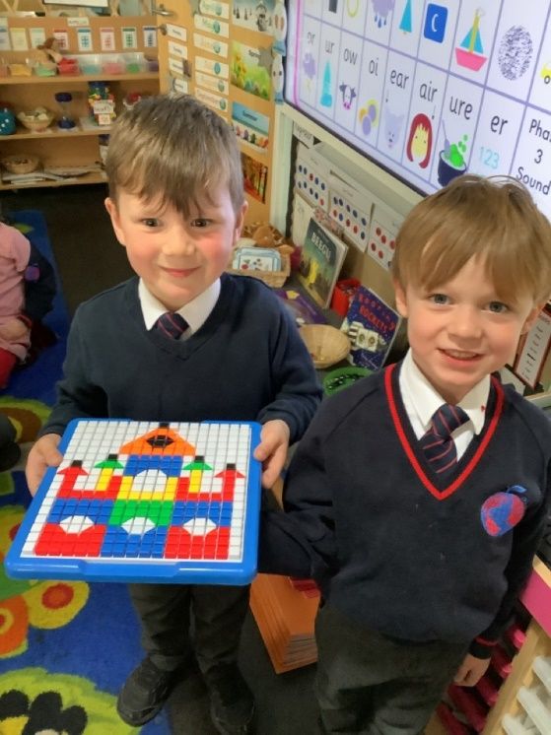
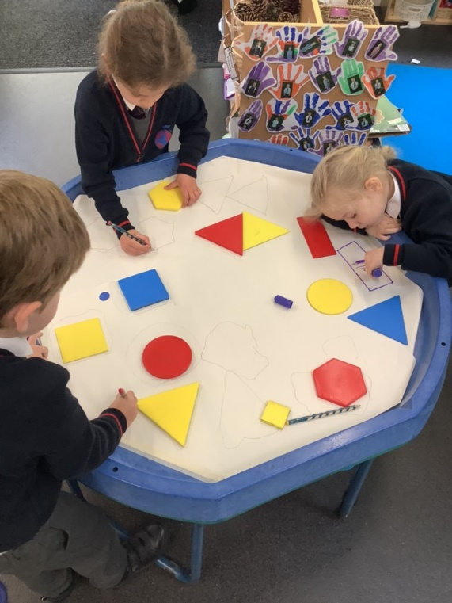
How we learn in EYFS
Follow Development Matters and the Early Years curriculum
Child initiated learning (PLR)
Teacher directed learning
Outside and indoor learning
Notes:
Nicolle

Slide 9

How we learn in EYFS
Timetable:
Every day starts at 8:40 and pick up is at 3:15.
You drop off your child at the KS1 gate and pick up at the classroom door.
Lunch time is at 11:30-12:30 every day. You can choose to have packed lunch or school dinners every day.
Please refer to our website for timetables and any other extra information about EYFS.
Notes:
Nicolle

Slide 10

Transition into eyfs
Slow transition – 1st week half days, 2nd week half days with lunch, 3rd week full time.
Two ‘Stay and play’ sessions in July.
Nursery visits
Home visits in September – please book.
Notes:
Gemma

Slide 11
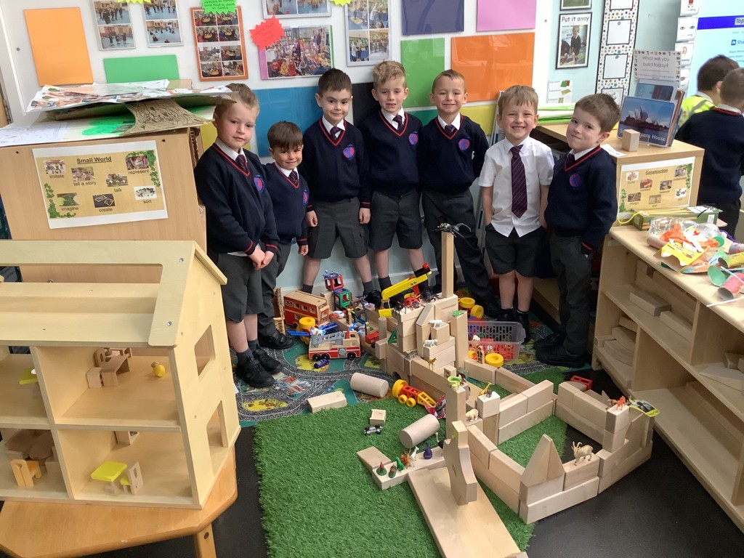
Plan, Learn, review
This is child initiated learning where the children will talk or draw what they would like to do.
Through their activities (play) solidify their learning.
Everyday provision includes role play, drawing, music, computers, building, sand and water.
Enhance the provision with activities linked to the topic e.g. Sewed superhero puppets, built traps for evil characters and collected evil peas from goo!
Teachers will be making a Sway video of the classroom your child will be in. This will allow your child to get familiar with their new learning environment.
Notes:
Gemma

Slide 12
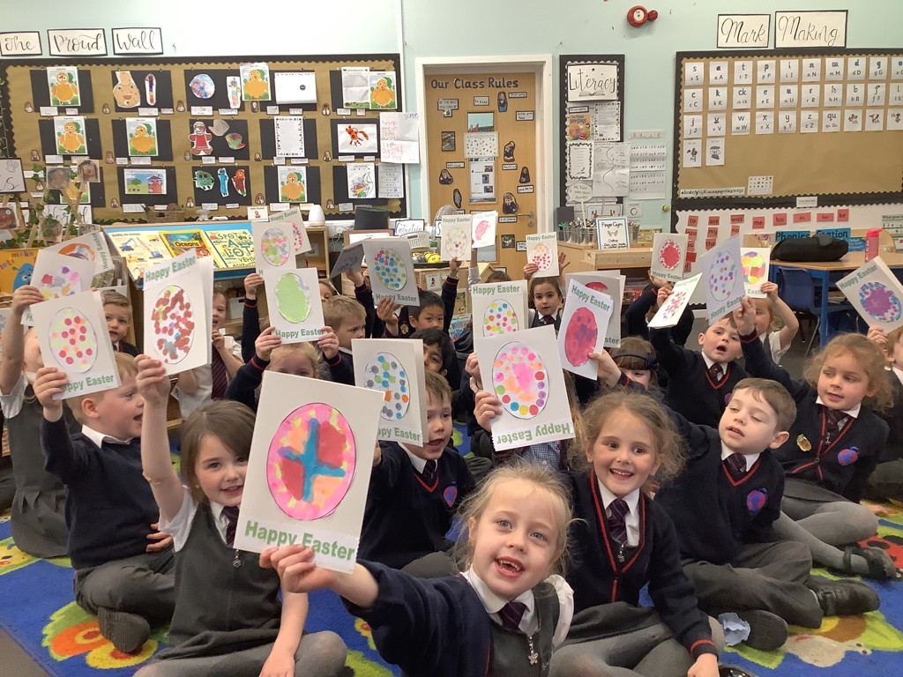
Directed Teaching
Phonics
Guided Reading Session
Literacy
Maths
Group Time
Other areas of the curriculum
Circle Time
Notes:
Nicolle

Slide 13

Question of discovery
At The Discovery School our learning is based on exploration and discovery so we use a focus question to lead our learning.
Across the year our learning is focussed around a ‘Question of Discovery’. This links to our topic and allows the children to go on a journey of exploration.
We find out what the children already know and what they would like to learn and we use this to support our planning and make learning engaging for the children.
Children use the ‘Question of Discovery’ to build on their prior learning and develop their knowledge and skills further.
We believe it is so important for children to be interested in the learning taking place so we make sure our topics link to the children’s interests and needs.
For example, we may observe that the children are struggling with naming wild animals but love to play with them, so we will plan for our question to be around a jungle topic and use this topic to develop and inspire our curriculum. We carefully plan and adapt our curriculum to ensure all children are making progress and building knowledge and skills which they can use to support their next steps in their learning journey.
Notes:
Nicolle

Slide 14
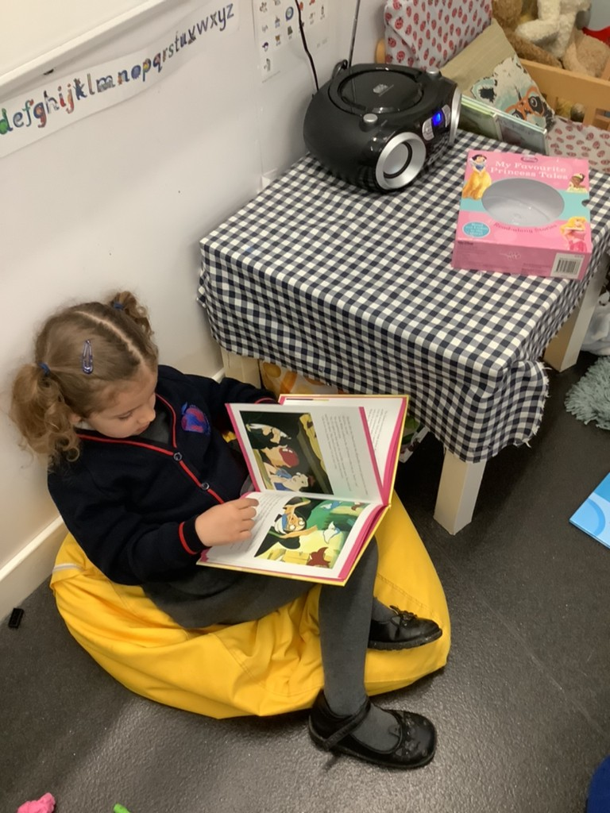
workshops
We will be making workshops for Phonics, reading, writing and Maths to support your understanding on how to help your child at home with their learning.
Resources will be in your child’s book bag to support your child’s learning over the summer.
If you do ever have any concerns or questions please do contact your class teacher and we will be happy to help.
Notes:
Leah

Slide 15
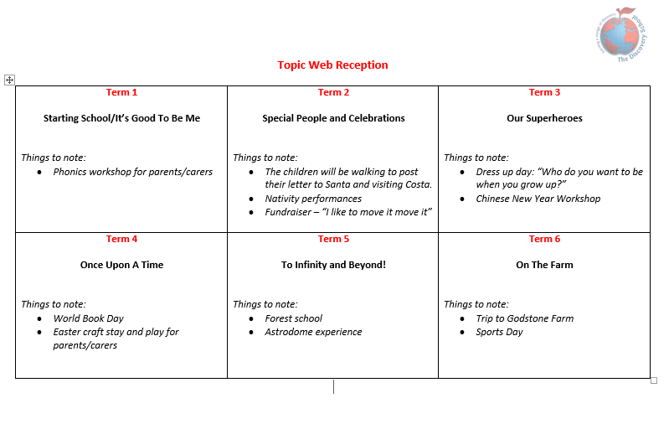

Focus texts
Notes:
Leah

Slide 16
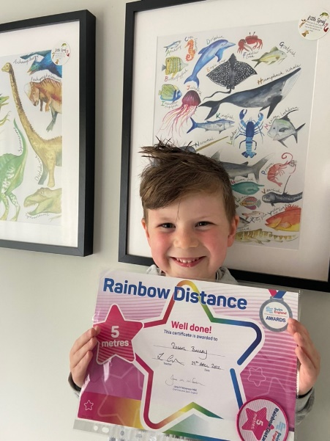

Tapestry/assessments
We use Tapestry, an online learning journal to upload learning that has taken place at school. Parents can enjoy this from home and comment on the pictures.
On Tapestry you can upload home achievements for us to celebrate at school. Home achievements are a very important part of your child’s learning journey.
Assessments are made through observations and questioning. All assessments we do with your child are purposeful and used to help us support their next steps. These will be communicated with you on parents consultations.
Notes:
Gemma

Slide 17
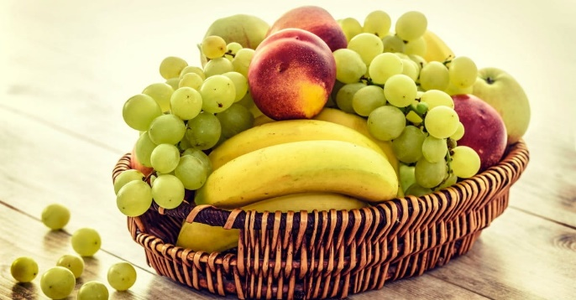
Snack/lunch time
Every day we have a morning snack and an afternoon snack. In the morning we have a piece of fruit or vegetable which is provided by the school. If you would like to provide an alternative healthy snack you can. The children are entitled to free milk until they turn 5 years old. Once your child has had their fifth birthday, if they would still like to have milk at snack time, you will need to pay via: www.coolmilk.co.uk.
In the afternoon the children can have a bread stick which is supplied by the school. If you would rather your child did not have a bread stick please let their class teacher know. You are welcome to supply them with something else if you do not want them to have a bread stick.
Children are entitled to a free school meal, up until the end of Year 2, the menu changes every 2 terms and will be provided to you as soon as we have it.
Notes:
Gemma

Slide 18
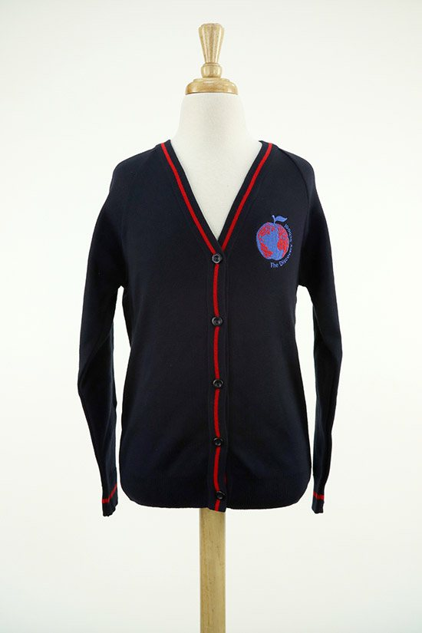
Uniform AND ESSENTIALS
Uniform: if you are unsure about the uniform you child should wear, please refer to our website. Please make sure your child brings in a coat and a jumper or cardigan every day regardless of the weather. PLEASE MAKE SURE ALL YOUR CHILDS ITEMS ARE NAMED. https://www.discovery.kent.sch.uk/about-us/starting-school/uniform/
Book bags, no rucksacks.
Please provide your child with a change of clothing in case of accidents.
Wellies and wet weather gear in a plastic bag to hang on their peg.
Please provide a named water bottle for your child to bring into school with them every day, these must only have water in, not squash or juice.
Medicines - office
Illnesses – please phone or email the office to let them know.
Notes:
Nicolle

Slide 19
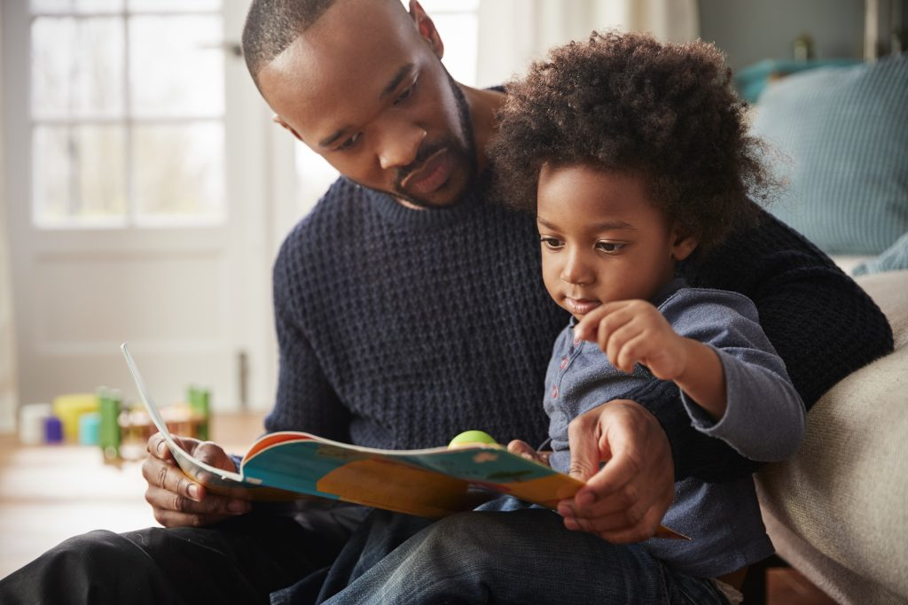
Reading at home
Your home reading book
Home Readers
Bug Club
Reading is everywhere!
Please do not forget to send your child in every day with their home readers and reading record as someone may read their books with them.
Notes:
Nicolle

Slide 20
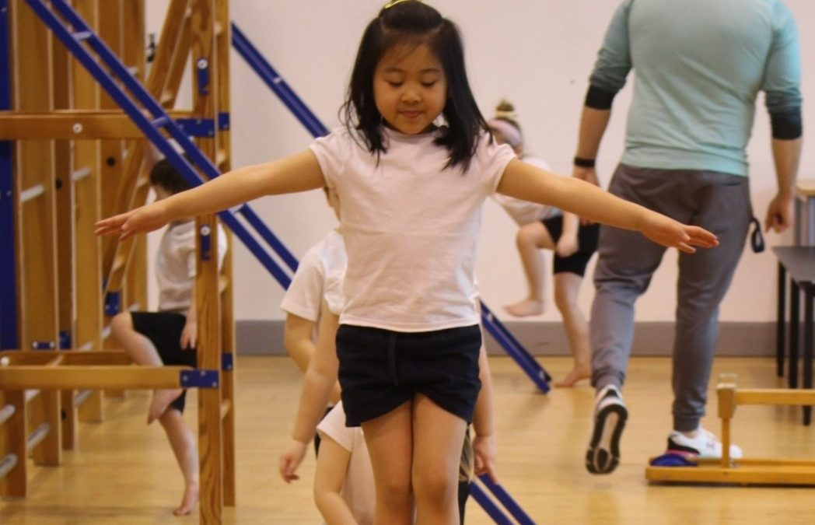
Physical education
PE doesn’t start until Term 2. PE will be indoors for the first two terms (Terms 2/3).
Allocated day each week.
Our PE kits and what your child needs to bring for PE.
Notes:
Leah

Slide 21


Celebrations
Year group celebration assembly every Friday: celebrations in school and outside school.
Star of the week award
Reading rewards
Post cards
Parents evening
Please refer to our school learning updates page on our website to keep up to date with our learning!
Stickers
Certificates
House points
Notes:
Leah

Slide 22

Communication
Termly News Letter
Reading record
Email or phone call
Drop off/pick up time
Please refer to our EYFS page on our website.
Notes:
Gemma

Slide 23
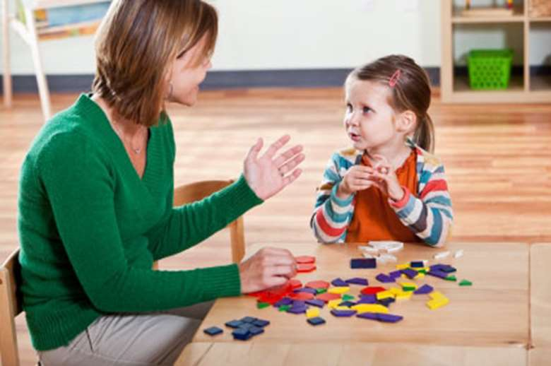
Baseline assessment/speech and language
When your child starts with us in September they will take part in a range of games to assess their skills and allow us to plan for their learning.
Alongside this we also give every child a speech and language assessment to ensure any gaps in their development are addressed at this early stage through lots of fun and engaging games.
Notes:
Gemma

Slide 24
Breakfast club and afterschool club
Breakfast club starts at 7:30am and after school club runs until 6pm.
Book 48 hours in advance via online booking system on our website, please call or speak to our office staff if you would like to use this service.
Notes:
Nicolle

Slide 25

We look forward to seeing you at stay and play!
Notes:
Nicolle

