Slide 1
Welcome to eyfs

Slide 2
staffing
Newton Class: Miss Aiston and Mrs Flint.
Jenner Class: Mrs Boulton, Mrs Baldwin and Mrs Brown.
Einstein Class: Miss Harris and Mrs Martin.
We are also very lucky to have an additional Teaching Assistant working across the 3 classes. Her name is Miss Carter.

Slide 3
How we learn in EYFS
Follow Development Matters and the Early Years curriculum
Child initiated learning (PDR)
Teacher directed learning
Outside and indoor learning.
Free flow between the classes.
Notes:
Mention that we follow the EYFS curriculum

Slide 4
Topics and curriculum
Notes:
Mention that we follow the EYFS curriculum

Slide 5
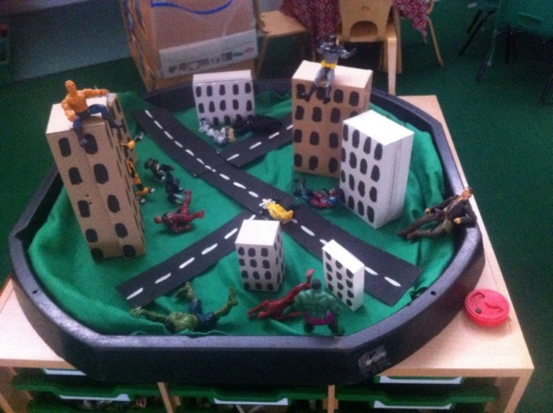
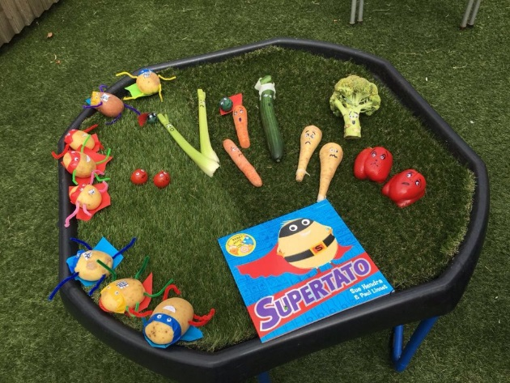
Plan, Learn, review
This is child initiated learning where the children will talk or draw what they would like to do.
Through their activities (play) solidify their learning.
Everyday provision includes role play, drawing, music, computers, building, sand and water.
Enhance the provision with activities linked to the topic e.g. Sewed superhero puppets, built traps for evil characters and collected evil peas from goo!

Slide 6
Snack/lunch time
Every day we have a morning snack and an afternoon snack. In the morning we have a piece of fruit or vegetable which is provided by the school. If you would like to provide an alternative healthy snack you can. The children are entitled to free milk until they turn 5 years old. Once your child has had their fifth birthday, if they would still like to have milk at snack time, you will need to pay via: www.coolmilk.co.uk.
In the afternoon the children can have a bread stick which is supplied by the school. If you would rather your child did not have a bread stick please let their class teacher know. You are welcome to supply them with something else if you do not want them to have a bread stick.
Children are entitled to a free school meal, up until the end of Year 2. At the moment we are providing a pack lunch style lunch. At the moment lunches will be eaten in the classroom and playtime will be on the KS1 playground in our EYFS bubble.

Slide 7
expectations
If your child is anxious or worried about starting school, please provide them with a photo of you that they can keep in their book bag or tray to look at if they are missing you while they are at school. We ask that NO TOYS are sent into school due to the risk of cross contamination or damage/loss of the item.
Behaviour/Rewards: Peg system, stickers, certificates, house points, reading ladder system and verbal praise.
Reading at home and Bug Club
Busy Things
Uniform: if you are unsure about the uniform you child should wear, please refer to our website. Please make sure your child brings in a coat and a jumper or cardigan every day regardless of the weather. PLEASE MAKE SURE ALL YOUR CHILDS ITEMS ARE NAMED.
PE is not until Term 2, your child will be allocated a house and this will be the colour needed for the tshirt.
Wet weather gear – wellies in bag for their peg.
COVID
Book bag/water bottle

Slide 8
Is my child ready for school?
Mythbusters!
My child should be able to read and write before starting school.
My child needs me for...
My child won’t like English/Maths because I didn’t.
Real expectations
Your child can get dressed by themselves.
They can put on their shoes and coat.
They can carry their own things.
They can use a knife and fork.
Be positive! (Smile even though your heart is breaking)
Be prepared to separate quickly at the gate. (Try separating at the transition dates)
Your child comes to school with the correct equipment.
You read something everyday with your child.

Slide 9
Celebrations
Year group celebration assembly every Friday: celebrations in school and outside school.
Star of the week award
Reading rewards
Post cards
Parents evening

Slide 10
Communication
News Letter
Reading record
COVID communication: email or telephone.
Please refer to our EYFS page on our website.

