Slide 1
Welcome to eyfs at the discovery school

Slide 2
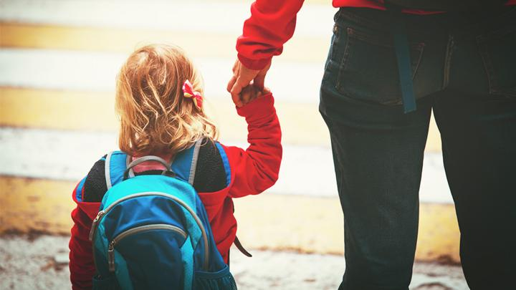
Is my child ready for school?
Mythbusters!
My child should be able to read and write before starting school.
My child needs me for...
My child won’t like English/Maths because I didn’t.
Real expectations
Your child can get dressed by themselves.
They can put on their shoes and coat.
They can carry their own things.
They can use a knife and fork.
Be positive! (Smile even though your heart is breaking)
Be prepared to separate quickly at the gate. (Try separating at the transition dates)
Your child comes to school with the correct equipment.
You read something everyday with your child.
Notes:
SUZ

Slide 3
Baseline assessment/speech and language
When your child starts with us in September they will take part in a range of games to assess their skills and allow us to plan for their learning.
Alongside this we also give every child a speech and language assessment to ensure any gaps in their development are addressed at this early stage through lots of fun and engaging games.
Notes:
SUZ

Slide 4
staffing
Each class has a teacher and a teaching assistant.

Slide 5
How we learn in EYFS
Follow Development Matters and the Early Years curriculum
Child initiated learning (PLR)
Teacher directed learning
Outside and indoor learning.
Free flow between the classes.
Notes:
Mention that we follow the EYFS curriculum

Slide 6
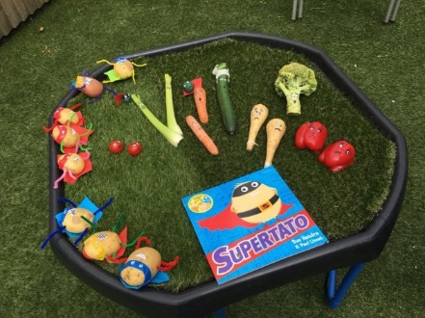
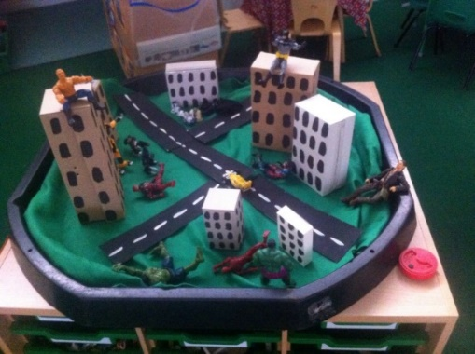
Plan, Learn, review
This is child initiated learning where the children will talk or draw what they would like to do.
Through their activities (play) solidify their learning.
Everyday provision includes role play, drawing, music, computers, building, sand and water.
Enhance the provision with activities linked to the topic e.g. Sewed superhero puppets, built traps for evil characters and collected evil peas from goo!

Slide 7
Topics and Focus texts
Notes:
Mention that we follow the EYFS curriculum

Slide 8
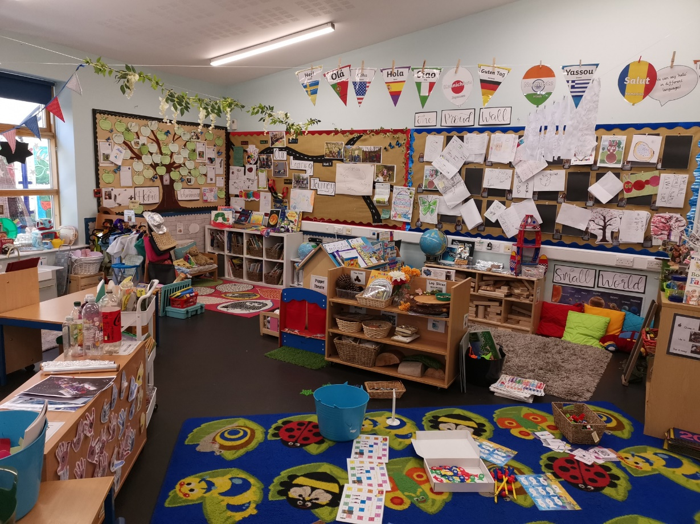
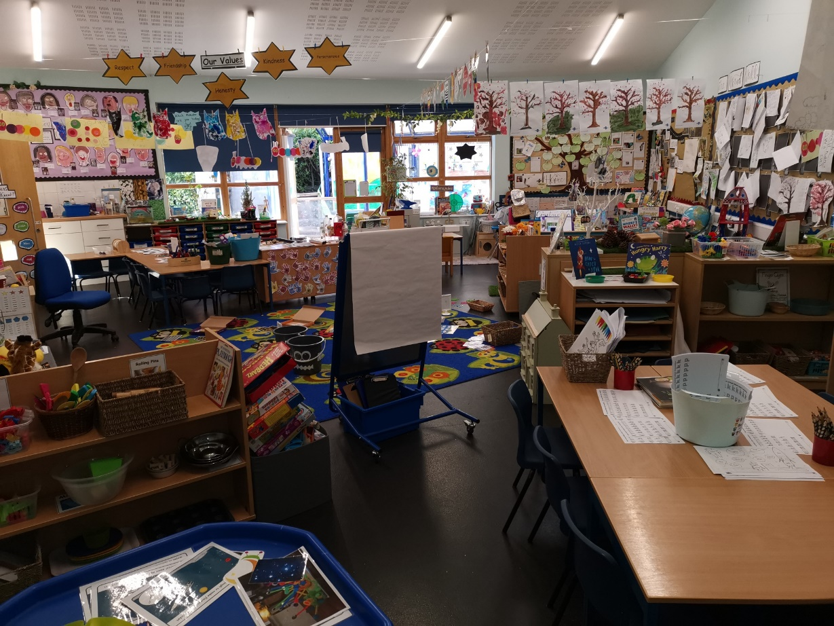
Newton Class
Notes:
GEM

Slide 9
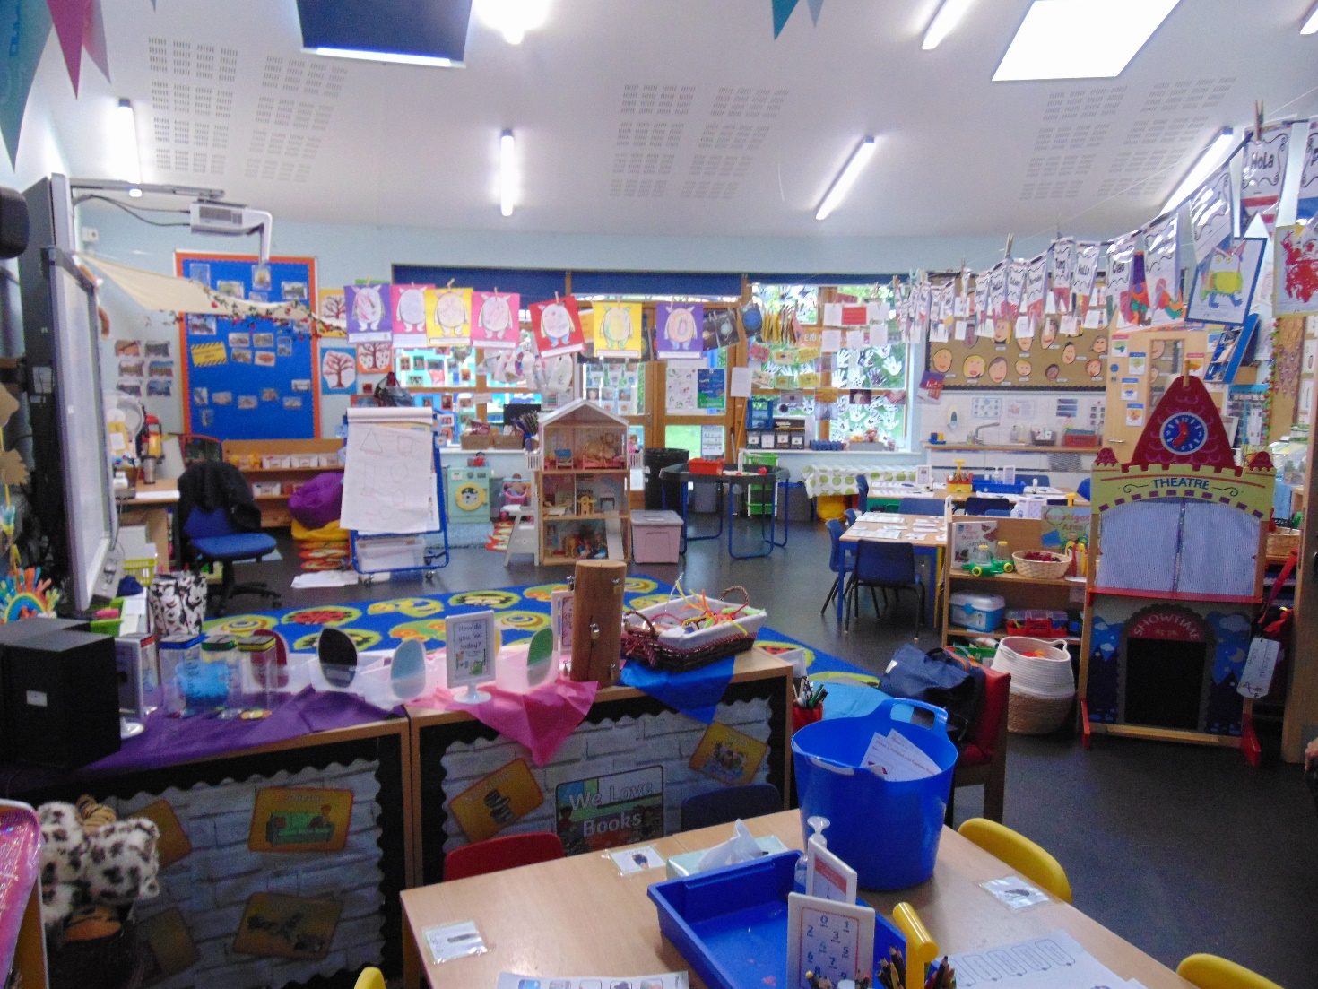
Jenner Class
Notes:
GEM

Slide 10
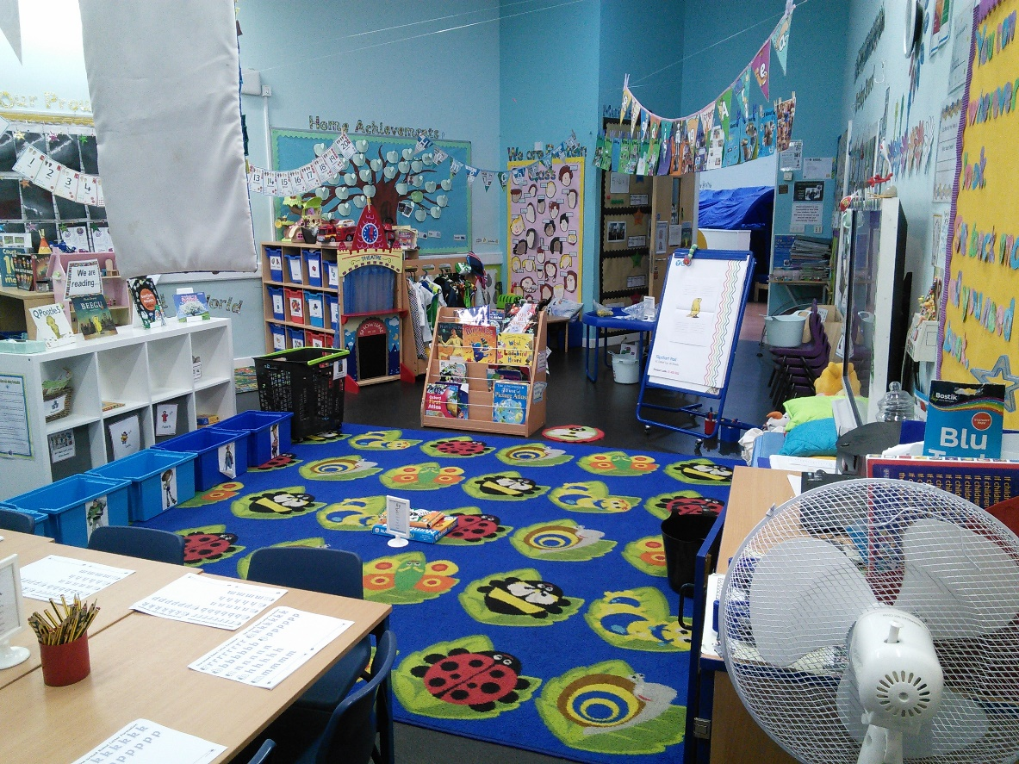
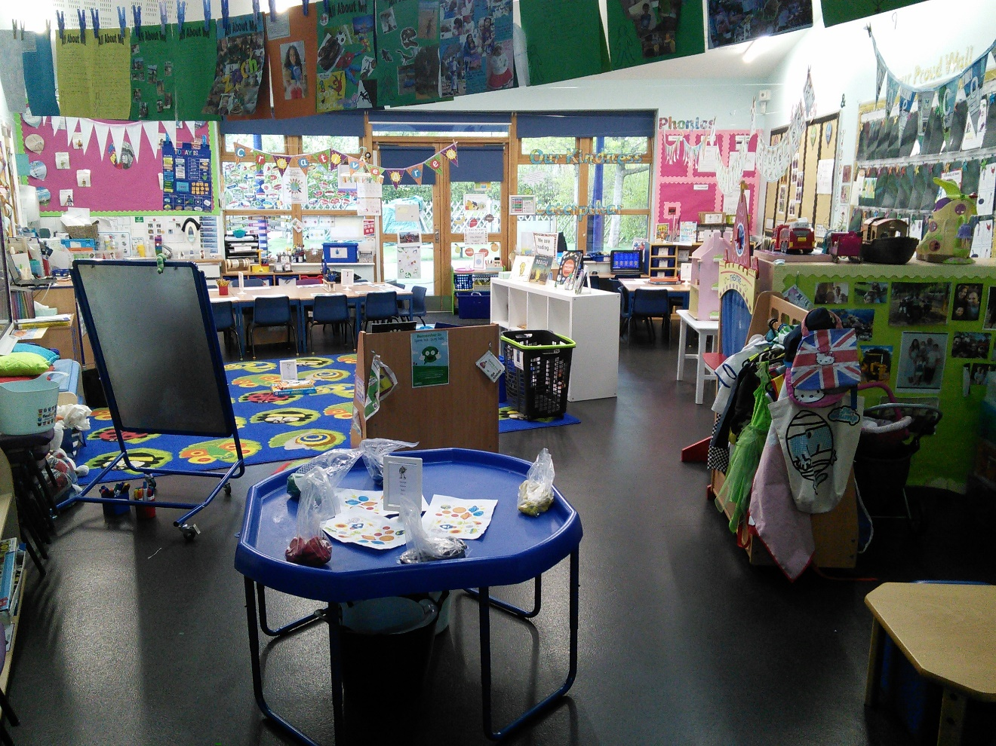
Einstein Class
Notes:
Mention that we follow the EYFS curriculum

Slide 11
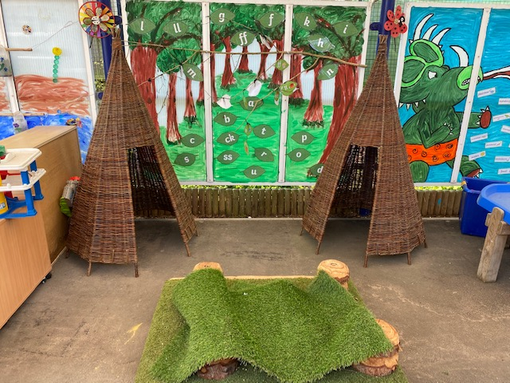
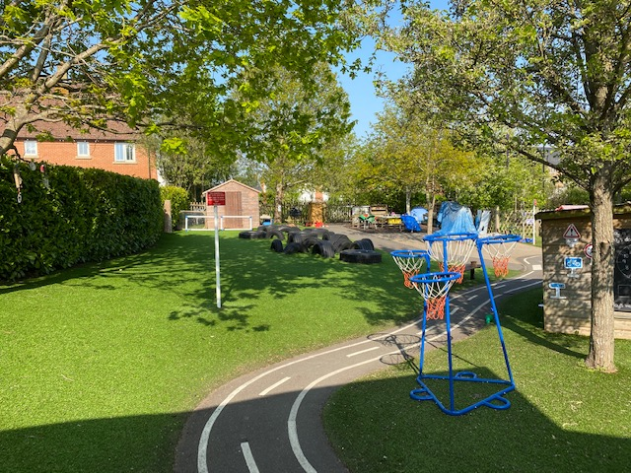
Outside area
Notes:
GEM

Slide 12
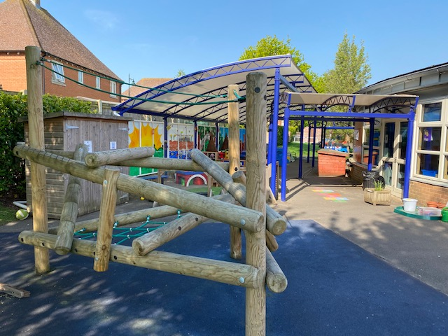
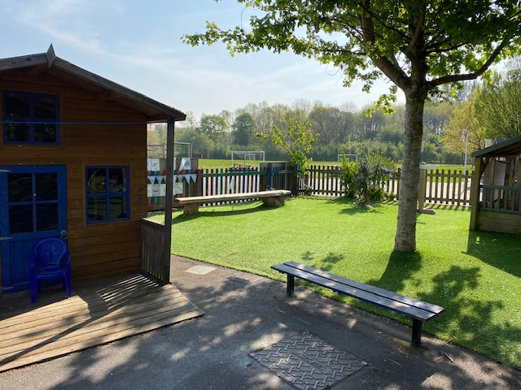
Outside area
Notes:
GEM

Slide 13
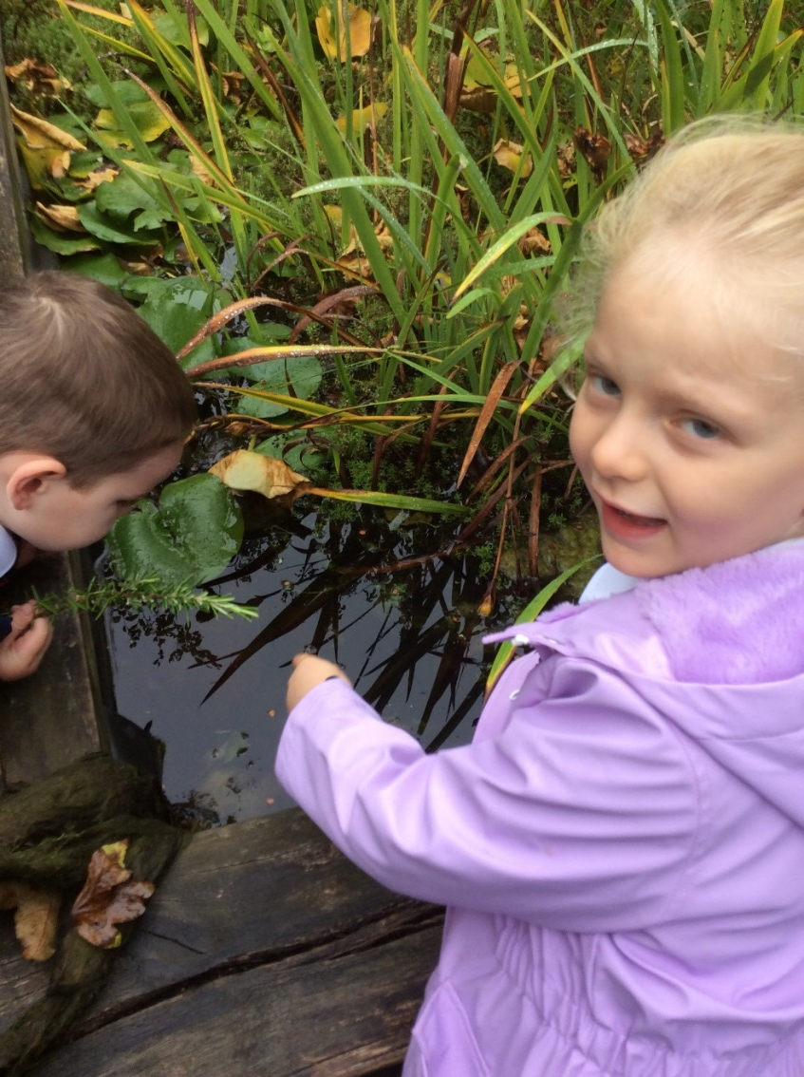
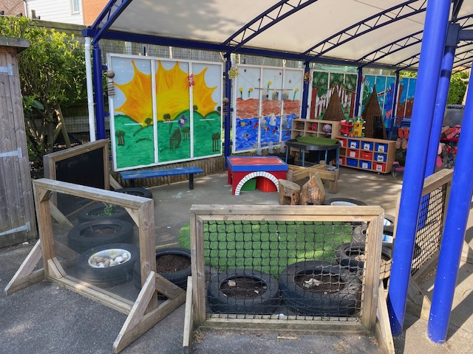
Outside area
Notes:
GEM

Slide 14
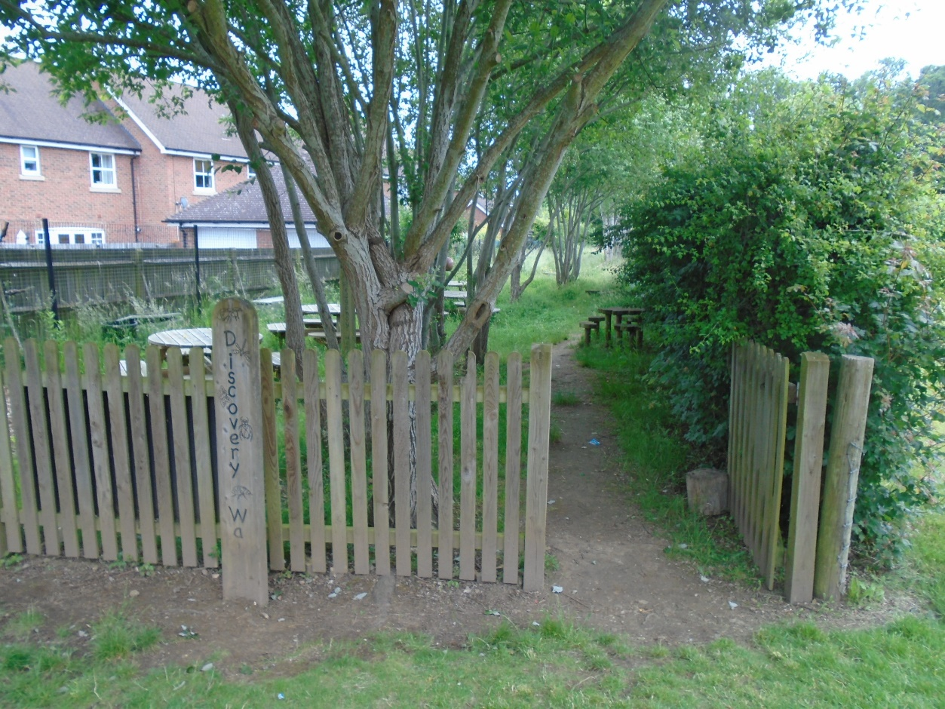
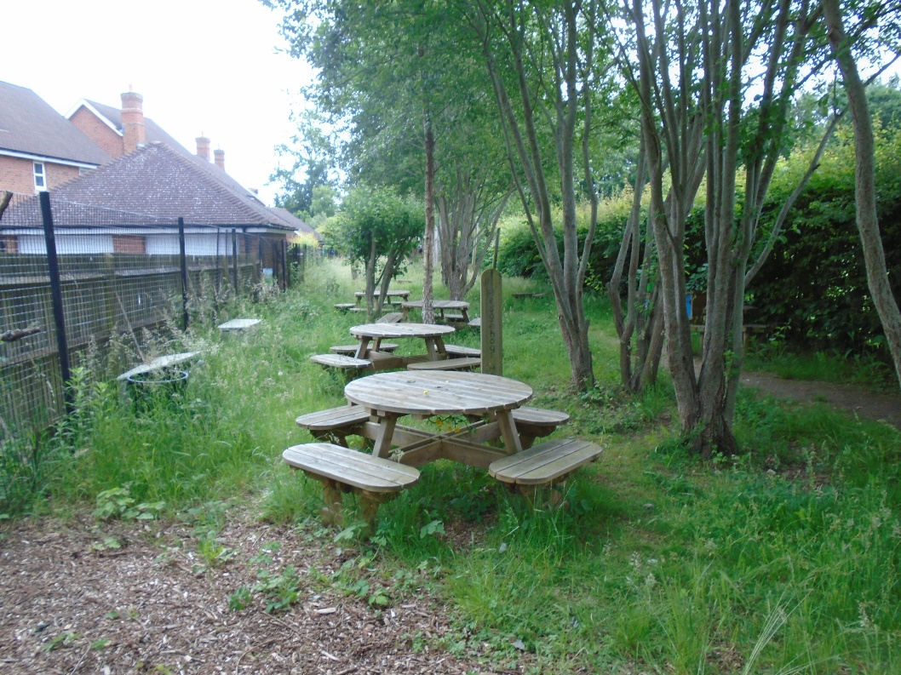
Discovery walk
Notes:
GEMMA

Slide 15
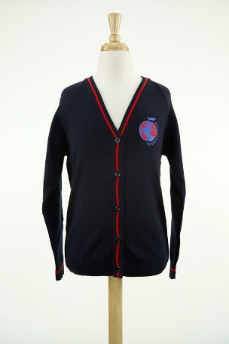
Uniform AND ESSENTIALS
Uniform: if you are unsure about the uniform you child should wear, please refer to our website. Please make sure your child brings in a coat and a jumper or cardigan every day regardless of the weather. PLEASE MAKE SURE ALL YOUR CHILDS ITEMS ARE NAMED. https://www.discovery.kent.sch.uk/about-us/starting-school/uniform/
No polo shirts.
Book bags, no rucksacks.
Please provide your child with a change of clothing in case of accidents.
Please provide your child with wellies and wet weather gear to stay in school.
Please provide a named water bottle for your child to bring into school with them every day, these must only have water in, not squash or juice.
Notes:
gem

Slide 16
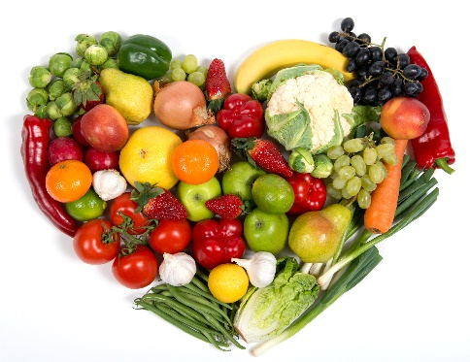
Snack/lunch time
Every day we have a morning snack and an afternoon snack. In the morning we have a piece of fruit or vegetable which is provided by the school. If you would like to provide an alternative healthy snack you can. The children are entitled to free milk until they turn 5 years old. Once your child has had their fifth birthday, if they would still like to have milk at snack time, you will need to pay via: www.coolmilk.co.uk.
In the afternoon the children can have a bread stick which is supplied by the school. If you would rather your child did not have a bread stick please let their class teacher know. You are welcome to supply them with something else if you do not want them to have a bread stick.
Children are entitled to a free school meal, up until the end of Year 2, the menu changes every 2 terms and will be provided to you as soon as we have it.
Notes:
gem

Slide 17
Reading at home
Your home reading book
Home Readers
Bug Club
Reading Eggs
Reading is everywhere!
Please do not forget to send your child in every day with their home readers and reading record as someone may read their books with them.

Slide 18
Physical education
PE doesn’t start until Term 2. PE will be indoors for the first two terms (Terms 2/3).
Allocated day each week.
Our PE kits and what your child needs to bring for PE.
Notes:
gem

Slide 19
Celebrations
Year group celebration assembly every Friday: celebrations in school and outside school.
Star of the week award
Reading rewards
Post cards
Parents evening
Please refer to our school learning updates page on our website to keep up to date with our learning!
Notes:
GEMMA

Slide 20
Celebrations CONTINUED
Stickers
Certificates
Behaviour chart
House points
Notes:
GEMMA

Slide 21
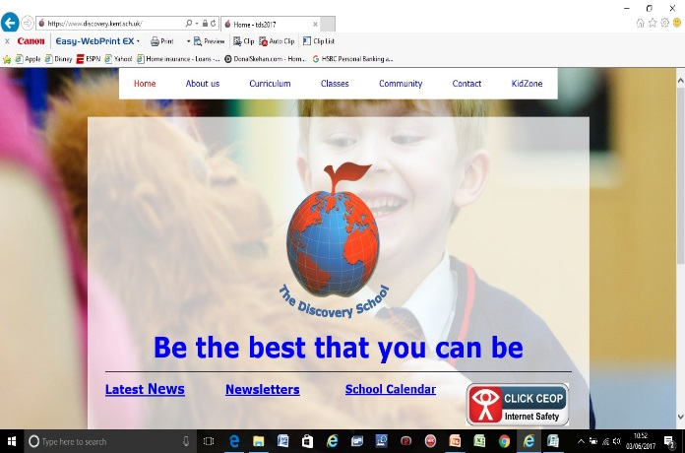
Communication
Termly News Letter
Reading record
Email or phone call
Drop off time
Please refer to our EYFS page on our website.
Notes:
GEMMA

