Slide 1
Friday 24th June – Monday 27th June 2022

Slide 2
The Discovery School Staff Team for PGL 2022 will be led by Miss Wilce. Staff from across the school will be going on the residential, supporting the children as Group Leaders and supervising them during all activities.
The members of staff going on the trip will be confirmed at a later date.

Slide 3
Trip departure and arrival times:
We will be leaving The Discovery School on Friday 24th June at approximately 1.30pm.
Children need to come to school at the normal time on Friday morning with their luggage and dressed appropriately for the trip.
We will return to The Discovery School on Monday 27th June at approximately 3.30pm. If we are delayed in traffic, the School Office will let you know.

Slide 4
Before we leave for PGL, we will tell children their activity groups, explain expectations for behaviour for the weekend and play some team-building games at school.
Children must bring a *packed lunch or have a school dinner as normal on this day.
(*Please make sure packed lunch items can be disposed of at school.)
The journey to PGL Marchants Hill will take approximately an hour and forty minutes. If your child needs to take travel sickness medicine, please make sure this is noted on the medical form (details of which can be found on a later slide).

Slide 5
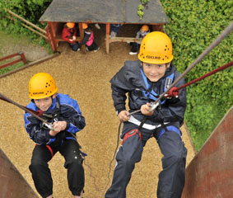
Arrival at PGL
We will arrive at the PGL site at approximately 3.00pm.
Children will be told their room groups and be given time to unpack before dinner.
We will then undertake an evening activity together.

Slide 6
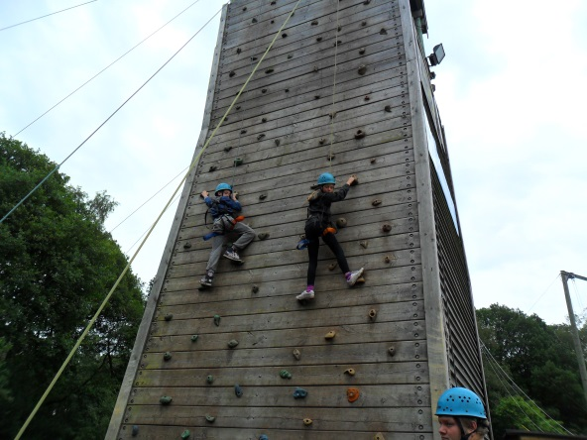
Daytime Activity Groups
The year group will be split into groups of 10-12 for the daytime activities.
Children will be given the opportunity to list four people they would like to be in a group with – girls or boys and across classes. They will be grouped with at least one of their choice of friends.
Each group will have a designated lead adult from The Discovery School who will be responsible for them during the day.
Children will be told their activity groups on the morning of the trip.

Slide 7
Daytime Activities
We have requested a range of daytime activities but these will not be confirmed until two weeks before the trip:
Abseiling, Aeroball, Archery, Challenge Course, Giant Swing, Low Level Rope Course, Quad Biking, Rifle Shooting, Sensory Trail, Problem Solving and Zip Wire.
All activities will be led by qualified PGL Activity Leaders and supervised by a designated member of The Discovery School Staff.
Please note we have not selected any of the water based activities that were available on site. This is because they take up two activity slots with changing, water safety and showering – we will fit more in without them. Also, not all children have reached the required level of confidence in the water to participate in the activities.

Slide 8
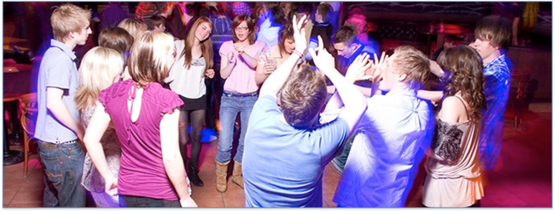
Evening Activities
We have also requested a range of evening activities – again, these will not be confirmed until two weeks before the trip:
50/50
Ambush
Campfire
Capture the Flag
Disco
Robot Wars Scrapheap Challenge
Shoe Golf
Wacky Races

Slide 9
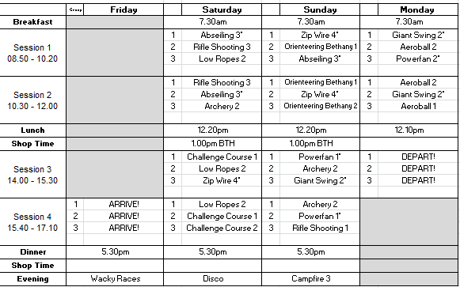
Example Activity Timetable

Slide 10
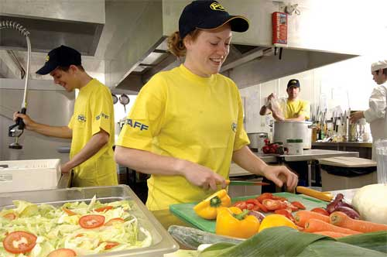
Meal Times and Food
Children need to bring a disposable packed lunch or have a school dinner for the first day. Make sure they pack a named water bottle to refill for the journey and over the weekend.
At PGL, children will be provided with three meals a day. This will include both hot and cold options.
As we are a healthy school, children are not to bring any sweets or fizzy drinks and will not be allowed to use any of the vending machines on site.

Slide 11
Please advise us of your child’s dietary needs by completing the medical form (which you will receive soon). The school will then ensure that PGL will cater for these requirements.

Slide 12
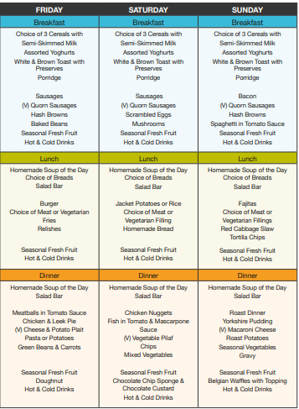
Here is a sample menu to give you an idea of what is available to eat for each meal.
At breakfast, children are encouraged to take a piece of fruit and fill up their water bottles for a mid-morning snack.
Water bottle filling stations can also be easily accessed at various points on site.

Slide 13
Bedtime Routine:
After the evening activity, children will be able to wind down in a communal area, chill out in their rooms or take a shower. Plenty of sleep is required to recharge their batteries – final lights out will be 10.00pm.

Slide 14
Room Groups
Each room will sleep up to six children; girls and boys will be sleeping separately.
Children will be given the opportunity to list four people they would like to be in a room with. They will be with at least one of their choice of friends.
Each room will be close to a room occupied by a Discovery member of staff. Staff rooms will be signposted so they can be easily located should children require assistance during the night.
Children will be told their room groups upon arrival at PGL.

Slide 15
What to bring: Packing
It is really useful if you can pack the bag with your child so they know exactly what should be in their bag when they leave PGL – make sure you include a bin liner for muddy clothes or wet towels!
It can be really useful if you can use the kit list to pack and then stick on the inside of your child’s bag. The children can then independently ‘tick off’ all their items as they pack them up.
Please make sure all packed items are
clearly named.

Slide 16
Kit List

Slide 17
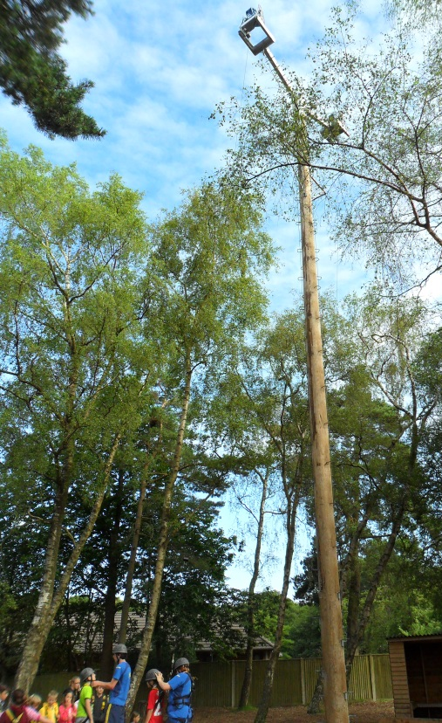
Roll-on Deodorant
Children must use roll-on deodorant during the trip.
The fire alarms are very, very sensitive and spray deodorant or hair spray will set them off.

Slide 18
Money
The children will have the opportunity to visit the on site souvenir shop and can bring up to £10 (better in coins rather than a note) to treat themselves to some souvenirs.
If the children are bringing money, this will need to be supplied in either a clearly marked money bag or envelope with their name and the amount of money written on it.
This will be given to the group leader, who will look after it until the children need it.
They will not need any other money for the trip.

Slide 20
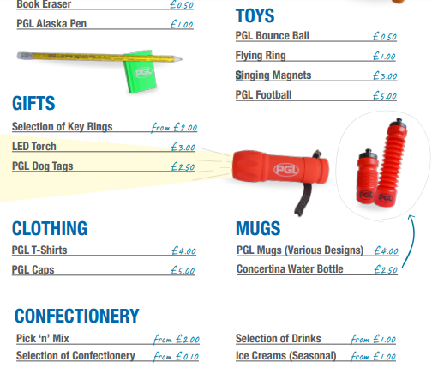

Slide 21
No Mobile Phones or Electrical Items
We/ PGL cannot guarantee the safety of expensive electronic items.
Children will only use their phones to contact you in their ‘low’ moments and this will be more upsetting for both you and them.
Children can bring an ‘older’ digital camera but we strongly recommend a disposable one.

Slide 22
Keeping in Touch
Children will be too busy enjoying themselves to worry about home and we are only there for a weekend!
We would inform you immediately if there were a medical issue that you need be made aware of.
If the Wi-Fi is working on site, we will endeavour to give a brief update on the day’s activities using the School Comms system.

Slide 23
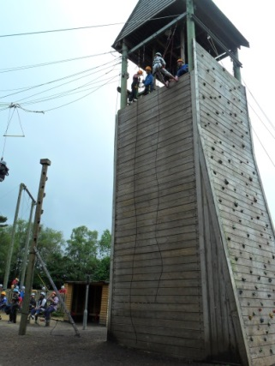
Emergency Contact
In real emergency situations, if you need to get in contact with a member of staff on the trip, you can call the school and they will get in touch on your behalf.
If there is a real emergency outside of school hours, you can contact the PGL Marchants Hill Reception - which operates 24 hours – who will then contact a member of The Discovery School Staff.
The PGL emergency contact number will be distributed nearer the time of the trip.

Slide 24
Rules on the Trip and Code of Conduct
We expect exemplary behaviour from the pupils on the trip.
This will include the children being polite to all members of staff (both school and PGL) and following all instructions first time; having excellent manners; being respectful to each other and working hard as part of their group.
Nearer the time, the children will be given a code of conduct for the trip that they are expected to follow.

Slide 25
Room Inspections
Teachers will conduct room inspections on a daily basis.
Rooms will be allocated points based on their tidiness.
Rooms with the most points will win a prize when they come back to school.

Slide 26
Medical Forms
Medical forms will be issued soon and must be returned as soon as possible so that any important information can be forwarded to PGL.
If anything to do with your child’s health changes, additional requirements can be added nearer the time.

Slide 27
Medicine
Any medicine that your child needs to take, either on a daily basis or as required, will need to be brought in on the morning of the trip with a medicine form.
Anyone with medicine will need to be in school at 8:25am on Friday 24th June to give the form and medicine to a member of staff.
All medicines will need to be brought in with a medicine form and put in either a clearly labelled plastic bag or Tupperware box.

Slide 28
Covid Safety
Maintaining Covid-safety, in line with government guidance at the time of the trip, will be a key priority.
Full details of the PGL Covid-19 Risk Assessment and procedures can be found on their website:
https://www.pgl.co.uk/en-gb/school-trips/resources/teacher-guide/covid-safe-and-secure
If you have any specific questions surrounding Covid-19 safety and procedures, please contact Miss Wilce.

Slide 29
Useful resources
You will find a host of FAQs and useful resources in the Parent Guide section of the PGL website:
https://www.pgl.co.uk/en-gb/school-trips/resources/parent-guide/about

Slide 30
If you have any questions, please contact your child’s class teacher. Winston – jwilce@discovery.kent.sch.uk Peake – tbeard@discovery.kent.sch.uk Galileo – lmarle@discovery.kent.sch.uk

