Slide 1
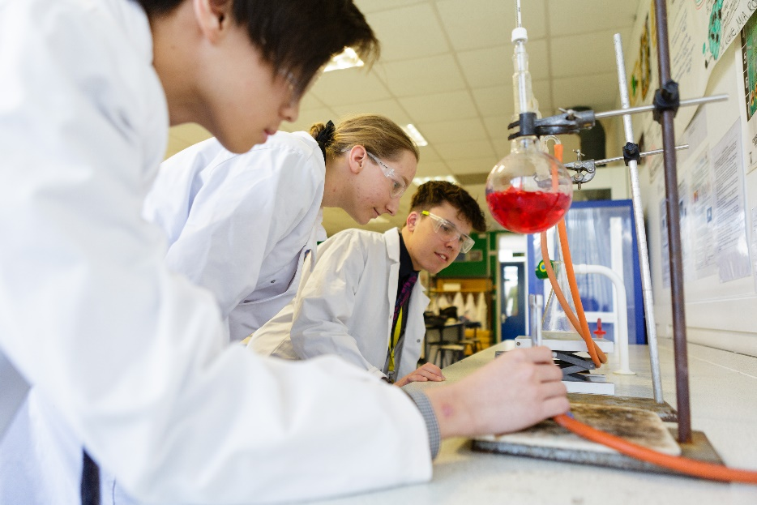
How to Apply
We warmly invite you to visit our school at one of our open events in October (see dates below).
If you wish to apply, submit TWO forms before 31st October:
The Secondary Common Application Form (SCAF) to KCC, online or by post;
A Supplementary Information Form (SIF) direct to the school.
Confirmation of school place – On March 1st you will receive an email from KCC confirming your child’s school place. Shortly afterwards you will receive your offer letter from the school with details on how to accept the offer, with further information.
You will then accept your child’s place at St Simon Stock Catholic School before Tuesday 15th March.
Then, in May to July you will be invited with your child to our school’s welcome and information events, which will help prepare your child for the transition to secondary school. Details of these events, including the dates will be outlined in your offer letter and will be on the school website.
September – Your child will start at St Simon Stock Catholic school!
St Simon Stock Catholic School
Live. Learn. Lead.
Work With Love
Dates for your diary
Open Evening Thursday 7th October 2021 4.30pm to 7pm
Open Mornings 9am to 10.30am
Tuesday 12th October 2021 & Thursday 14th October 2021
Booking is required for all our Open Events.
Please visit: Admissions – St Simon Stock Catholic School (ssscs.co.uk)
Visit our website www.ssscs.co.uk
and on social media @ssscskent
St Simon Stock Catholic School
Oakwood Park, Maidstone, ME16 0JP
01622 754551
reception@ssscs.co.uk

Slide 2
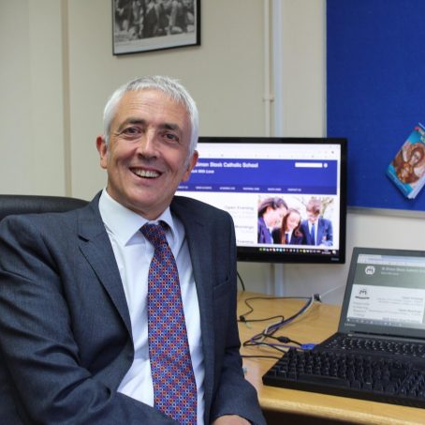
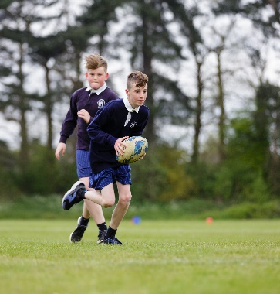
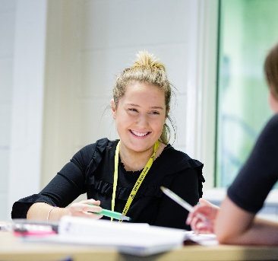
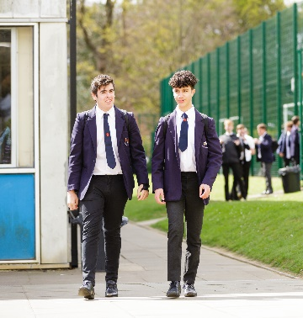
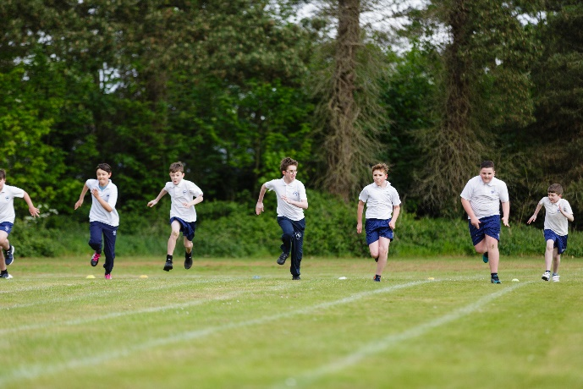
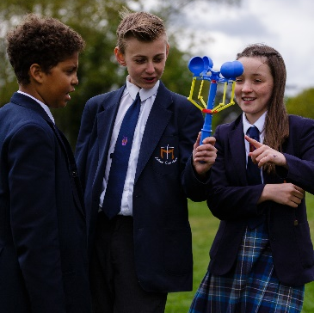
Welcome
St Simon Stock Catholic School is an academically high achieving school, with results that rank amongst the best in the country at GCSE and at A Level.
We are, however, about more than just academic excellence. Guided by our Catholic tradition, our mission is to help each student achieve their full potential, so that they can use their gifts to lead a life of service to others.
Getting off to a great start
Making sure your child settles in well is extremely important to us. A series of events and activities, commencing in Year 5, prepares students for their transfer to secondary school and ensures that we know and understand their learning needs when they join us.
Expert teaching
We have expert teachers, who are specialists in their subjects, who make learning exciting. They have deep knowledge and passion for their subjects, which brings our students’ learning to life. They have the skills and training to explain complex concepts in ways that make sense. Our teachers understand that each child learns in different ways and will push every child to be the best they can be at all times.
World class opportunities
Our varied and exciting extra-curricular opportunities, including a range of educational visits and clubs, add breadth to the students’ learning and help develop their self-confidence, resilience and happiness. These activities include sport, music, drama performances and the Duke of Edinburgh’s Award, amongst others.
Where every child is known and valued
A real strength of St Simon Stock Catholic School is the social, emotional and spiritual support for the well-being of the children, with a pastoral support team, well-being professionals and chaplaincy support. Ours is a caring community where students from all backgrounds, faiths and ethnic groups work happily together, gaining strength and compassion by embracing diversity.
Our aim is to develop the whole child, so that they grow to be confident, resilient, self-motivated and with a commitment to lifelong learning. We prepare our students to make a positive difference to the wider world.
At St Simon Stock Catholic School we passionately believe in a mentality of a ‘growth mindset’, in which intelligence is grown through hard work, curiosity, and deliberate practice, and in which students are secure in their understanding that each mistake, no matter how small, provides an opportunity through reflection to improve on the next attempt.
Our students learn these and other values through our formally taught curriculum, and also through our wider curriculum, which includes the Duke of Edinburgh’s Award. We have also recently been awarded status as an International Baccalaureate World School.
Jon Malone, Academy Principal
“Pupils’ conduct is typically exemplary, both in lessons and around the school. They are courteous and welcoming to visitors.”
Ofsted

