Slide 1
Welcome to Year 1
Hello!
Bonjour!
Konitchuwa!
Hola!
September 2023

Slide 2
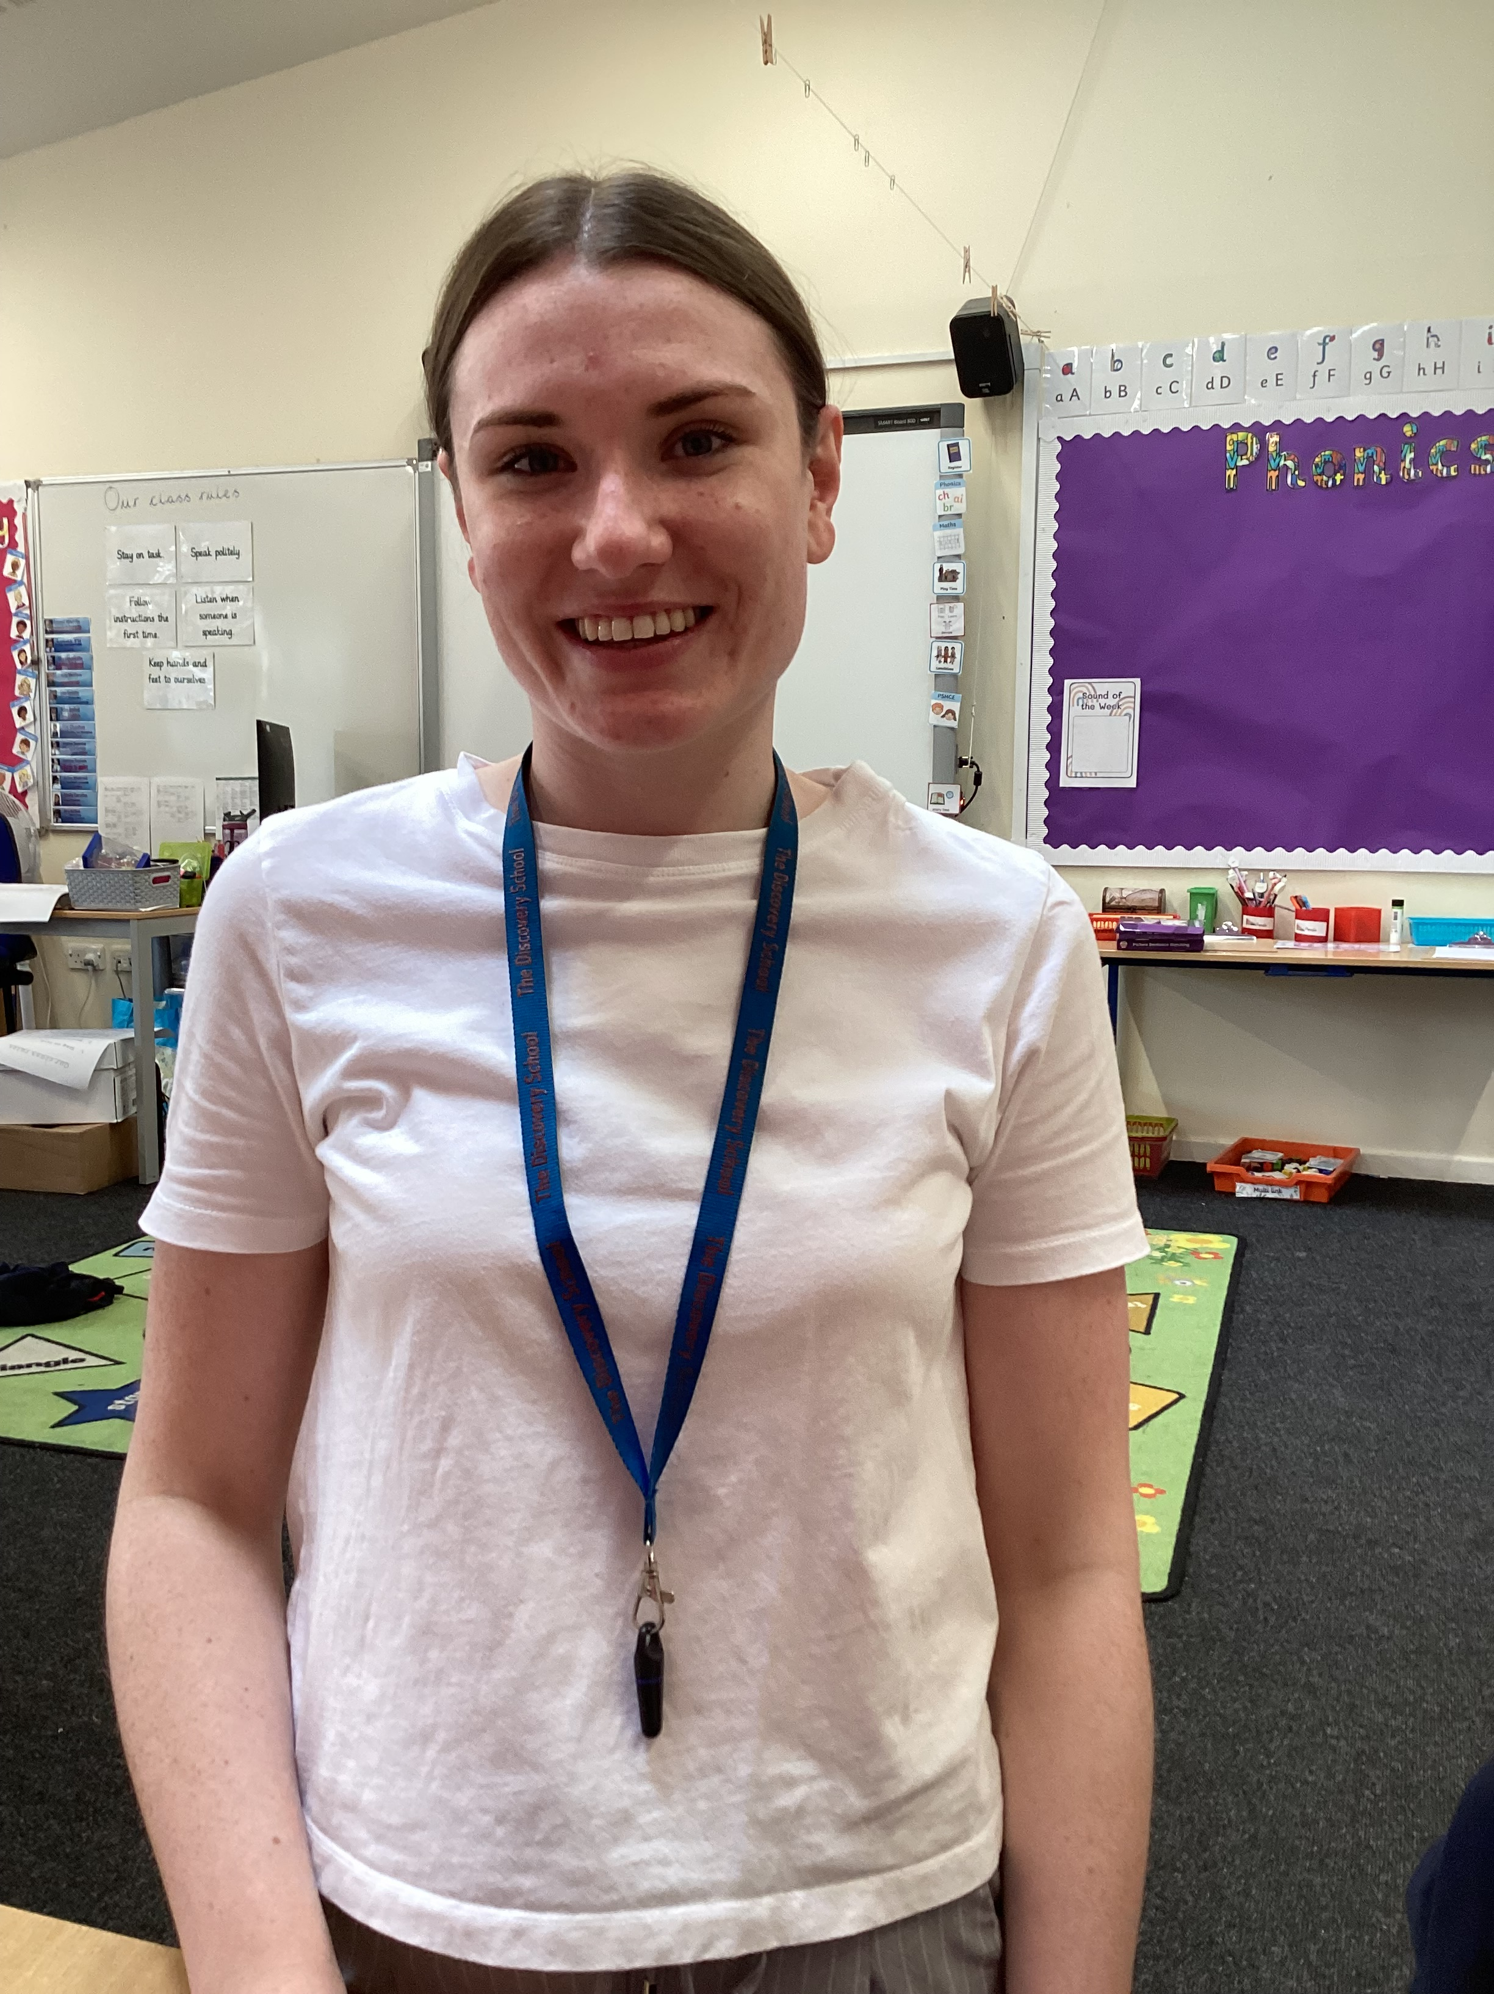
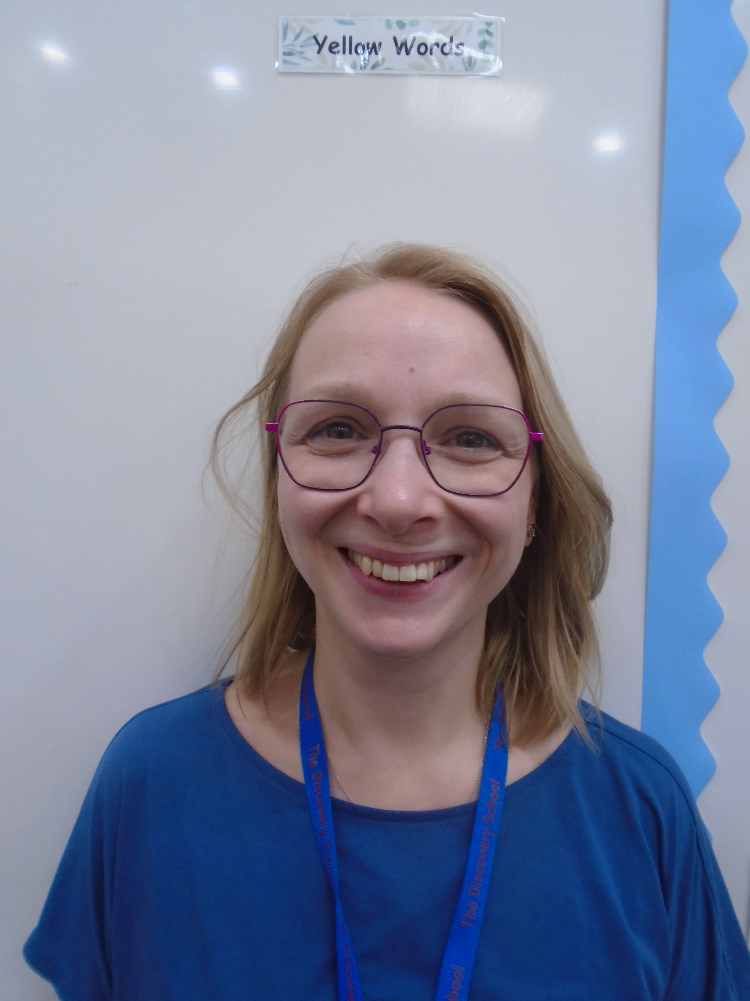
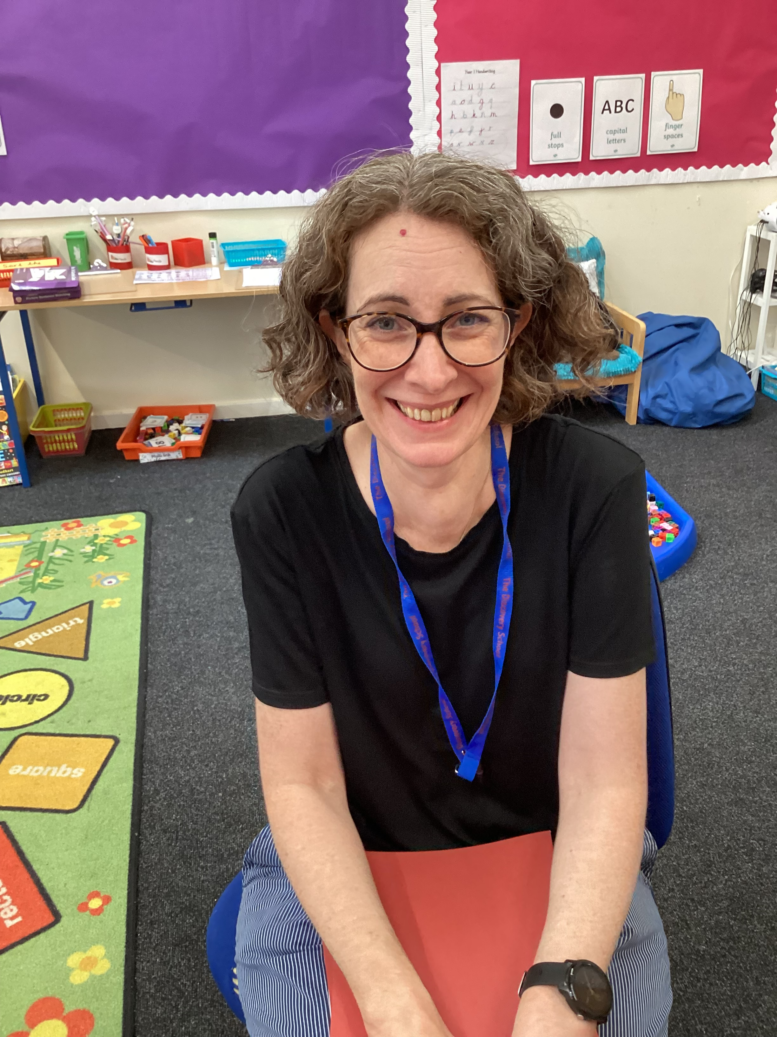
Who are we?
Goodall Class
Miss Roe
Mrs Catt
Darwin Class
Mrs Ismail
(Mon- Thurs)
Mrs Healey
(Thurs- Fri)
Mrs Oakley
Mrs Wiggins
Earhart Class
Mrs Hook
Mrs Moore

Slide 3
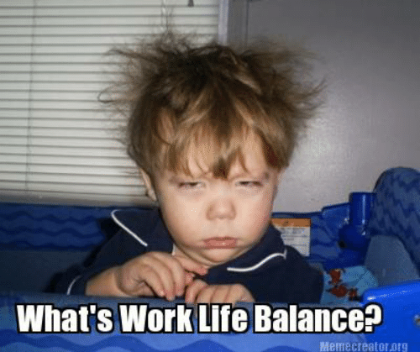
Emails
Governors duty
No emails after 5pm Monday-Friday or during weekends and holidays.
Staff will respond to emails within 48hours
Urgent enquiries
Notes:
Governors have a duty to ensure that staff keep a good work/life balance. Therefore, no emails will be answered after 5pm Monday-Friday or at any time during weekends and holidays.
Staff will respond to emails within 48hours during term time, If the email appears to be a complex matter, we will invite you to come into school and meet with us.
If your enquiry is urgent please telephone the school office during the school day.

Slide 4
Transition from EYFS
Practical English and maths lessons
Two ‘Plan, Learn and Review’ sessions per day
Shared reading and DEAR sessions each day
Continued phonic sessions
Circle times
There will be a gradual build up to a full class timetable
Notes:
English and maths lessons in the morning are very practical and hands on – similar to the learning in reception
Lesson 1 in the afternoon offers the children the opportunity to investigate a theme in different ways
Lesson 2 in the afternoon is replaced with ‘Let’s Explore’
Circle times around routines and learning in Year 1 have replaced some morning lessons
There will be a gradual build up to a full class timetable

Slide 5
Useful information
Break and snack
Children can bring their own healthy snack for playtime as an alternative
Book bags
Notes:
Break and snack – Everyday there is fruit available at playtime, for example, green beans, apples, bananas and tomatoes. However, school do not know what will be in the fruit delivery until it arrives in school
Children can bring their own healthy snack for playtime as an alternative
Book bags – Many of the children have returned to school with large backpacks. Although these are lovely, they do take up a lot of room in the cloakrooms and make it very difficult for the children to fit all of their belongings onto their pegs. If you look to replace your child’s bag over the course of the year a slimmer bag would be ideal.

Slide 6
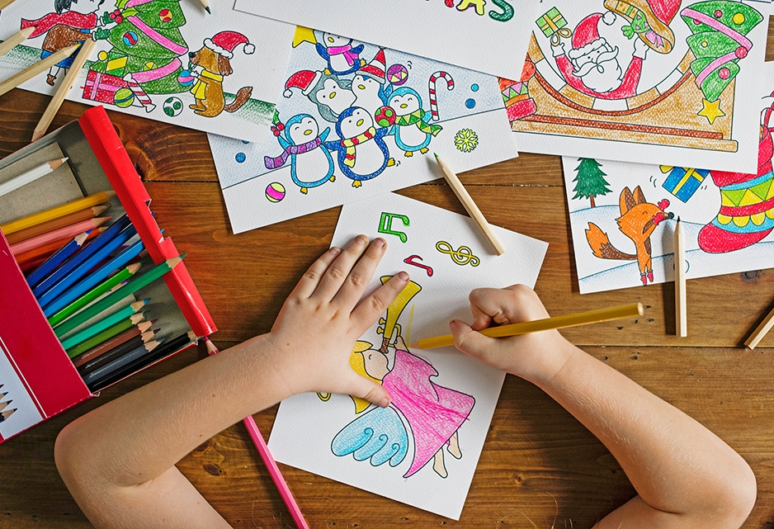
A Typical Day in Term 1 for the Year 1 class 2023
8:40– 9:00 Morning Activity
9:00- 9:30 Phonics
9:30-10:10 Maths
10:15-10:30 Break & snack
10:30-11:15 Plan, Learn, Review
11.15-11.30 Maths Fluency
11:45-12:45 Lunch
12:45-13:20 English
13:20-14:15 Linked Provision
14:15-15:00 Plan, Learn, Review
15:15 Home
Notes:
Lessons include: Topic, RE, science, art/DT, music, PSHE, PE, computing, history and geography

Slide 7
Termly Overview
Term 1 | Family and Feelings (family picnic)
Term 2 | Fireworks and Festivals (visitors)
Term 3 | Amazing Africa (workshop)
Term 4 | Once upon a time… (educational visit)
Term 5 | The Sky’s the Limit! (workshop)
Term 6 | The Sky’s the Limit! (local walks)
A snap shot of
the year to come!
Our curriculum intent
Children learn through discovery & investigation.
Big question.
Notes:
In line with our exciting topics, we are hoping to have workshops in school for terms 1 & 2, terms 3 & 4 we have a fun-packed ‘animation day’, term 5 we have provisionally booked a trip to Kent Life and term 6 we will have some local walks. All trips and workshops will feed in and support the children’s learning and ensure that all children are able to access new concepts and consolidate understanding.

Slide 8
Phonics, Reading and Writing
Visit the school website for information and resources
https://www.discovery.kent.sch.uk/curriculum/phonics/
Phonics
Reading
Writing

Slide 9
The Phonics Screening
National assessment
Real and pseudo or ‘alien’ words
Children to read the words by sounding out or sight reading
Scores are sent to the Local Authority and a bench mark is set
Interventions in preparation
Please do not take your children out of school during this time
Notes:
This is a national assessment of children’s phonic knowledge.
Comprises of real and pseudo or ‘alien’ words
Children to read the words by either sounding out or sight reading
Scores are sent to the Local Authority and a bench mark is set
Maybe necessary for us to support children through a small group intervention throughout the year in preparation for the screening
Please do not take your children out of school during this time
Pure sounds

Slide 10
Impact of Reading
This chart shows the impact reading at home, for just 20 minutes a night can have on a child’s learning. It is staggering the difference 20 minutes per day can make.

Slide 11
Read, Read, Read!
Book change – Monday and Thursday
FFT reading
Please record in reading records
Notes:
Please read every night with your child.
It is so important.
It could be ANY form of reading not just school scheme books
Books will be changed on a Monday and Thursday as much as possible. You will receive two books.
Reading is fun!! Please do not feel pressured to read every page, every night. Share read, read to your child – mix it up!
Please record each night that you have read with your child, even if this is just the date and an initial or smiley face. This could be done by the children
We will not change books if there is no record of the child having read.

Slide 12
Common Exception Words
Notes:
The children will be assessed on how well they can read and spell these words throughout the year. They need to be able to spell/use in their writing by the end of year 1. These will be in reading records in the next few weeks

Slide 13
Maths – Key Objectives
Gain a strong understanding of number
Recognising a number is not understanding number
Practical investigations
s
Notes:
This year focuses on gaining a strong understanding of number
Children maybe able to recognise a number but we want them to understand what ‘makes’ that number, different ways it can be represented and used
Children will begin to take part in practical investigations

Slide 14
Building Independence
Completing tasks by themselves
Encourage to ‘help themselves’ during lessons
Messages from home
Notes:
We have been supporting children from their first day to complete tasks by themselves
These include – sorting their book bags for messages and notes, giving in their reading books, managing their personal belongings, changing independently
We are encouraging children to ‘help themselves’ in lesson time by using visual resources around the classrooms
We would like children to try to come into school without a parent
Please tell your child if they have something important in their book bag so they can give it to their class teacher

Slide 15
School Values and Rewards
Respect, honesty, friendship, kindness and perseverance.
Rewards – school values, golden time, house points, stickers and star of the week.
Achievements outside of school
Notes:
At the Discovery School our school values underpin all that we do, as we work to enable our children to be prepared for life beyond their primary school.
Children are always encouraged to try their best and all 3 classes share similar reward systems such as peg charts, house points and class bears.
Friday’s assembly to share achievements outside of school.
Behaviour – misbehaviour will lead to pegs being removed from golden time, bigger issues – phase leader and if still no improvement then AHT (SLT)
Presentations and standards – high expectation – rewarded for this.

Slide 16
Show and Tell
Once a week
It will be led by the children
Timetables
Notes:
This will take place once a week for each group in a class, children will bring home a letter confirming their S&T date.
It will be led by the children with them talking to each other and asking questions without the need for an adult taking the lead.
Please send in objects that children can talk confidently about. Although every effort if given to looking after belongings, please could nothing of significant monetary or sentimental value be sent in
Timetables have been given to the children, if you are unsure please ask at the end of the session

Slide 17
Homework
A must!
PLEASE READ EVERY NIGHT
Optional - yet beneficial
Year One Common Exception words.
Number recognition
Writing/mark making
K?
Notes:
PLEASE READ EVERY NIGHT – This does not have to be our scheme books, practising our cursive writing, sharing a story book, playing a phonics game all count
Recognising, writing and using common words – We will be focusing on the Year One Common Exception words.
Number recognition in the environment (Door numbers, 10s and 1s, counting stairs, prices, spelling number names correctly)
Writing as much as possible (always reminding children of finger spaces, capital letters etc)
PLEASE READ EVERY NIGHT – This does not have to be our scheme books, practising our cursive writing, sharing a story book, playing a phonics game all count

Slide 18
Housekeeping
Medication – school office
Going home arrangement
Reporting absences – office and class teacher

Slide 19
Useful websites
Discovery website,
Year One page, Phonics page
Phonics Play http://www.phonicsplay.co.uk
Top marks http://www.topmarks.co.uk
ICT games http://ictgames.com/index.html
BBC bitesize http://www.bbc.co.uk/bitesize/ks1/literacy/
National curriculum https://www.gov.uk/government/collections/national-curriculum
Bug Club - app
Notes:
Please make sure that you look at the year 1 websites.

Slide 20
Thank You!
We hope that your children have a wonderful time in Year 1.
Notes:
If you would be interested in being a parent volunteer……

