Slide 1

Year 5
Hawking
Jackson
Johnson
Please sign in on the sheet at the back of the hall
Meet the teacher
September 2026
AC

Slide 2
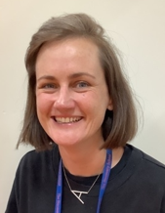
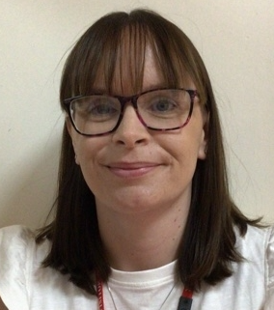
Staffing
Jackson
Class Teacher and Year Group Lead:
Miss Charlton
Email address:
acharlton@discovery.kent.sch.uk
Teaching Assistant:
Mrs Phillips
Miss Charlton
Mrs Phillips
AC

Slide 3
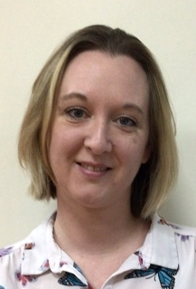
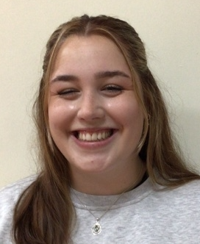
Staffing
Johnson
Class Teachers:
Mrs Price
Email address:
cprice@discovery.kent.sch.uk
Teaching Assistant:
Miss Skinner
Mrs Price
Miss Skinner
CP

Slide 4
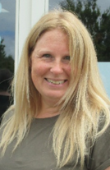
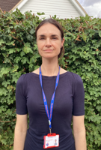

Staffing
Hawking
Class Teachers:
Mrs Ingles
Email address:
ringles@discovery.kent.sch.uk
Teaching Assistant:
Miss Ward-Lewis
Support staff:
Mrs Austin
Mrs Ingles
Miss Ward-Lewis
RI
Mrs Austin

Slide 5



Yearly Overview
Curriculum
Our curriculum will focus on the following three big questions:
Were the Vikings always vicious?
What is the next giant leap for mankind?
Were all Ancient Egyptians like Tutankhamun?
We will be finding out what the children already know about each topic and using their questions to drive the curriculum.
AC

Slide 6
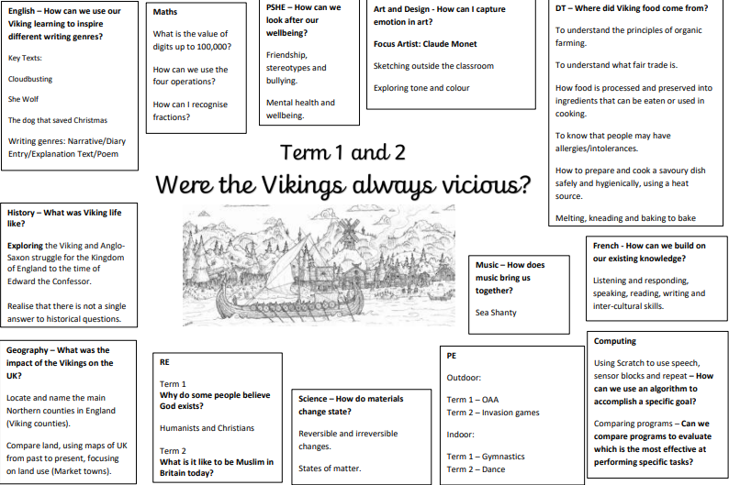

Slide 7

Unique Experiences
Curriculum
Design and make decorations using preserved fruit and spices.
Sleep overnight at school!
AC

Slide 8

Finding out more about Year 5: Class Webpage
Curriculum
Information about your child’s class and curriculum can be found on the following webpage:
Termly SWAY presentations are sent to you via email.
These include:
Important information and notices,
Photographs of our learning
Links to resources to support your child at home
AC

Slide 9
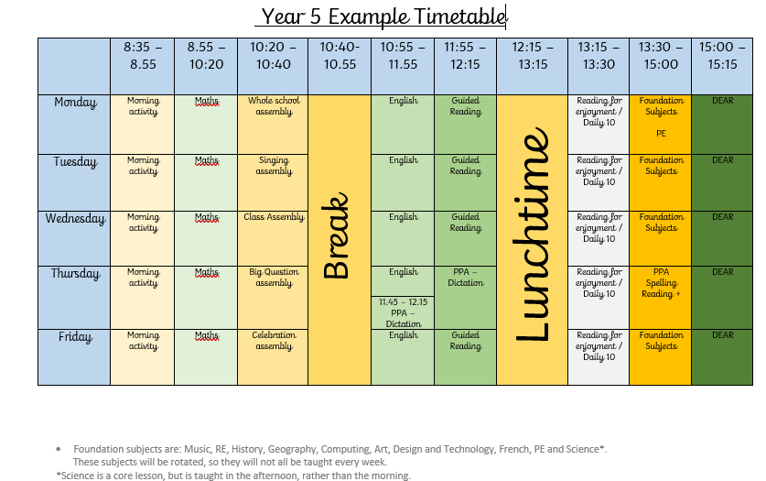
Curriculum
A day in Year 5!
Example only
AC

Slide 10

PE
Curriculum
On your child’s PE day, they will be expected to come to school ready for PE.
Children will need to wear:
House coloured t-shirt
Shorts or navy tracksuit bottoms
Black or white Plimsolls or trainers
Socks
Warm navy jumper or hoody
Earring tape/hair tie (please tape earrings and tie up hair at home)
Our PE days are:
Monday and Thursday
AC

Slide 11
Homework Expectations
Curriculum
Homework is set in Year 5 in order for the children to develop self-motivation, self-regulation and perseverance.
Homework will be set on Friday and is due in on Wednesday.
This will be posted to their Class Dojo page and given to the children as a paper copy.
This will usually consist of:
Reading Plus
Maths task
Spelling
Please encourage your child to speak to us if they don’t understand the set homework.
Praise and rewards will be available for homework completed in a timely manner.
If homework is not completed by Wednesday, children will be asked to complete the work during a lunch time (this will not take a whole lunch time).
CP

Slide 12

Reading Expectations
Curriculum
Year 5 will have reading records. This is to ensure that both parents and teachers are able to track what children are reading.
Children are able to write in this themselves and there is a space for adults at home and teachers to sign at the end of the week.
We expect to see children’s reading records every day, so that we can read with them.
CP

Slide 13
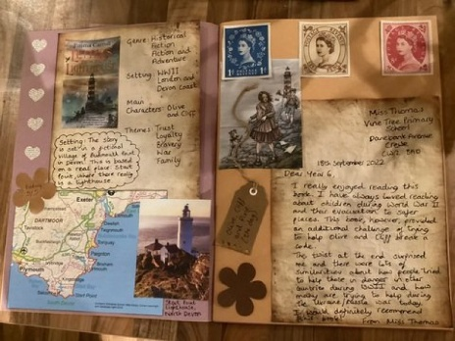

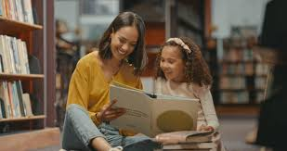



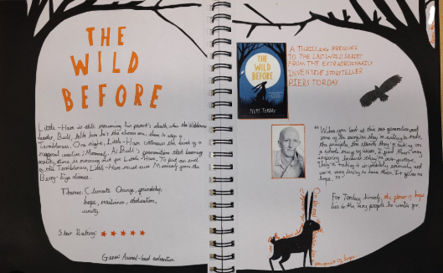
How can we support children with their reading?
Curriculum
Read to your child (even though they might think they’re too old!)
Read alongside your child.
Support your child with creating an imaginative page or two for our class reading scrap book which each child will bring home this year.
Be a role model by reading and talking about what you have read.
Borrow books (including audio books) from the local library.
CP

Slide 14


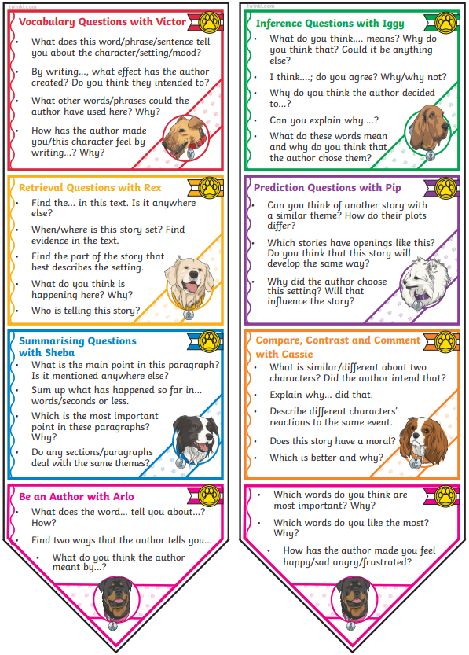
How can we support children with their reading?
Curriculum
Ask questions about the books your child is reading.
You might ask them to:
Summarise what they have read,
Share their favourite part,
Describe their favourite (and least favourite) character,
Explain why they think the author chose a particular word or phrase.
Encourage your child to borrow an ambitious, age appropriate book from our Reading Trees and earn a Bronze, Silver and Gold Reading Tree Award!
Fill in your child’s reading record and encourage them to do the same. This is a written record filled in by teachers, adults at home and children to share and celebrate the children’s reading progress.
CP

Slide 15

Behaviour and expectations
Recognising our values
By displaying our school values of kindness, respect, friendship, honesty and perseverance, children earn:
Value points
Star of the Week certificates
Postcards of praise
Excellence Awards at the end of term
Dojo points or Table points
CP

Slide 16

Healthy Snacks
Behaviour and expectations
Please ensure your child’s snack for breaktime is a healthy, balanced snack.
Please remember that we are a nut free school.
Changes to our Food Policy:
  We have stopped the practice of bringing birthday treats and sweets into school.
  Changes to packed lunches can be found on the school website.
https://www.discovery.kent.sch.uk/assets/Documents/Attachments/TDS-Food-Policy-September-2024.pdf - Link to food policy
CP

Slide 17

Phones
New to Year 5
If your child brings a phone into school, it must be switched off at the gate.
Your child’s phone will be kept in a phone box in class during the day and returned at the end of
the day.
RI

Slide 18

Walking Home
New to Year 5
Children in Year 5 are allowed to walk home alone – with your permission
We will need written permission from you to be able to authorise this.
Please also inform us if any other adults will be collecting your child.
RI

Slide 19

Secondary Transfer
New to Year 5
Now is the time to start thinking about secondary transfer for your child, you could:
Look on secondary school websites to ‘get a feel’ for each school.
Look on secondary school websites for any experience days offered at that school that may interest your child.
In May or June, come along to Dr Wilce-Cordner’s presentation for all Year 5 parents to discuss secondary transfer and the Kent Test registration process.
RI

Slide 20

Communication
Communication and support
As a school we welcome communication from our parents. If you have any concerns, we would much rather answer them directly as soon as possible. This could be done through email, a face to face conversation or a telephone call.
Please always contact your child’s Class Teacher in the first instance.
Emails will be answered Monday – Friday, between the hours of 7:30am – 5pm.
Staff will respond to emails within 48 hours. If the email appears to be a complex matter, we will either phone you or invite you to come into school and meet with us.
If your enquiry is urgent please telephone the school office
during the school day.
RI

Slide 21


Reporting absences
Communication and support
Please inform the school office if your child will be absent.
The best way to do this is via email.
The school office’s email is: office@discovery.kent.sch.uk
Please send all medication in to the office.
It must not remain in your child’s bag.
RI

Slide 22
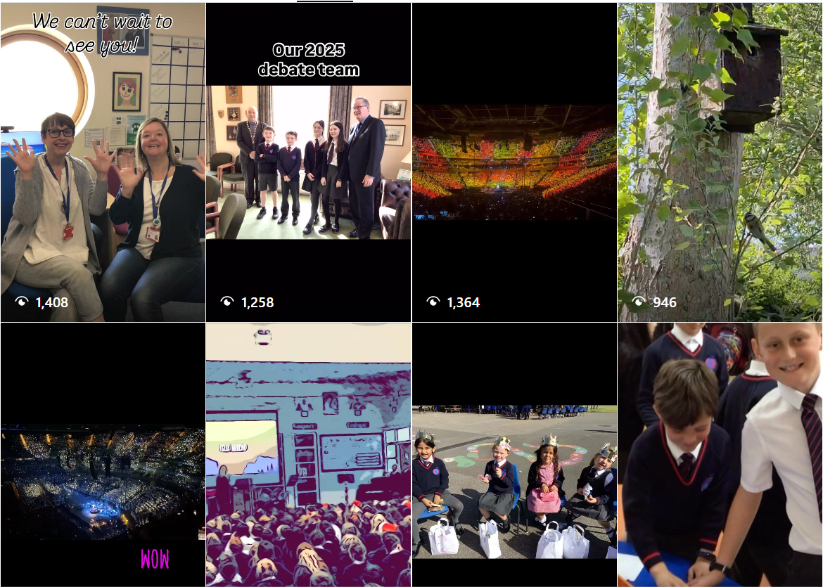

Follow us on Instagram for exciting learning updates!
RI

Slide 23

The FODS committee are a group of volunteers made up of parents, teachers and staff members.
We plan and run multiple fundraising initiatives over the year to raise money which is donated to the school including:
Fireworks night
Christmas Fair
Summer Fair
Raffles
Easter Egg hunt
Christmas cards designed by your child to buy and send at Christmas
These donations go towards various projects which benefit your children day to day in school.
We are always looking for volunteers and committee members to help make all our work possible.
We welcome anyone who would like to give some of their time to help the FODs in their plans, that can be in the lead up to
or on event day itself.
If you would like to find out more or offer your help, contact Amy Russell and Lou Bettridge at discovery.fods@gmail.com
RI

Slide 24
Reminder: Key days for Year 5
PE
Jackson: Monday and Tuesday
Reading Records
In school every day
Homework
Handed out on Fridays, due in Wednesdays
RI

Slide 25

Any questions? ☺
If we don’t have the opportunity to speak to you now, please do email us.

