Slide 1

Year 5
Hawking
Jackson
Johnson
Please sign in on the sheet at the back ☺
Meet the teacher
September 2025
Notes:
Alex – general welcome

Slide 2
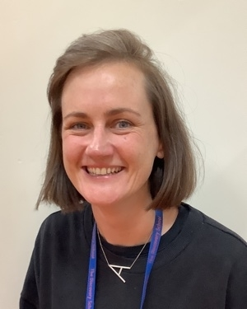
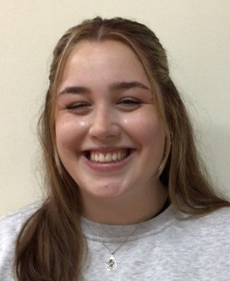
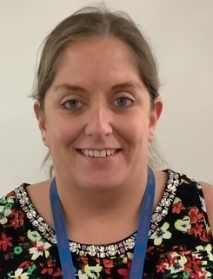
Staffing
Jackson
Class Teacher and Year Group Lead:
Miss Charlton
Email address:
acharlton@discovery.kent.sch.uk
Teaching Assistant:
Miss Skinner
Key Workers:
Miss Lee
Miss Charlton
Miss Skinner
Miss Lee
Notes:
Alex

Slide 3
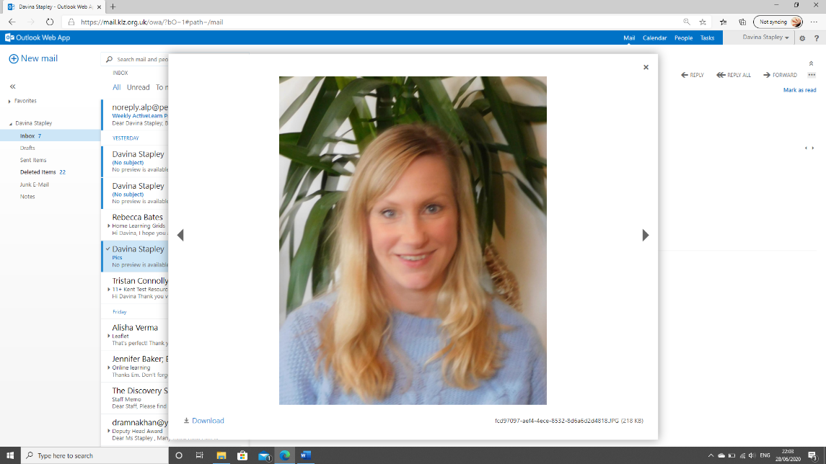
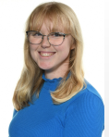
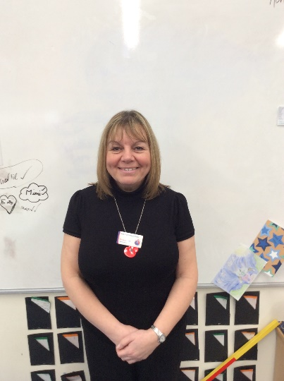
Staffing
Johnson
Class Teachers:
Miss Talbot and Mrs Repsch
Email address:
jrepsch@discovery.kent.sch.uk
ntalbot@discovery.kent.sch.uk
Teaching Assistant:
Miss Smith
Miss Talbot
Mrs Repsch
Miss Smith
Notes:
Nic

Slide 4
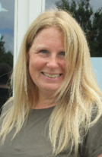
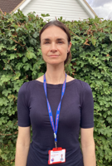
Staffing
Hawking
Class Teachers:
Mrs Ingles
Email address:
ringles@discovery.kent.sch.uk
Teaching Assistant:
Miss Ward-Lewis
Mrs Ingles
Miss Ward-Lewis
Notes:
Rachel

Slide 5

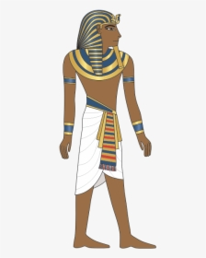

Yearly Overview
This year, our curriculum will focus on the following three big questions:
Were the Vikings always vicious?
What is the next giant leap for mankind?
Were all Ancient Egyptians like Tutankhamun?
We will be finding out what the children already know about each topic and using their questions to drive the curriculum.
Our focus this year is facilitating discovery!
Notes:
Nic

Slide 6
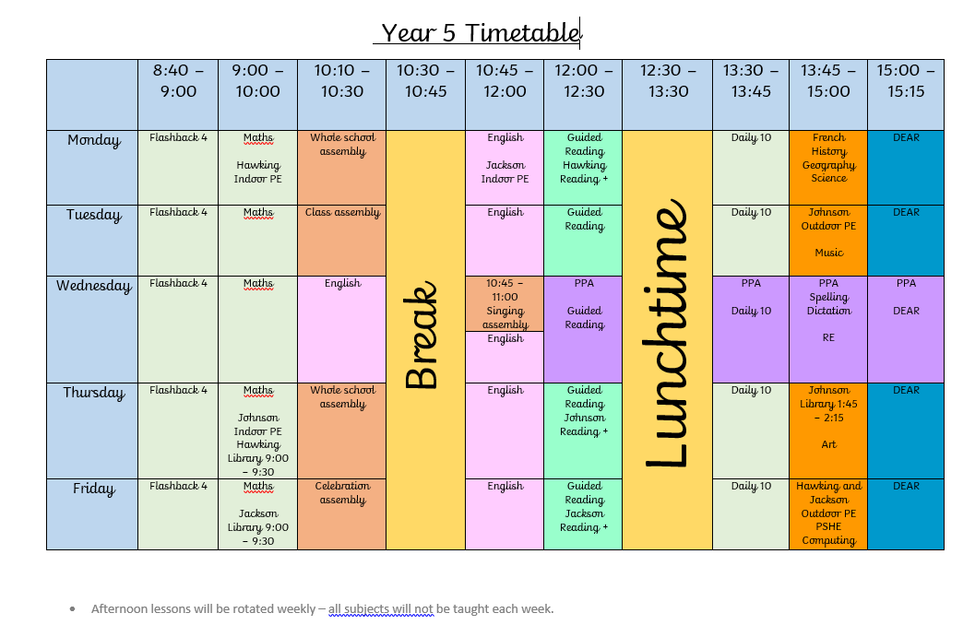
A day in Year 5!
Example only
12:00 – 12:15
12:15 – 13:15
Notes:
Nic

Slide 7
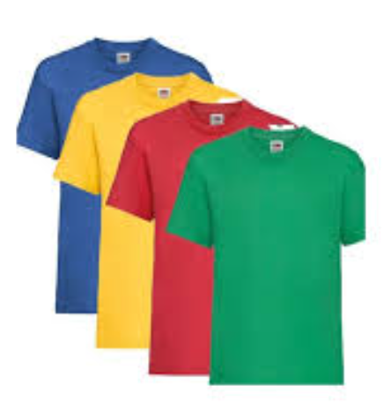
PE
On your child’s PE day, they will be expected to come to school ready for PE. They will stay in their PE kit for the day and will not be changing at school.
Children will need to wear:
House coloured t-shirt
Shorts or navy tracksuit bottoms depending on
the weather
Plimsolls or trainers
Socks
Warm navy jumper or hoody
Earring tape /hair tie (please tape earrings and tie up hair at home)
PE days are:
Jackson: Monday and Tuesday Johnson: Tuesday and Thursday
Hawking: Monday and Thursday
Notes:
Nic

Slide 8

Unique Experiences
Design and make decorations using preserved fruit and spices.
Sleep overnight at school!
Notes:
Nic

Slide 9
Homework Expectations
Homework is introduced in Year 5 in order for the children to develop self-motivation, self-regulation and perseverance in order to be ready for secondary school and beyond!
Homework will be set on Friday and is due in on Wednesday.
This will be posted to their Class Dojo page and given to the children as a paper copy.
This will usually consist of:
Reading Plus
Maths task
Spelling
Please encourage your child to speak to us if they don’t understand the set homework.
Praise and rewards will be available for homework completed in a timely manner. If homework is not completed by Wednesday, children will be given time to complete the work in school.
Notes:
Nic

Slide 10

Reading Expectations
Year 5 will have reading records. This is to ensure that both parents and teachers are able to track what children are reading.
Children are able to write in this themselves and there is a space for adults at home and teachers to sign at the end of the week.
Reading records due in on Wednesdays
Notes:
Alex

Slide 11
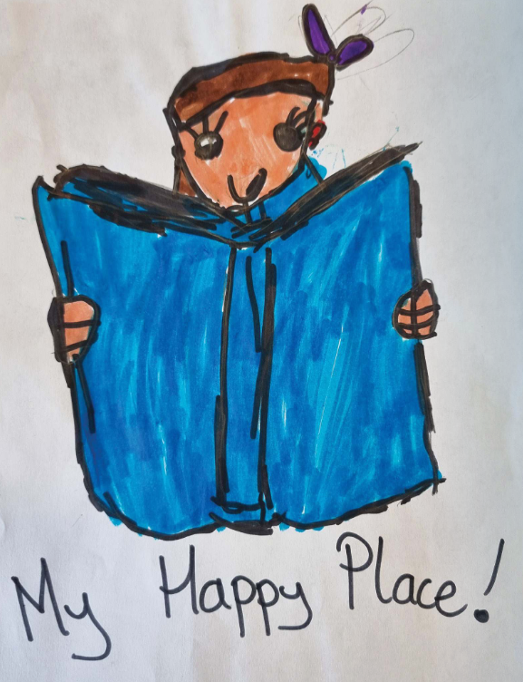
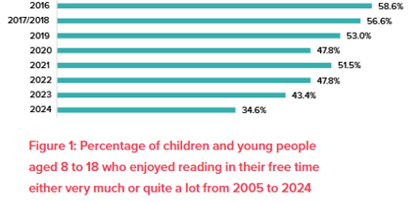
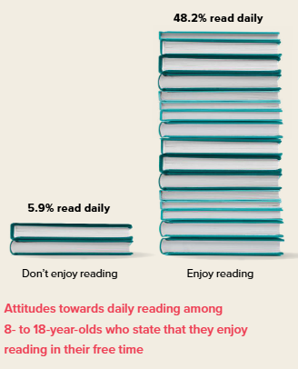

The importance of Reading
A growing body of evidence…consistently links reading for pleasure with a wide range of benefits, from improved academic outcomes and future employment prospects to enhanced mental wellbeing.
(see, e.g. Sullivan & Brown, 2015; WPI, 2021;Sun et al., 2023).
When children read often, they are likely to enjoy it more!
There was an almost 10% decrease in children who enjoy reading in their free time between 2023-2024.
In 2024, just 34.6% of over 1 million children questioned said that they enjoyed reading in their free time very much or quite a lot. In 2005, the figure was 51.4%.
Author: Keith Topping
Notes:
Alex

Slide 12
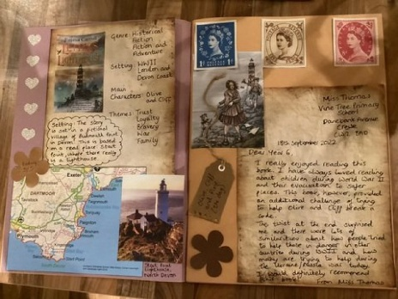

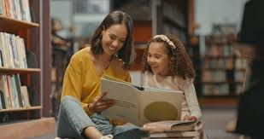



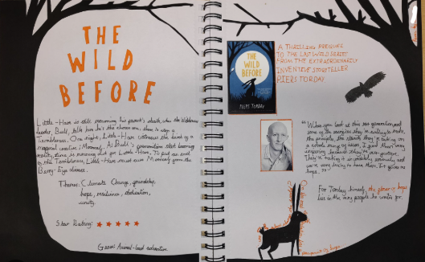
How can we support children with their reading?
Read to your child (even though they might think they’re too old!)
Read alongside your child.
Support your child with creating an imaginative page or two for our class reading scrap book which each child will bring home this year.
Be a role model by reading and talking about what you have read.
Borrow books (including audio books) from the local library.
Notes:
Alex

Slide 13


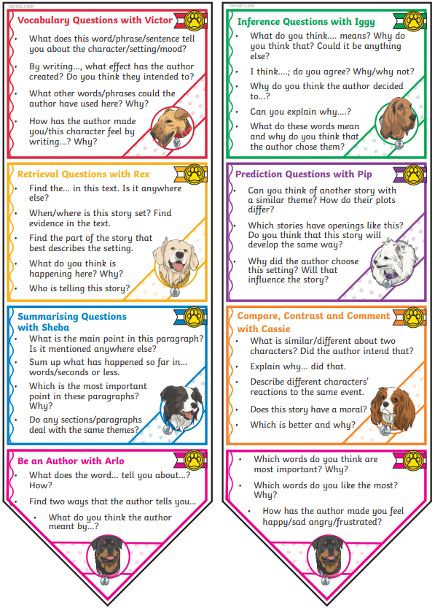
How can we support children with their reading?
Ask questions about the books your child is reading.
You might ask them to:
Summarise what they have read,
Share their favourite part,
Describe their favourite (and least favourite) character,
Explain why they think the author chose a particular word or phrase.
Encourage your child to borrow an ambitious, age appropriate book from our Reading Trees and earn a Bronze, Silver and Gold Reading Tree Award!
Fill in your child’s reading record and encourage them to do the same. This is a written record filled in by teachers, adults at home and children to share and celebrate the children’s reading progress.
Notes:
Alex

Slide 14

Recognising our values
By displaying our school values of kindness, respect, friendship, honesty and perseverance, children earn:
Value points
Star of the Week certificates
Postcards of praise
Excellence Awards at the end of term
Dojo points or Table points
Notes:
Alex

Slide 15
When our values are not followed…
  In Year 5, we continue to follow our school behaviour policy and issue sanctions where appropriate.
  These may be:
  Missing a portion of break/ lunch in order to discuss an incident
  Parent contact, if deemed necessary.
  Some serious or ongoing incidents may be escalated to the Year Group Lead, Senior Leaders, Deputy Head or the Headteacher.
Notes:
Alex

Slide 16

New to Year 5: Phones
If your child brings a phone into school, it must be switched off at the gate.
Your child’s phone will be kept in a phone box in class during the day and returned at the end of
the day.
Notes:
Alex

Slide 17

New to Year 5: Walking Home
Children in Year 5 are allowed to walk home alone – with your permission
We will need written permission from you to be able to authorise this.
Please also inform us if any other adults will be collecting your child.
Notes:
Alex

Slide 18

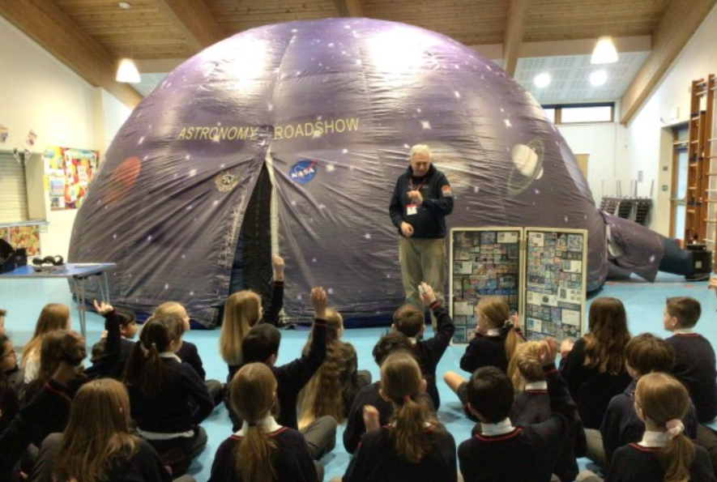
Finding out more about Year 5: Class Webpage
Information about your child’s class and curriculum can be found on the following webpage:
Learning updates can be found here:
Events are also documented on Instagram….
Notes:
Alex

Slide 19
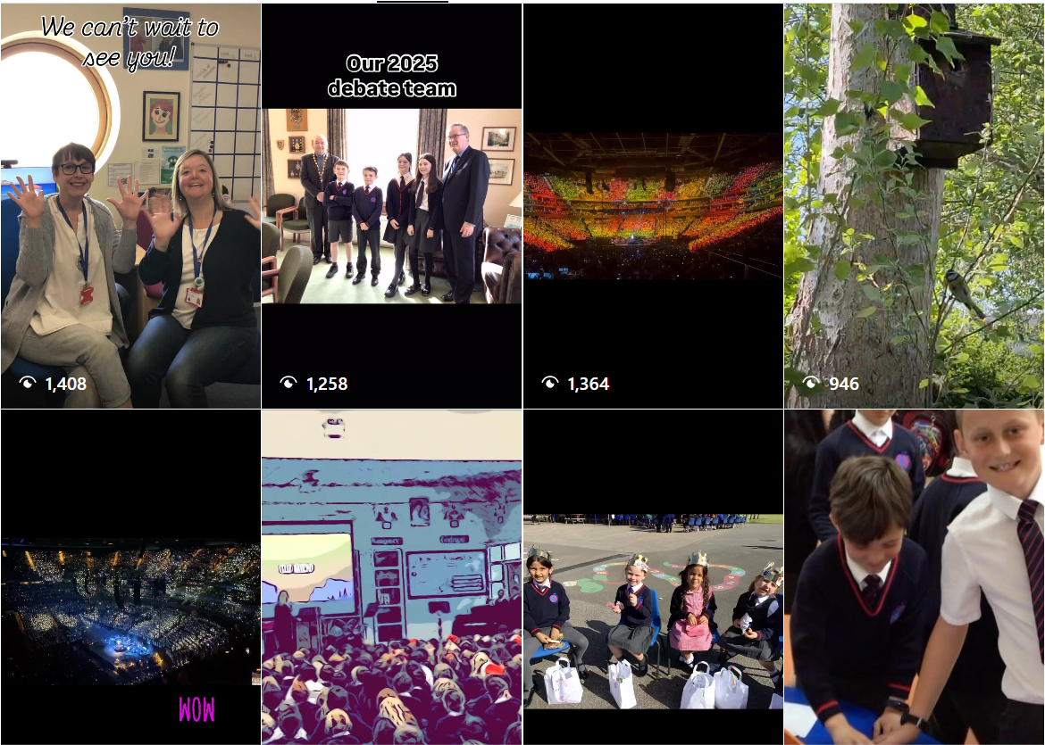

Follow us on Instagram for exciting learning updates!
Notes:
Alex

Slide 20

Reporting absences
Please inform the school office if your child will be absent.
The best way to do this is via email.
The school office’s email is: office@discovery.kent.sch.uk
Notes:
Rachel

Slide 21

Medication
Please send all medication in to the office.
It must not remain in your child’s bag.
Notes:
Rachel

Slide 22

Healthy Snacks
Please ensure your child’s snack for breaktime is a healthy, balanced snack.
Please remember that we are a nut free school.
Changes to our Food Policy:
  We have stopped the practice of bringing birthday treats and sweets into school.
  Changes to packed lunches can be found on the school website.
Notes:
Rachel

Slide 23

Communication
As a school we welcome communication from our parents. If you have any concerns, we would much rather answer them directly as soon as possible. This could be done through email, a face to face conversation or a telephone call. Please always contact your child’s Class Teacher in the first instance.
Emails will be answered Monday – Friday, between the hours of 7:30am – 5pm.
Staff will respond to emails within 48 hours. If the email appears to be a complex matter, we will either phone you or invite you to come into school and meet with us. Please include both teachers if your child is in Johnson.
If your enquiry is urgent please telephone the school office during the school day.
Notes:
Rachel

Slide 24

Secondary Transfer
Now is the time to start thinking about secondary transfer for your child, you could:
Look on secondary school websites to ‘get a feel’ for each school.
Look on secondary school websites to identify if there are any experience days offered at that school that may interest your child. These normally take place in the summer term in Year 5.
Later in the year, there will be a meeting for all Year 5 parents to discuss secondary transfer and the Kent Test registration process. This process is usually during July and children usually sit the test in the first few days of Year 6.
If you have any further questions then Dr Wilce-Cordner will be happy to answer them for you.
Notes:
Rachel

Slide 25

The FODS committee are a group of volunteers made up of parents, teachers and staff members.
We plan and run multiple fundraising initiatives over the year to raise money which is donated to the school including:
Fireworks night
Christmas Fair
Summer Fair
Raffles
Easter Egg hunt
Christmas cards designed by your child to buy and send at Christmas
These donations go towards various projects which benefit your children day to day in school.
We are always looking for volunteers and committee members to help make all our work possible.
We welcome anyone who would like to give some of their time to help the FODs in their plans, that can be in the lead up to
or on event day itself.
If you would like to find out more or offer your help, contact Amy Russell and Lou Bettridge at discovery.fods@gmail.com

Slide 26
Reminder: Key days for Year 5
PE
Jackson: Monday and Tuesday
Johnson: Tuesday and Thursday
Hawking: Monday and Thursday
Reading Records
In school on Wednesdays
Homework
Handed out on Fridays, due in Wednesdays

Slide 27

Any questions? ☺
If we don’t have the opportunity to speak to you now, please do email us.
Notes:
Rachel

