Slide 1
Year 5 Hawking Jackson Johnson
Please sign in on the sheet at the back ☺
Meet the teacher
September 2024

Slide 2
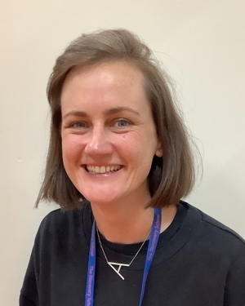
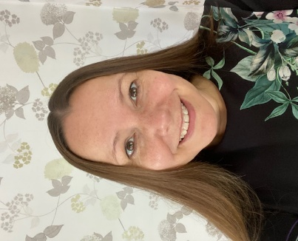
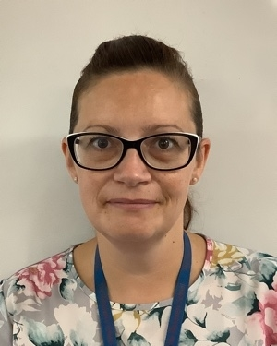
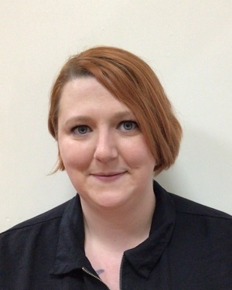
Staffing
Jackson
Class Teacher and Year Group Lead: Miss Charlton
Email address: acharlton@discovery.kent.sch.uk
Teaching Assistant: Mrs Reed
Key Workers:
Mrs Bridge
Mrs Parrington
Miss Charlton
Mrs Reed
Mrs Bridge
Miss Parrington

Slide 3
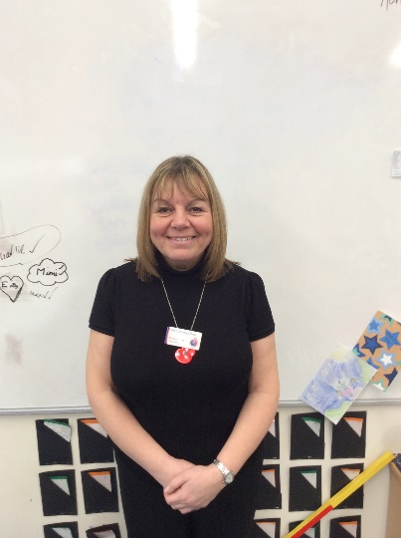
Staffing
Johnson
Class Teachers:
Miss Talbot and Miss Beard
Email address:
tbeard@discovery.kent.sch.uk
ntalbot@discovery.kent.sch.uk
Teaching Assistant:
Miss Smith
Miss Talbot
Miss Beard
Miss Smith

Slide 4
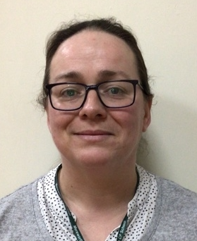
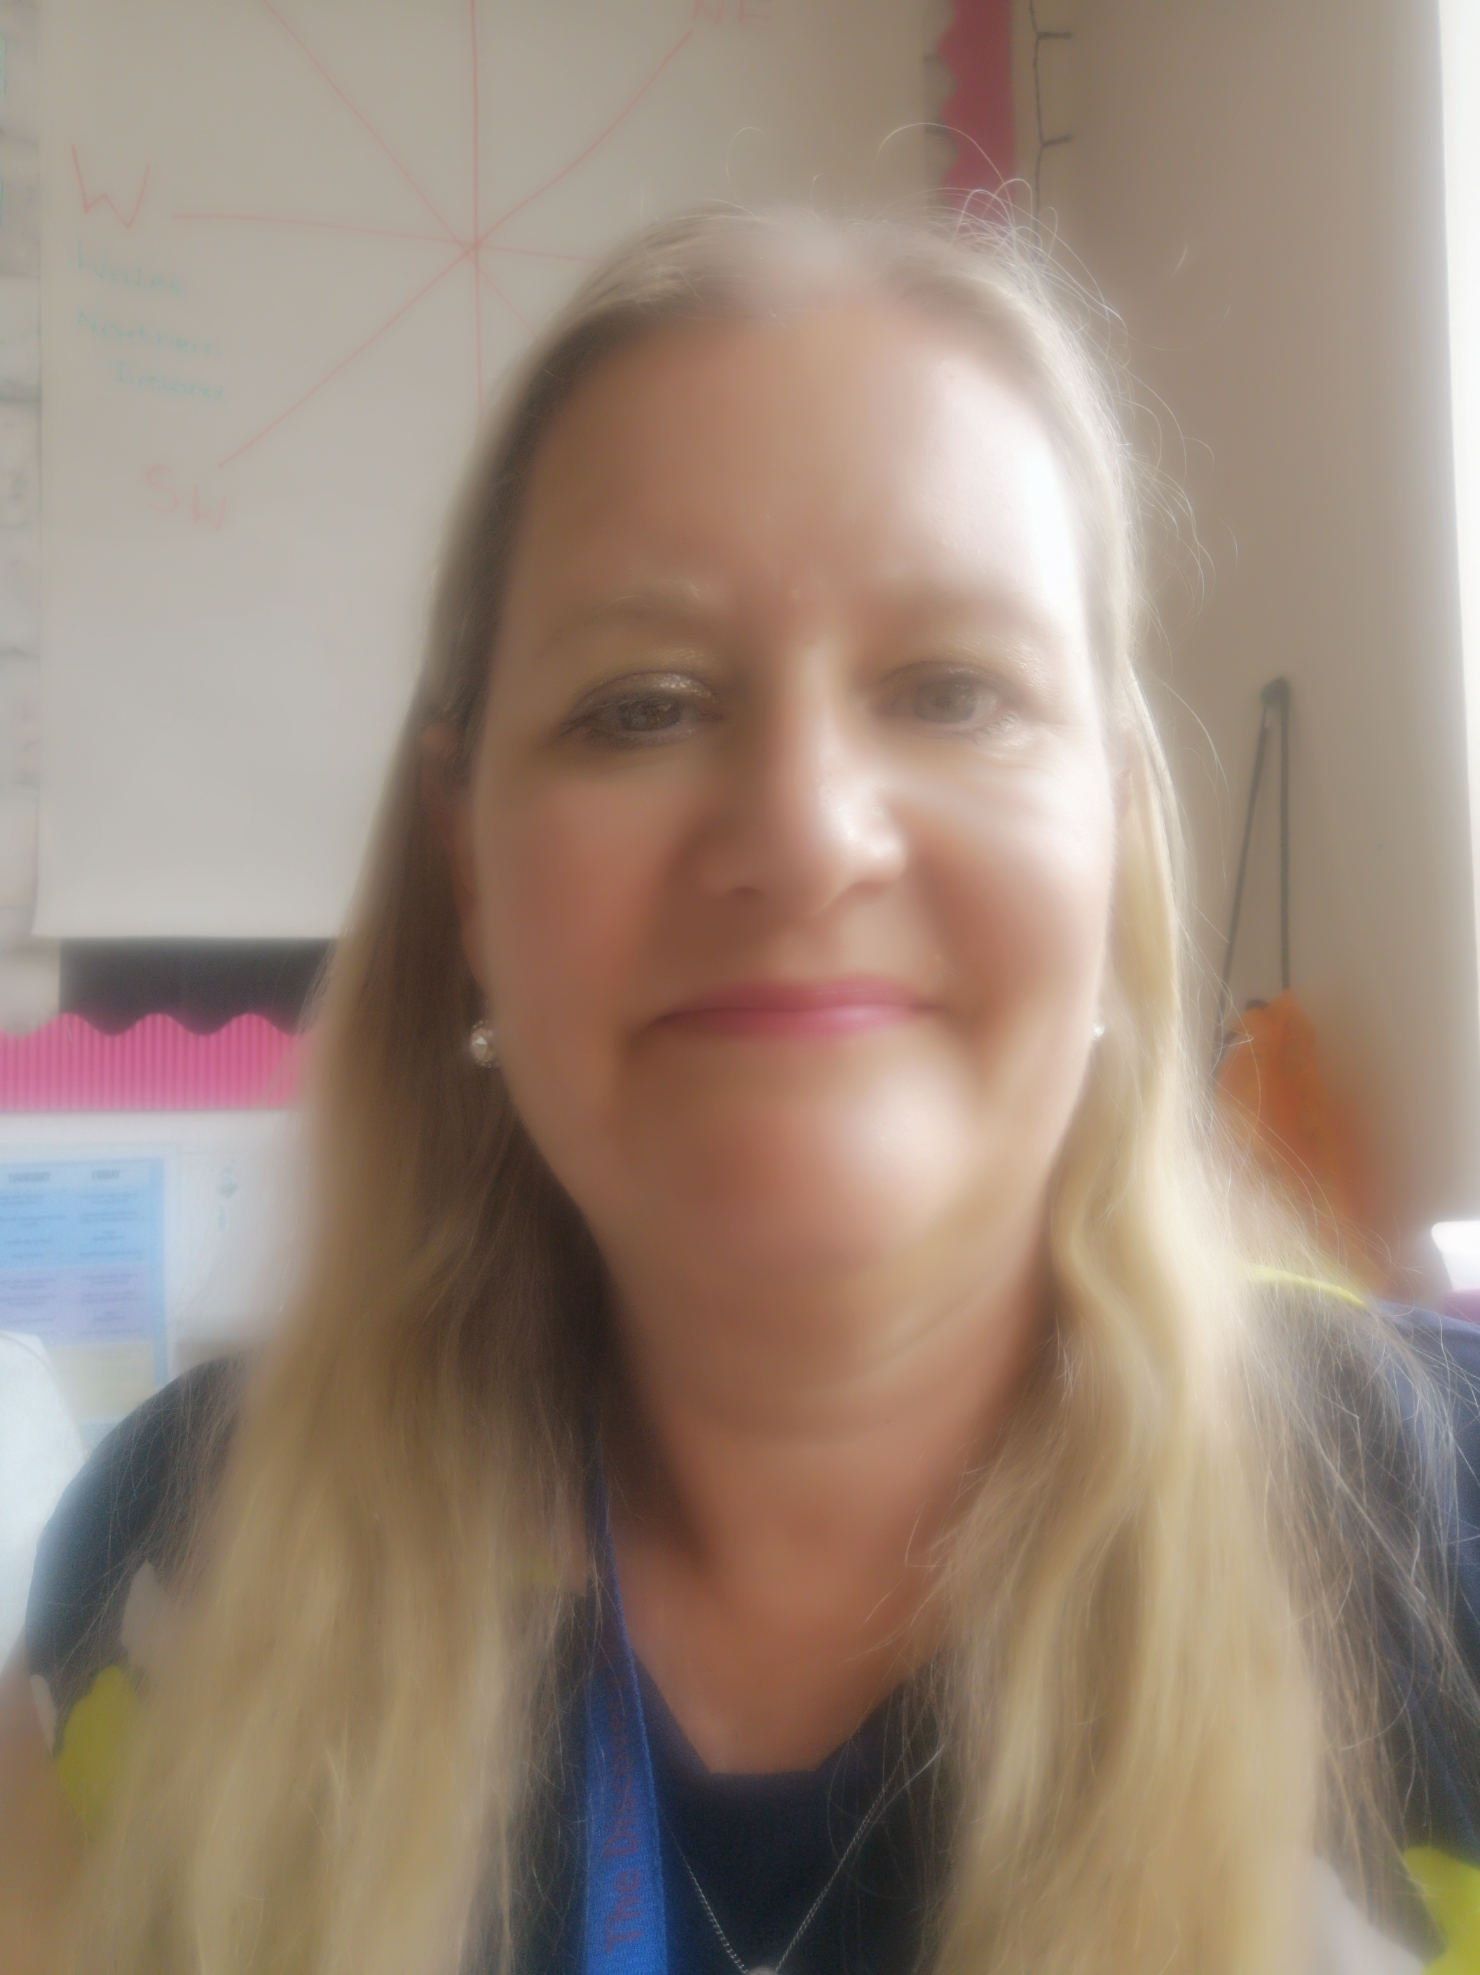
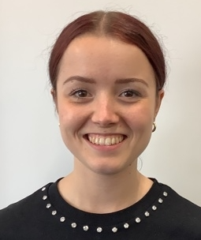
Staffing
Jackson
Class Teachers:
Mrs Dunne
Email address:
mdunne@discovery.kent.sch.uk
Teaching Assistant:
Mrs Palmer
Mrs Dunne
Mrs Palmer
Miss Ball

Slide 5
Yearly Overview
This year, our curriculum will focus on the following three big questions:
Were the Vikings always vicious?
What is the next giant leap for mankind?
Were all Ancient Egyptians like Tutankhamun?
We will be finding out what the children already know about each topic and using their questions to drive the curriculum.
Our focus this year is facilitating discovery!

Slide 6
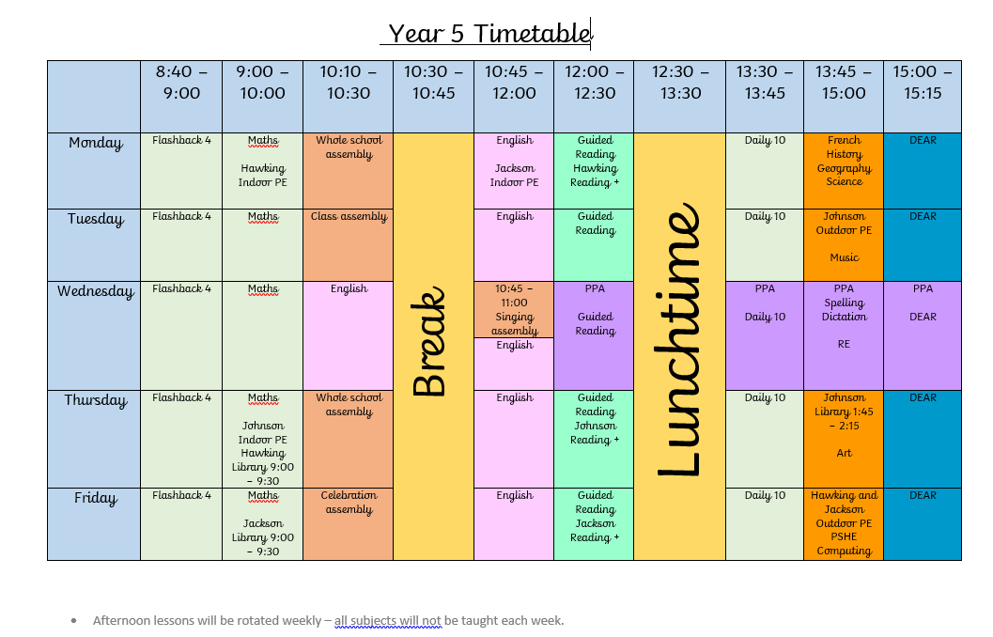
A day in Year 5!
12:00 – 12:15
12:15 – 13:15

Slide 7
PE
On your child’s PE day, they will be expected to come to school ready for PE. They will stay in their PE kit for the day and will not be changing at school.
Children will need to wear:
House coloured t-shirt
Shorts or navy tracksuit bottoms depending on the weather
Plimsolls or trainers
Socks
Warm navy jumper or hoody
Earring tape /hair tie (please tape earrings and tie up hair at home)
PE days are Monday and Tuesday for Jackson Class
Monday and Thursday for Johnson Class
Tuesday and Thursday for Hawking Class

Slide 8
Healthy Snacks
Please ensure your child’s snack for breaktime is a healthy snack.
Please remember that we are a nut free school.
Changes to our Food Policy:
Stopping the practice of bringing birthday treats and sweets into school.
Changes to packed lunches can be found on the school website.

Slide 9
Unique Experiences

Slide 10
Homework Expectations
Homework is introduced in Year 5 in order for the children to develop self-motivation, self-regulation and perseverance in order to be ready for secondary school and beyond!
Homework will be set on Friday and is due in on Wednesday
In Year 5, children are expected to complete one hour of homework weekly – this will be posted to their Class Dojo page.
This will usually consist of:
Reading Plus
Maths task
Spelling
Please encourage your child to speak to us if they don’t understand the set homework.
Praise and rewards will be available for homework completed in a timely manner. If homework is not completed by Friday, children will be given time to complete the work in school.

Slide 11
Reading Expectations
Year 5 will have reading records. This is to ensure that both parents and teachers are able to track what children are reading.
Children are able to write in this themselves and there is a space for adults at home and teachers to sign at the end of the week.

Slide 12
Reading Trees
Our Reading Trees inspire children to read high quality texts for their year group.
The aim is to ensure that children read a wider range of poetry, fiction and non-fiction throughout the year.
When children have read 30 books , they earn a Gold Certificate.
When they read 20 books, they can earn a Silver Certificate.
When they read 10 books, they can earn a Bronze Certificate!
Books can be taken home, but we ask that they are well looked after and returned. Teachers from each class will be monitoring which books are going home.
Please share the books with your child. If the book is too challenging for your child to read, please read to them or take turn to read with them.
Our Reading Tree list will be in your child’s reading record.

Slide 13
Presentation and Standards
Only use handwriting pens for all writing – no biro pens for school work.
Pencil for maths work.
Keep book covers, name labels and trays neat –no writing or doodling on these.
Maths question numbers written in a margin recorded in brackets:
1)
Colouring in books in coloured pencil only.
All lines drawn with a ruler.
Dates and headings underlined in pencil.
All labelled diagrams use a ruler for labels.

Slide 14
Rewards
By displaying our school values of kindness, respect, friendship, honesty and perseverance, children earn:
Value points
Star of the Week certificates
Postcards of praise
Excellence Awards at the end of term
Dojo points or Table points

Slide 15
Sanctions
In Year 5, we continue to follow our school behaviour policy and issue sanctions where appropriate.
These may be:
Missing a portion of break/ lunch in order to discuss an incident
Parent contact, if deemed necessary.
Some serious or ongoing incidents may be escalated to the Year Group Lead, Senior Leaders, Deputy Head or the Headteacher.

Slide 16
New to Year 5: Phones
If your child brings a phone into school, it must be switched off at the gate.
Your child’s phone will be kept in a phone box in class during the day and returned at the end of
the day.

Slide 17
New to Year 5: Walking Home
Children in Year 5 are allowed to walk home alone – with your permission
We will need written permission from you to be able to authorise this.
Please also inform us if any other adults will be collecting your child.

Slide 18
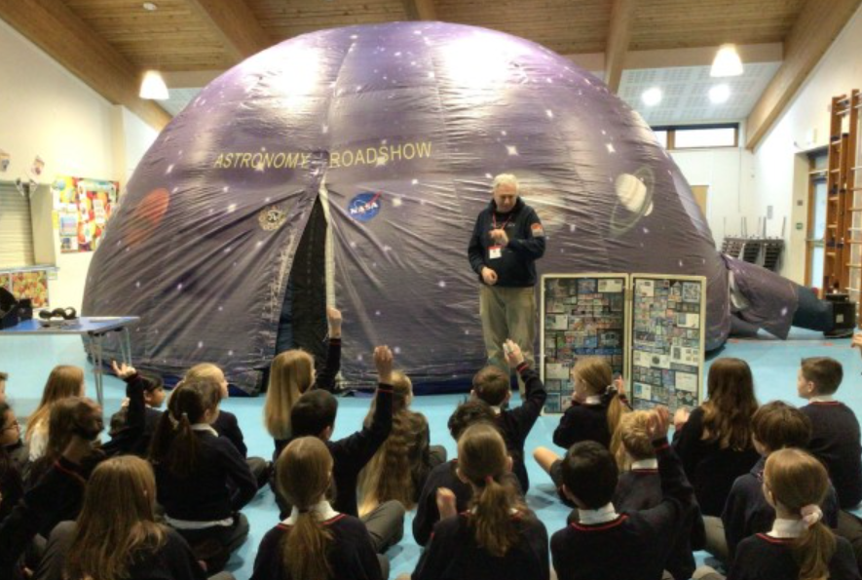
Finding out more about Year 5: Class Webpage
Information about your child’s class and curriculum can be found on the following webpage:
Learning updates can be found:

Slide 19
Medication
Please send all medication in to the office.
It must not remain in your child’s bag.

Slide 20
Reporting absences
Please inform the school office if your child will be absent.
The best way to do this is via email.
The school office’s email is: office@discovery.kent.sch.uk

Slide 21
Communication
As a school we welcome communication from our parents. If you have any concerns, we would much rather answer them directly as soon as possible. This could be done through email, a face to face conversation or a telephone call. Please always contact your child’s Class Teacher in the first instance.
Emails will be answered Monday – Friday, between the hours of 7:30am – 5pm.
Staff will respond to emails within 48 hours. If the email appears to be a complex matter, we will either phone you or invite you to come into school and meet with us. Please include both teachers if your child is in Johnson.
If your enquiry is urgent please telephone the school office during the school day.

Slide 22
Secondary Transfer
Now is the time to start thinking about secondary transfer for your child, you could:
Look on secondary school websites to ‘get a feel’ for each school.
Look on secondary school websites to identify if there are any experience days offered at that school that may interest your child. These normally take place in the summer term in Year 5.
Later in the year, there will be a meeting for all Year 5 parents to discuss secondary transfer and the Kent Test registration process. This process is usually during July and children usually sit the test in the first few days of Year 6.
If you have any further questions then Dr Wilce-Cordner will be happy to answer them for you.

Slide 23
Any questions? ☺
If we don’t have the opportunity to speak to you now, please do email us.

