Slide 1
Year 5 Hawking Jackson Johnson
Please sign in on the sheet at the back ☺
Meet the teacher
September 2023

Slide 2
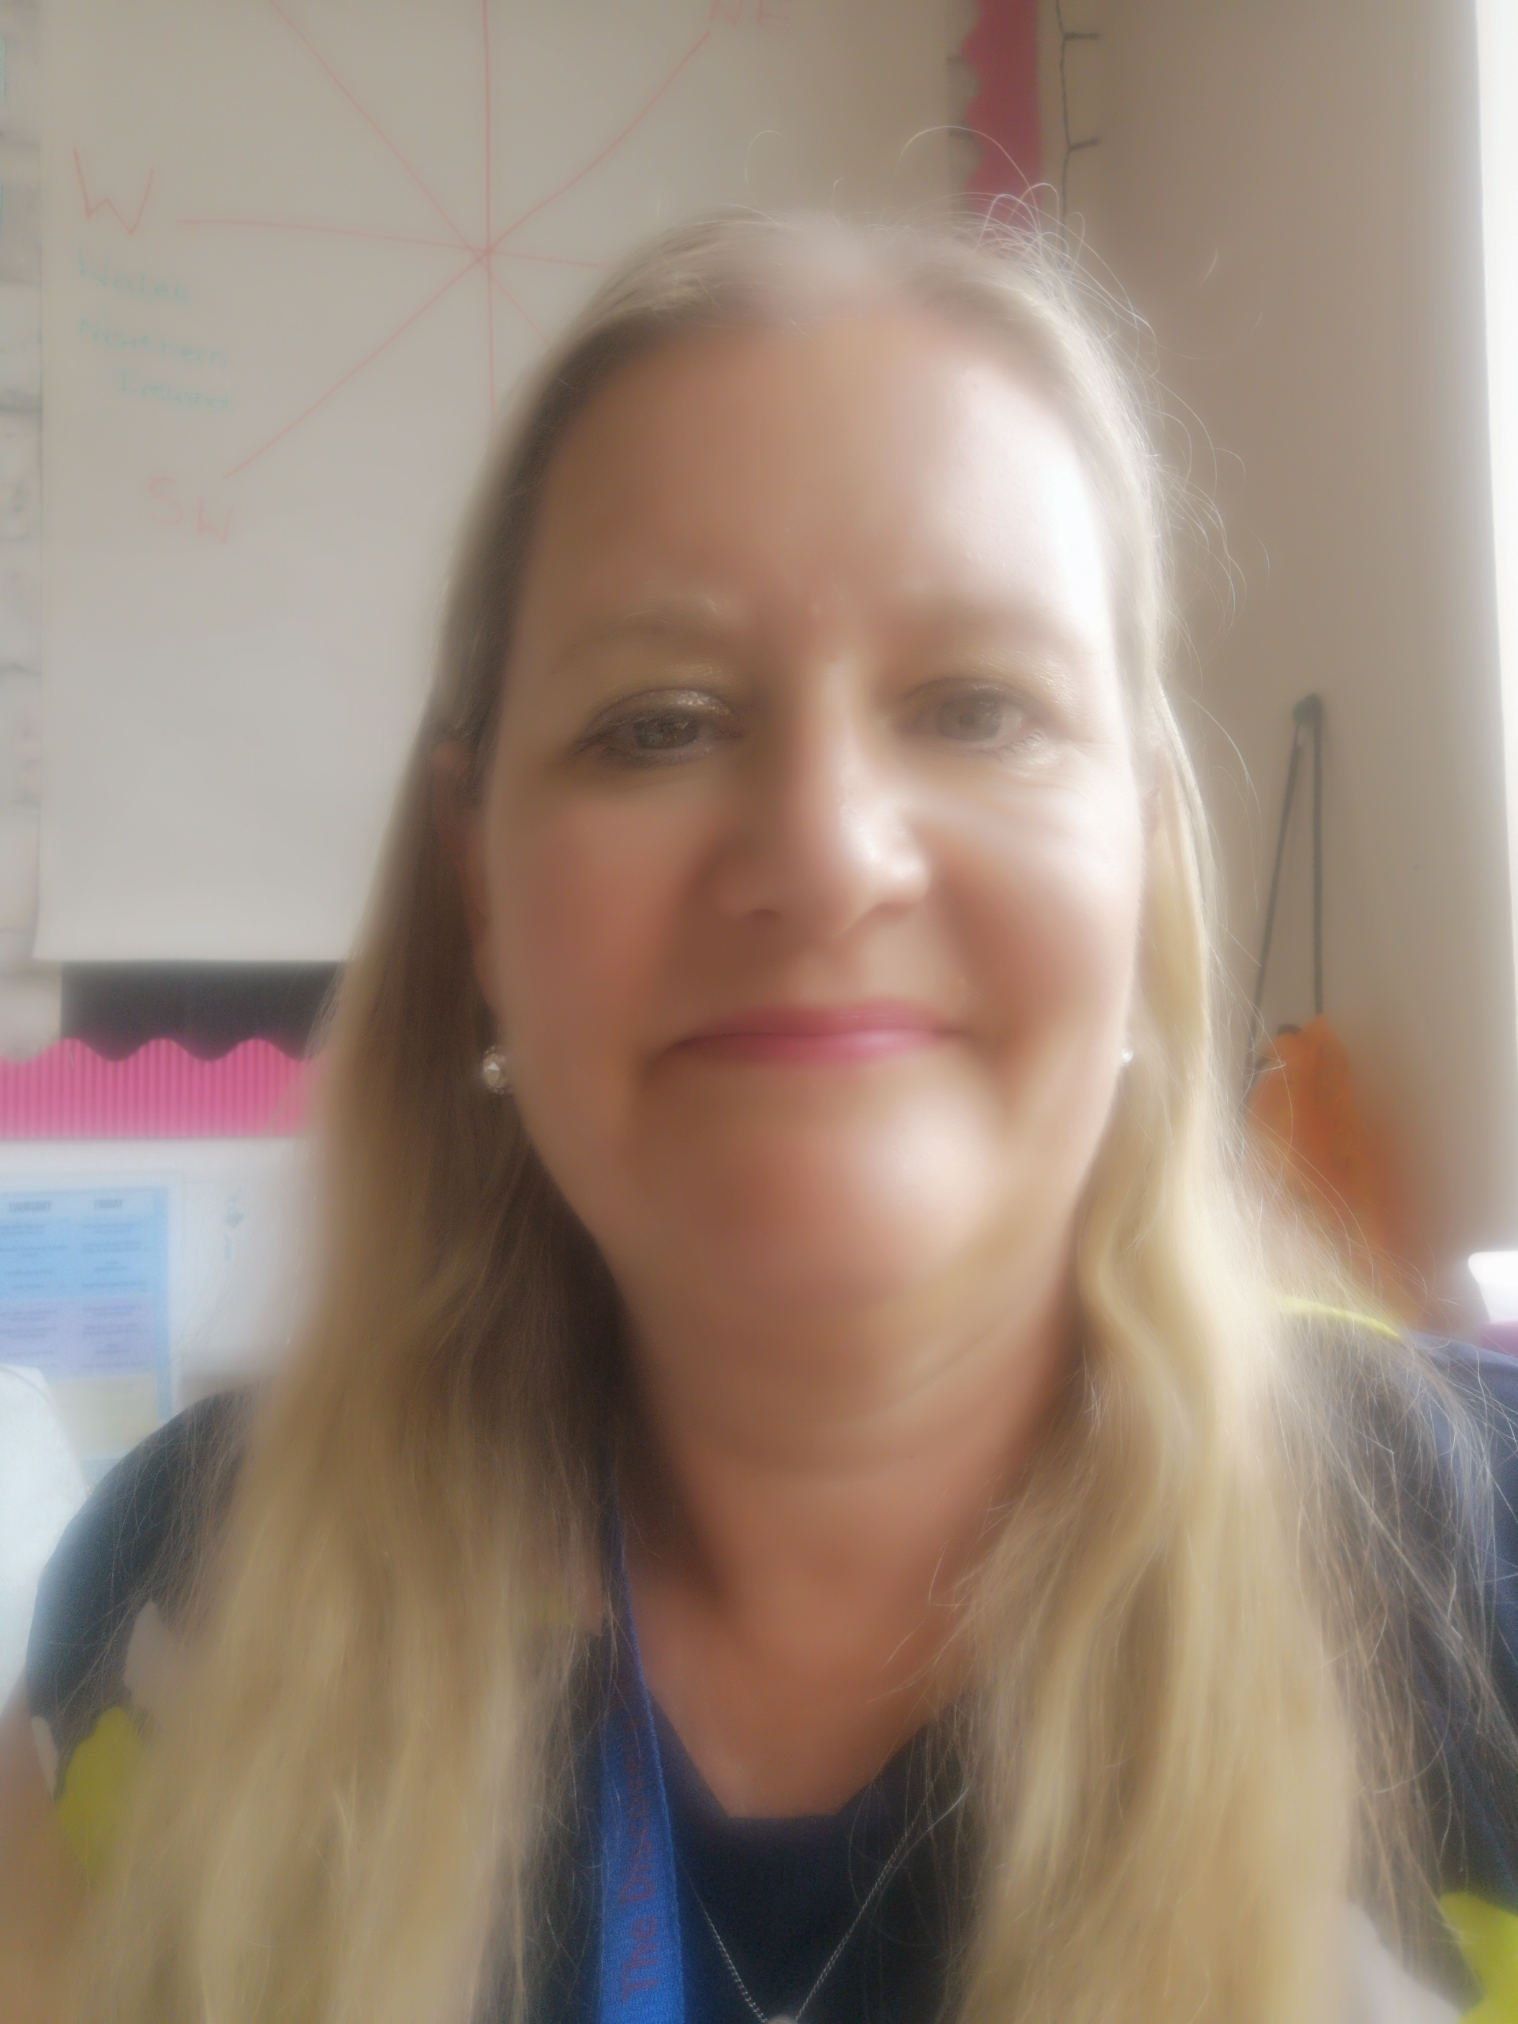
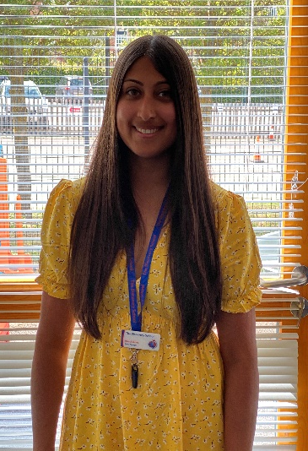
Staffing
Hawking
Class Teacher and Year Group Lead: Mrs Hind Teaching Assistants: Mrs Palmer Email address: ahind@discovery.kent.sch.uk
Mrs Hind
Mrs Palmer

Slide 3
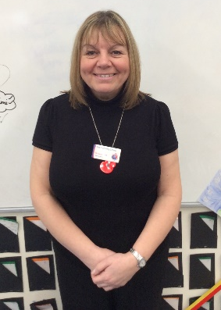
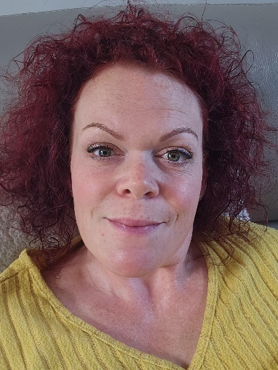
Staffing
Johnson
Class Teachers:
Miss Talbot and Miss Beard
Teaching Assistant:
Miss Smith
Email address:
tbeard@discovery.kent.sch.uk
ntalbot@discovery.kent.sch.uk
Miss Talbot
Miss Beard
Miss Smith
Miss Whiting

Slide 4
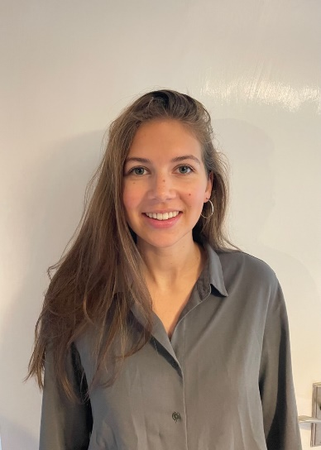
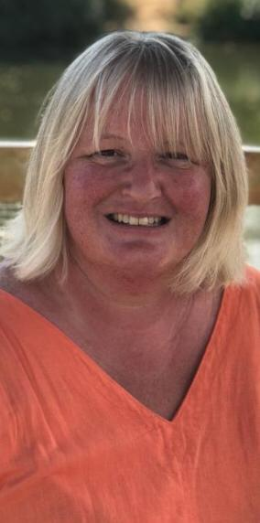
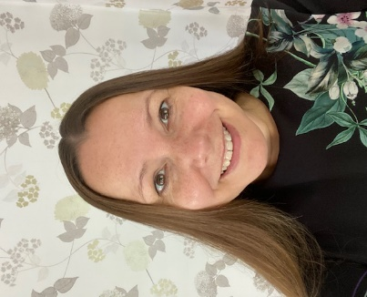
Staffing
Jackson
Class Teachers:
Miss McNicoll
Teaching Assistants:
Mrs Reed and Mrs Brett
Email address:
hmcnicoll@discovery.kent.sch.uk
Miss McNicoll
Mrs Brett
Mrs Reed

Slide 5
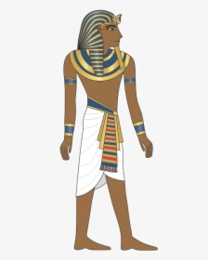
Yearly Overview
This year, our curriculum will focus on the following three big questions:
Were the Vikings always vicious?
What is the next giant leap for mankind?
Were all Ancient Egyptians like Tutankhamun?
We will be finding out what the children already know about each topic and using their questions to drive the curriculum.
Our focus this year is facilitating discovery!

Slide 6
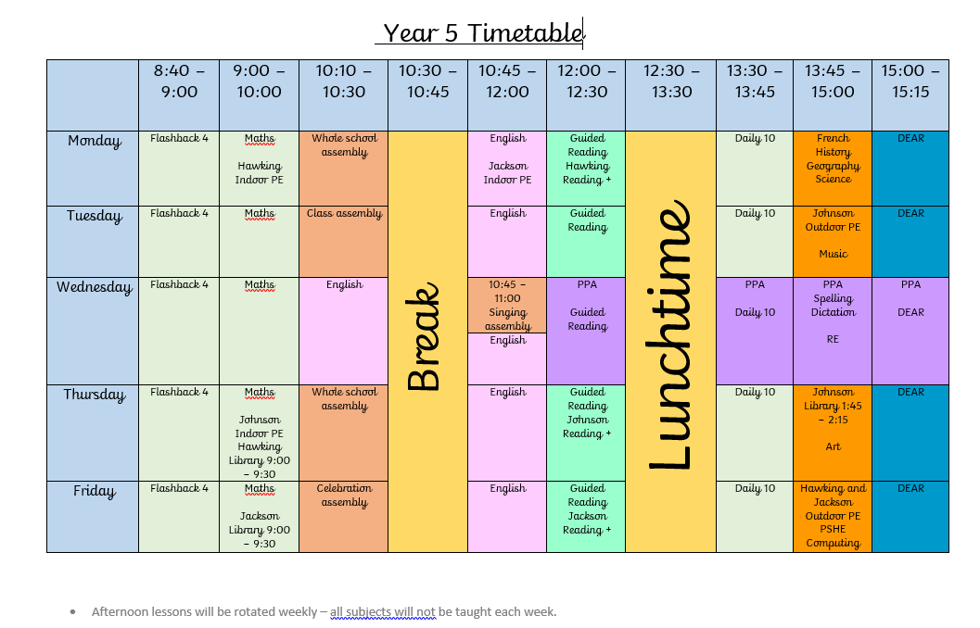
A day in Year 5!
12:00 – 12:15
12:15 – 13:15

Slide 7
PE
On your child’s PE day, they will be expected to come to school ready for PE. They will stay in their PE kit for the day and will not be changing at school.
Children will need to wear:
House coloured t-shirt
Shorts
Plimsolls or trainers
Socks
Navy tracksuit bottoms (this is essential, as it will be getting cold!)
Warm navy jumper or hoody
Earring tape /hair tie (please tape earrings and tie up hair at home)
PE days are Tuesday and Thursday
Hawking and Johnson: Indoor Thursday, outdoor Tuesday
Jackson: Indoor Tuesday, outdoor Thursday

Slide 8
Healthy Snacks
Please ensure your child’s snack for breaktime is a healthy snack
No nuts!
The new food policy will be sent out as soon as the DfE has updated their Food Standards.

Slide 9
School trips and events
We will be taking part in the following trips/events for this year:
Viking experience
Astrodome
Wildwood
Sleepover

Slide 10
Homework Expectations
Homework will be set on Friday and is due in on Wednesday
In Year 5, children are expected to complete an hour of homework weekly – this will be posted to their Class Dojo page.
This will usually consist of:
Reading Plus
Maths task
Spelling
SPaG.com
If your child has difficulty understanding their homework, they need to see their Class Teachers or TAs as soon as possible.

Slide 11
Reading Records
Year 5 will have reading records.
This is to ensure that both parents and teachers are able to track what children are reading.
Children are able to write in this themselves and there is a space for adults at home and teachers to sign at the end of the week.

Slide 12
Reading Trees!
We wanted to find a way to inspire children to read high quality texts for their year group.
The aim is to ensure that children read a wider range of poetry, fiction and non-fiction throughout the year.
Consequently, we have created ‘Reading Trees’ for each class to inspire children to develop independent reading for pleasure.

Slide 13
Reading Trees!
There will be 36 high quality books will be in each class.
The list of these books will be placed on the school website and sent home.
The aim is for children to read 30 books to earn a Gold Certificate.
If they read 20 books, they can earn a Silver Certificate.
If they read 10 books, they can earn a Bronze Certificate!
Children can read these books to you, and you can read them to your child.
Books can be taken home, but we ask that they are well looked after and returned! Teachers from each class will be monitoring which books are going home.
Children will be encouraged to take responsibility to record when they have read each book, so they know when they have completed the challenge!

Slide 14
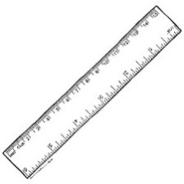
Presentation and Standards
Maths question numbers written in a margin recorded in brackets:
2)
Keep book covers, name labels and trays neat – NO writing or doodling on these.
Only use handwriting pens for all writing – no biro pens for school work.
Pencil for maths work.
Colouring in books in coloured pencil only.
All lines drawn with a ruler. All labelled diagrams use a ruler for labels.

Slide 15
Rewards
As a school the children can earn:
Value points on a daily basis
Receive a Star of the Week certificate
Receive a postcard of praise
Achieve an Excellence Award
Dojo points
Marbles

Slide 16
Sanctions
Teacher’s sanction linked to missing break/ lunch
Parent Contact - if deemed necessary.
In addition, children will also be sent to the Year Group Lead, Senior Leaders, Deputy Head then the Headteacher.

Slide 17
Behavioural Expectations
Being polite and respectful at all times to all members of the school community.
Always putting in 100% effort in all subjects.
Acting as ambassadors of the school and as role models for younger pupils.

Slide 18
Phones
If your child brings a phone into school, it must be switched off at the gate.
This will be kept in a phone box in class during the day and returned at the end of the day.

Slide 19
Our music offer
@ The discovery school

Slide 20
Whole class ensemble teaching
Recorder
Y3
Ukulele
Y4
Djembe
Y5

Slide 21
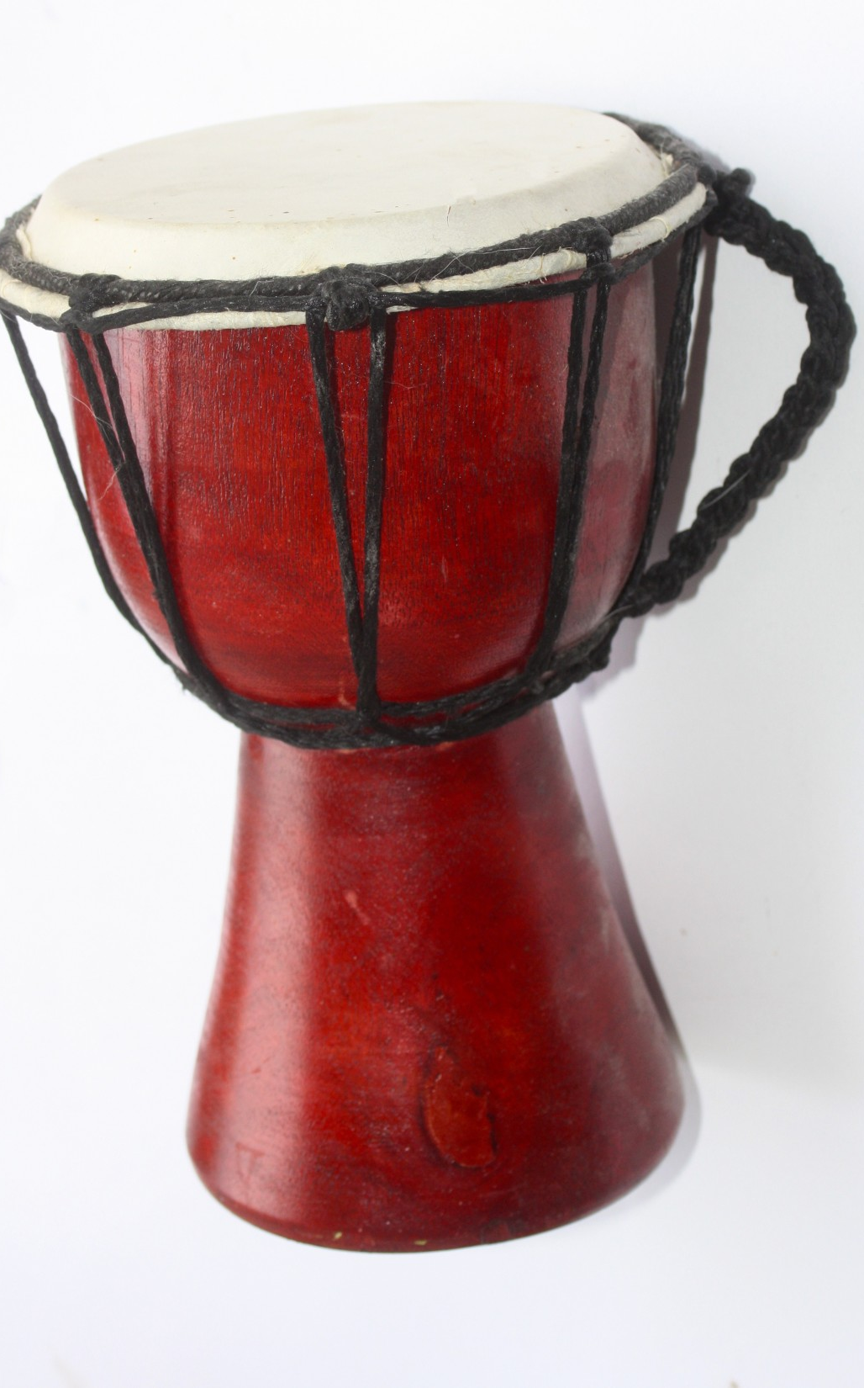
Y5 Whole class Djembe lessons
In year 5, all pupils learn how to play the djembe as part of their music curriculum.
Djembe lessons are delivered by the class teacher and/or teaching assistant and follow an online djembe tuition programme.
Each class will receive two terms of lessons.
Children will be able to use an instrument from school for lessons.
The lessons develop children’s musicianship skills as well as their confidence in playing and performing together.

Slide 22
Co-curricular music
All children from year 1 to 6 have the opportunity to learn a range of instruments as part of the school’s
co-curricular offer.
Lessons are delivered by independent peripatetic tutors and take place during the school day.
The tutors liaise with class teachers and rotate lesson times each term to avoid children missing the same subjects.
Children can choose to learn the piano, violin, electric guitar, clarinet, flute, cornet, trumpet, saxophone, classical guitar or continue with the ukulele.
Children can also learn to play as part of a band selecting either drums, keyboard, lead guitar, bass guitar or vocals.

Slide 23
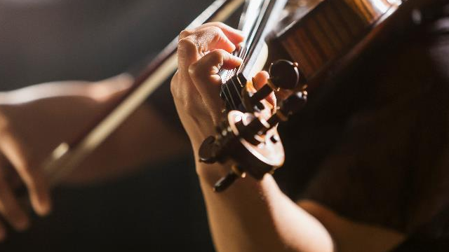
FOR FURTHER INFORMATION ABOUT INDIVIDUAL OR GROUP MUSIC LESSONS, PLEASE CONTACT Mrs Wilce-Cordner, assistant headteacher for KS2.
jwilce@discovery.kent.sch.uk

Slide 24
Medication
Please send all medication in to the office.
It must not remain in your child’s bag.

Slide 25
Walking Home
Children in Year 5 are allowed to walk home alone – with your permission!
We will need written permission from you to be able to authorise this.
Please also inform us if any other adults will be collecting your child.

Slide 26
Class Webpage
Information about your child’s class and curriculum can be found on the following webpage:
https://www.discovery.kent.sch.uk/year-groups/year-5/
Learning updates can be found:
https://www.discovery.kent.sch.uk/curriculum/learning-updates/year-5-learning-updates/

Slide 27
Reporting absences
Please inform the school office if your child will be absent.
The best way to do this is via email.
The school office’s email is: office@discovery.kent.sch.uk

Slide 28
Communication
As a school we welcome communication from our parents. If you have any concerns, we would much rather answer them directly as soon as possible. This could be done through email, a face to face conversation or a telephone call. Please always contact your child’s Class Teacher in the first instance.
Emails will be answered Monday – Friday, between the hours of 7:30am – 5pm.
Staff will respond to emails within 48 hours. If the email appears to be a complex matter, we will either phone you or invite you to come into school and meet with us. Please include both teachers if your child is in Johnson.
If your enquiry is urgent please telephone the school office during the school day.

Slide 29
Secondary Transfer
Now is the time to start thinking about secondary transfer for your child, you could:
Look on secondary school websites to ‘get a feel’ for each school.
Look on secondary school websites to identify if there are any experience days offered at that school that may interest your child. These normally take place in the summer term in Year 5.
Later in the year, there will be a meeting for all Year 5 parents to discuss secondary transfer and the Kent Test registration process. This process is usually during July and children usually sit the test in the first few days of Year 6.
If you have any further questions then Miss Wilce will be happy to answer them for you.

Slide 30
Any questions? ☺

