Slide 1

Expectations for Year 4 pupils.
Greater independence – working walls, class dictionaries.
Develop a greater sense of resilience and maturity
Always putting in 100% effort.
High expectations of presentation and behaviour.
Children are encouraged to bring a healthy snack at break time such as fruit, salad or vegetable based snacks.
Polite, kind and courteous behaviour – follow the school values of honesty, friendship, kindness, respect and perseverance.
Always smartly dressed in correct
uniform (labelled please). This includes the correct PE kit.

Slide 2
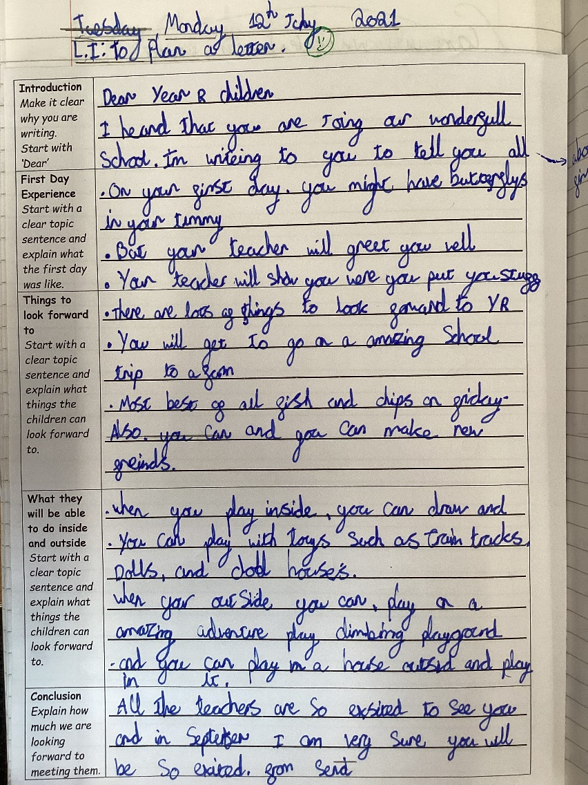
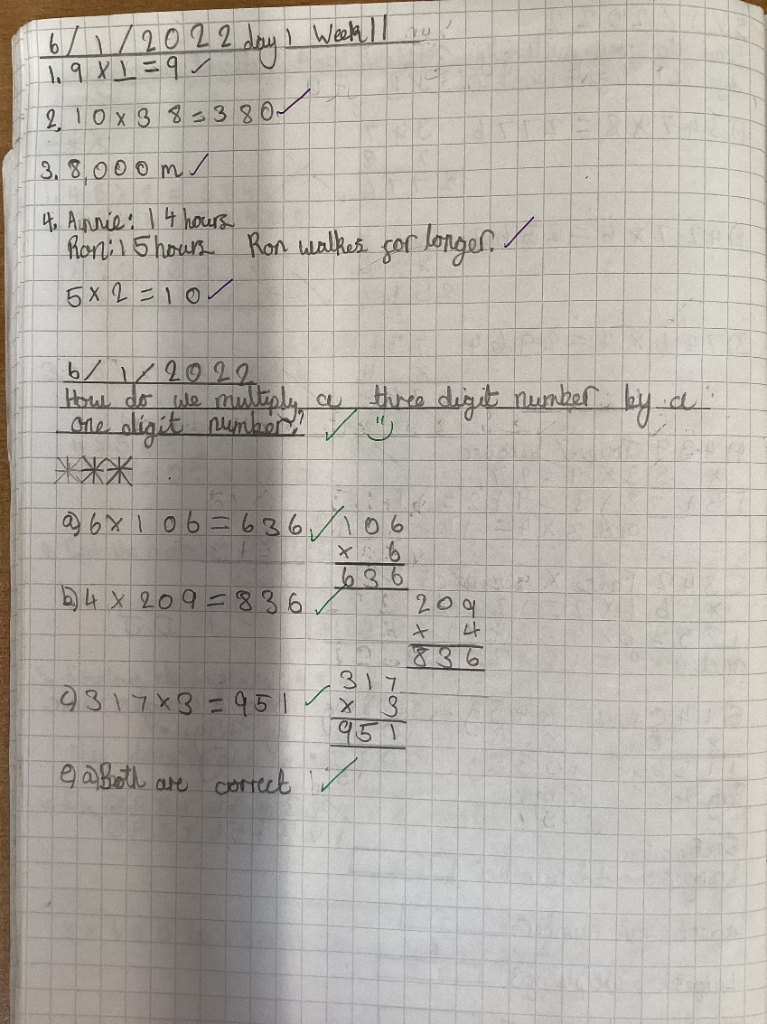
Our aim – to have all children issued with a pen licence by the end of Year 4.

Slide 3
Rewards and Sanctions
Rewards
  Stickers, house points, postcards of praise, behaviour ladder, star of the week, head teacher awards, deputy head awards, excellence awards, and share good work with other classes and staff.
  Reward time earnt.
Sanctions
  warnings, isolated learning within class or within the year group, missed minutes from playtimes.
  Sent to Year Group Leader or members of the SLT as set out in the behaviour policy.
  Parents informed as appropriate.

Slide 4
Term 1 and 2
What did the Romans bring to Britain?
Enrichment opportunity: cooking outdoors, Roman Britain trip TBC
Term 3 and 4
What makes our world wonderful?
Enrichment opportunity: outdoor learning activity
Term 5 and 6
What makes the Anglo-Saxons special?
Enrichment opportunity: external workshop TBC

Slide 5
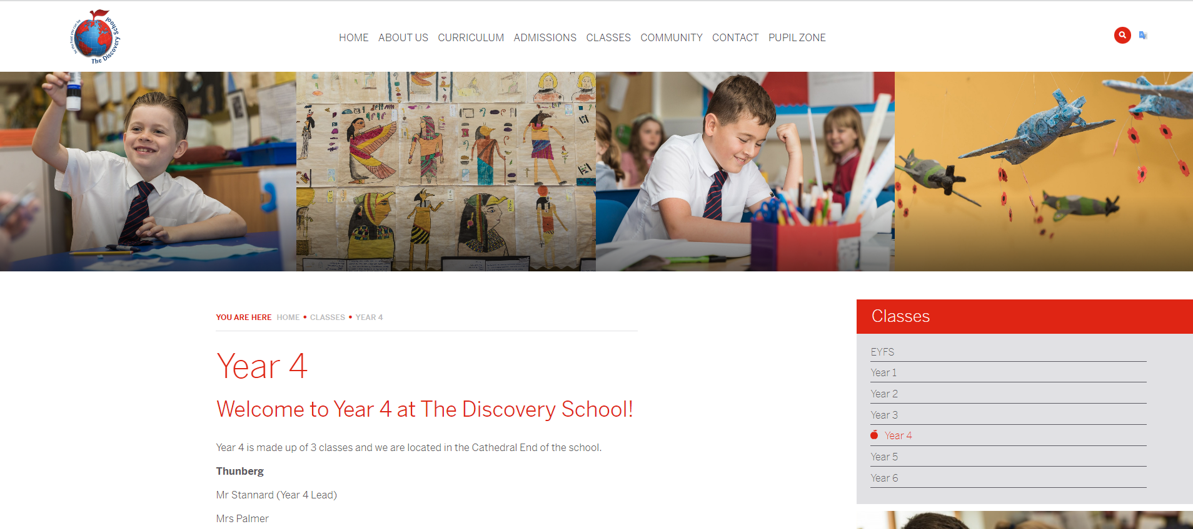
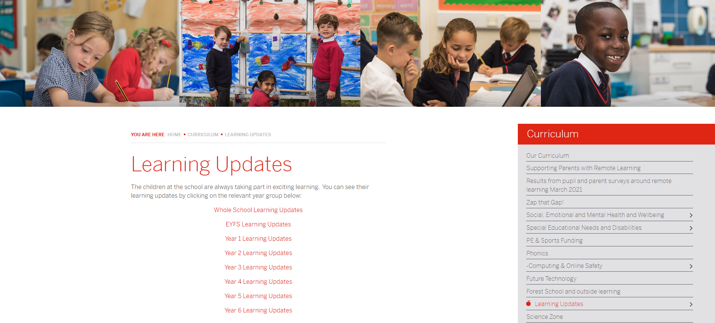
Learning updates & Year group page
https://www.discovery.kent.sch.uk/year-groups/year-4/
https://www.discovery.kent.sch.uk/curriculum/learning-updates/year-4-learning-updates/

Slide 6


Our music offer
@ The Discovery School

Slide 7
Whole class ensemble teaching - wcet
Recorder
Y3
Ukulele
Y4
Djembe
Y5

Slide 8
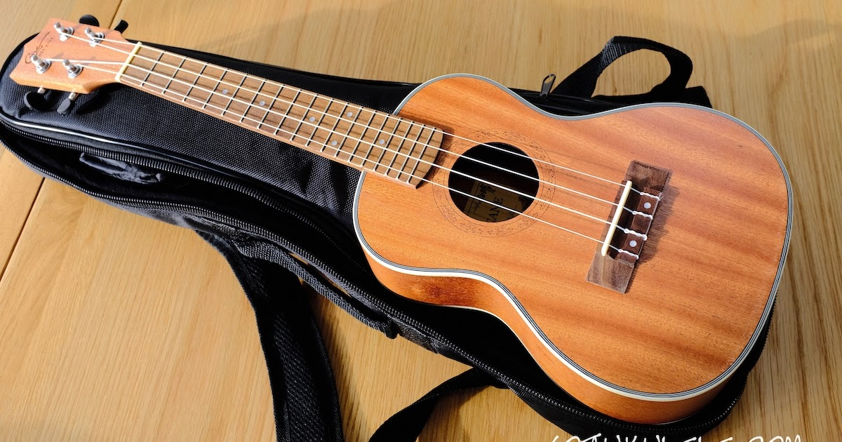
Y4 Whole class UKULELE lessons
In Year 4, all pupils learn how to play the ukulele as part of their music curriculum.
Ukulele lessons are delivered by a specialist Music Teacher and are part funded by the Music Plus Scheme.
Each class will receive a 30-minute lesson per week throughout the whole academic year..
The lessons develop children’s musicianship skills as well as their confidence in playing and performing together.
Children are able to borrow a school ukulele for their lessons but can purchase their own instrument if they choose.
The year’s programme will culminate in an end of year performance to parents to celebrate progress.
This Photo by Unknown Author is licensed under CC BY-NC-ND

Slide 9








Co-curricular music
All children from year 1 to 6 have the opportunity to learn a range of instruments as part of the school’s co-curricular offer.
Lessons are delivered by independent peripatetic tutors and take place during the school day.
The tutors liaise with class teachers and rotate lesson times each term to avoid children missing the same subjects.
Children can choose to learn the piano, violin, electric guitar, clarinet, flute, cornet, trumpet, saxophone, classical guitar or continue with the ukulele.
Children can also learn to play as part of a band selecting either drums, keyboard, lead guitar, bass guitar or vocals.

Slide 10
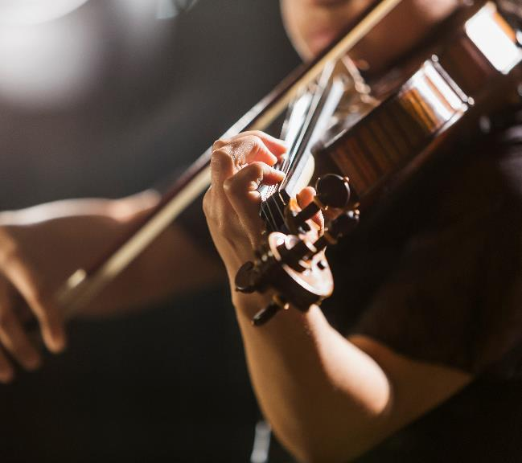
FOR FURTHER INFORMATION ABOUT INDIVIDUAL OR GROUP MUSIC LESSONS, PLEASE CONTACT Mrs Wilce-Cordner,
Assistant Headteacher for ks2.
jwilce@discovery.kent.sch.uk

Slide 11
Open Door
Telephone 01732 847000
Email office – change of pick up, appointments, absence.
office@discovery.kent.sch.uk
You can email your class teacher and staff will respond to e-mails within 48 hours between the hours of 7:30am – 5pm. If the email appears to be of a complex nature, we will invite you to come into school and meet with us if appropriate.
Class teacher emails:
kstannard@discovery.kent.sch.uk (Year 4 Leader)
arose@discovery.kent.sch.uk
ringles@discovery.kent.sch.uk
hmeiners@discovery.kent.sch.uk

Slide 12
Pick-up
Some children in Year 4 may need to walk home with older siblings in Year 5 and 6. If this is the case, you will need to email your wishes in advance to your child’s class teacher. They will then need to discuss the arrangements with you before agreeing.

