Slide 1
Welcome to
Year 4!

Slide 2
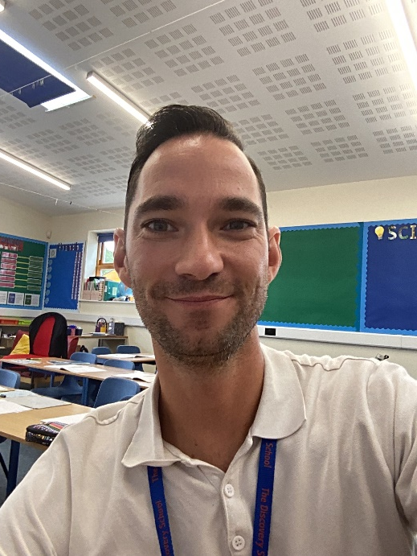
The Current Year Four Team
Thunberg
Mr Stannard (Year 4 Leader).
T.A. Mrs Palmer
T.A. Mrs Wiggins

Slide 3
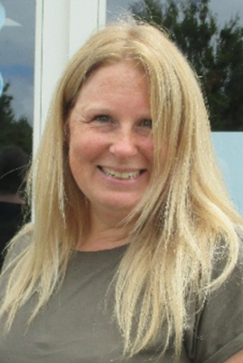
The Current Year Four Team
Berners-Lee
Mrs Rose
Mrs Ingles
T.A. – Mrs Stiff

Slide 4
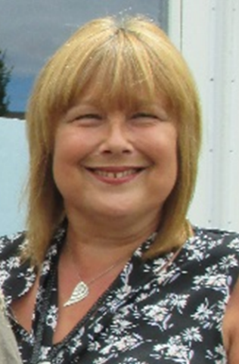
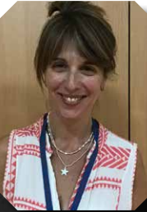
The Current Year Four Team
Jemison
Miss Meiners.
T.A. - Mrs Healy – Monday, Tuesday and Wednesday.
T.A. - Mrs Scott - Thursday and Friday.

Slide 5
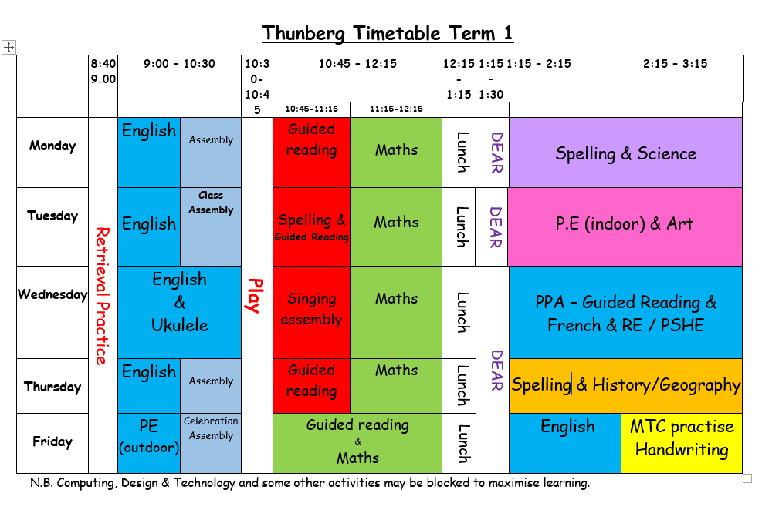

Slide 6
PE and Swimming
PE days for Thunberg Class and Jemison Class are on a Tuesday and Friday. Berners-Lee Class have PE on a Tuesday and Wednesday.
Swimming will take place on a Tuesday and Jemison are the first class to attend. Thunberg Class will be swimming in Terms 3 and 4. Berners-Lee Class will be swimming Terms 5 and 6.
You will receive a letter closer to the event, however so that you can plan ahead here is the general information on the letter:
It is during school hours and will exclude half term.
Children can come to school with their swimming costumes on under their PE kit. If they choose to change at the pool, then they must remember that they will only have a short amount of time to do so, therefore you may wish to practise this at home!
Larkfield’s swimming lesson policy states that swimming costumes must be one piece and not bikini or tankini and shorts should not be below the knee.
Long hair must be tied back.
If your child wishes to wear a swimming hat then they will need to put this on independently, prior to the lesson.
If your child is able to remove their earrings, then this is preferable.
Children are encouraged to bring their own goggles, even if they are non-swimmers. This often helps with confidence in the pool when learning to swim.

Slide 7
Times Tables
You may be aware that the government introduced the Multiplication Check for all children in Year 4.
It will take place during the Spring/Summer (a similar format to the Y1 phonics screening).
It tests the pupils’ recall of their times tables from 2 to 12.
It is computer based – pupils can use iPads, laptops and some have adult support to type if required.
They have 6 seconds to answer each question.
We are doing lots to prepare your children for this and will give you additional information as we receive it throughout the year.

Slide 8
Times tables
Baseline assessment to find out where the pupils are at in September.
Each week the children will be expected to learn their times tables, focussing on the ones they struggle with.
TT Rockstars at home will support this too.
The children should be practising their times tables in this order:
*: 2 5 10 3 4 8
**: 6 7 9 11 12
***: All

Slide 9
Homework Expectations
Reading every night – to be recorded in the reading record.
Times tables – the children must spend some time learning their tables each week.
Weekly spellings pattern.
Additional tasks will be available on Purple Mash linked to a current topic or on Reading Plus.

Slide 10
Reading Trees!
Following feedback from some parents that it can be difficult to encourage children to read recommended challenging texts at home, we have devised a new initiative.
We wanted to find a way to inspire children to read high quality texts for their year group.
The aim is to ensure that children read a wider range of poetry, fiction and non-fiction throughout the year.
Consequently, we have created ‘Reading Trees’ for each class to inspire children to develop independent reading for pleasure.
The ‘Reading Trees’ will be appearing in the classrooms over the next few weeks!

Slide 11
Reading Trees!
There will be 36 high quality books will be in each class.
The list of these books will be placed on the school website and sent home.
The aim is for children to read 30 books to earn a Gold Certificate.
If they read 20 books, they can earn a Silver Certificate.
If they read 10 books, they can earn a Bronze Certificate!
Children can read these books to you, and you can read them to your child.
Books can be taken home, but we ask that they are well looked after and returned! Teachers from each class will be monitoring which books are going home.
Children will be encouraged to take responsibility to record when they have read each book, so they know when they have completed the challenge!

Slide 12
Volunteer Readers!
Reading is such a key skill, as it allows children to access all areas of the curriculum!
Therefore, we would really appreciate any extra help to read with children individually.
Can you spare some time to come into school, perhaps for a couple of hours, to share reading experiences with children in a class that is different to your child’s class?
If so, please speak to your class teacher!

