Slide 1

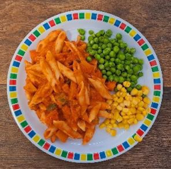
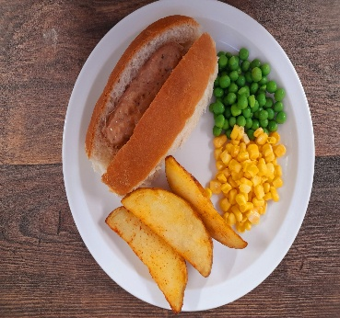
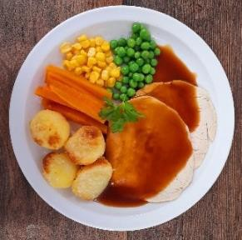
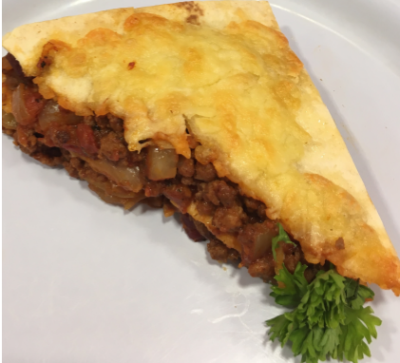
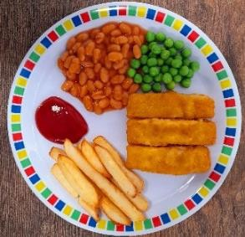
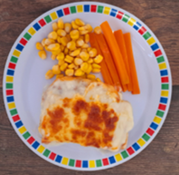

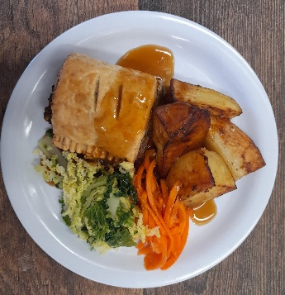
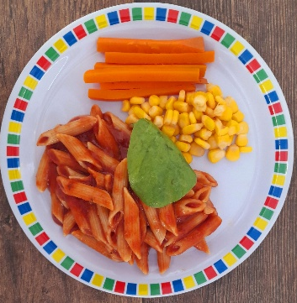
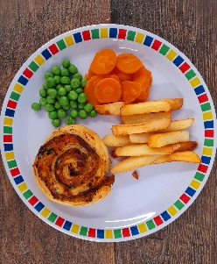
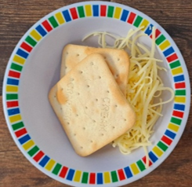
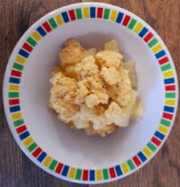
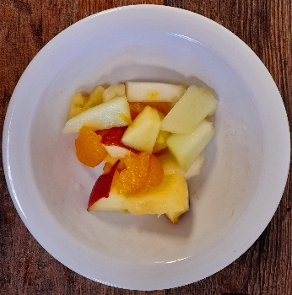
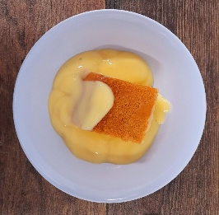
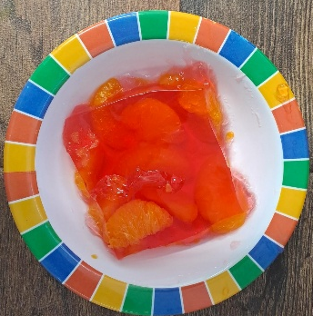
WEEK ONE
 | MONDAY | TUESDAY | WEDNESDAY | THURSDAY | FRIDAY
OPTION 1 02.11.2026 23.11.2026 14.12.2026 18.01.2027 08.02.2027 08.03.2027 | Tomato Pasta with Garlic Bread | Pork Hot Dog with Potato Wedges | Roast Chicken, Stuffing, Roast Potatoes & Gravy | Beef Tortilla Stack with Rice | Fish Fingers or Salmon Fish Fingers with Chips & Ketchup
OPTION 2 | Vegetable Lasagne | Veggie Hot Dog with Potato Wedges | Vegetable Wellington, Roast Potatoes & Gravy | Vegetable Pasta Bake | Cheese Whirl with Chips
DESSERT | Cheese & Crackers | Apple Crumble with Cream | Fruit Medley | Syrup Sponge with Custard | Jelly with Mandarins
*VEGETABLES AND SIDES MAY DIFFER THAN THOSE SHOWN

Slide 2

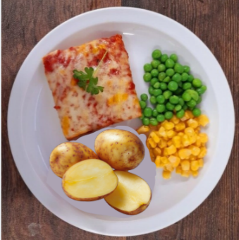
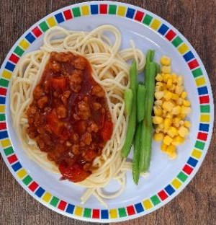
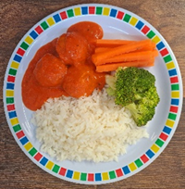

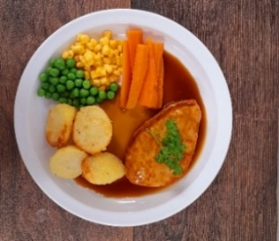
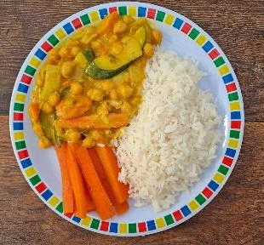
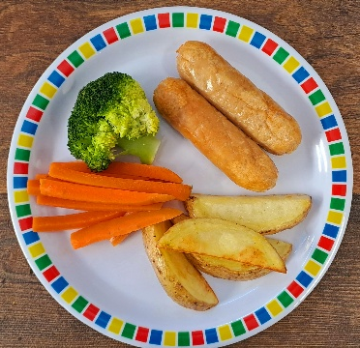
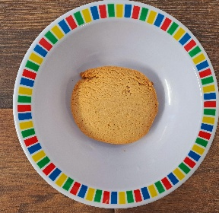
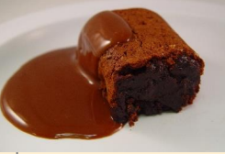
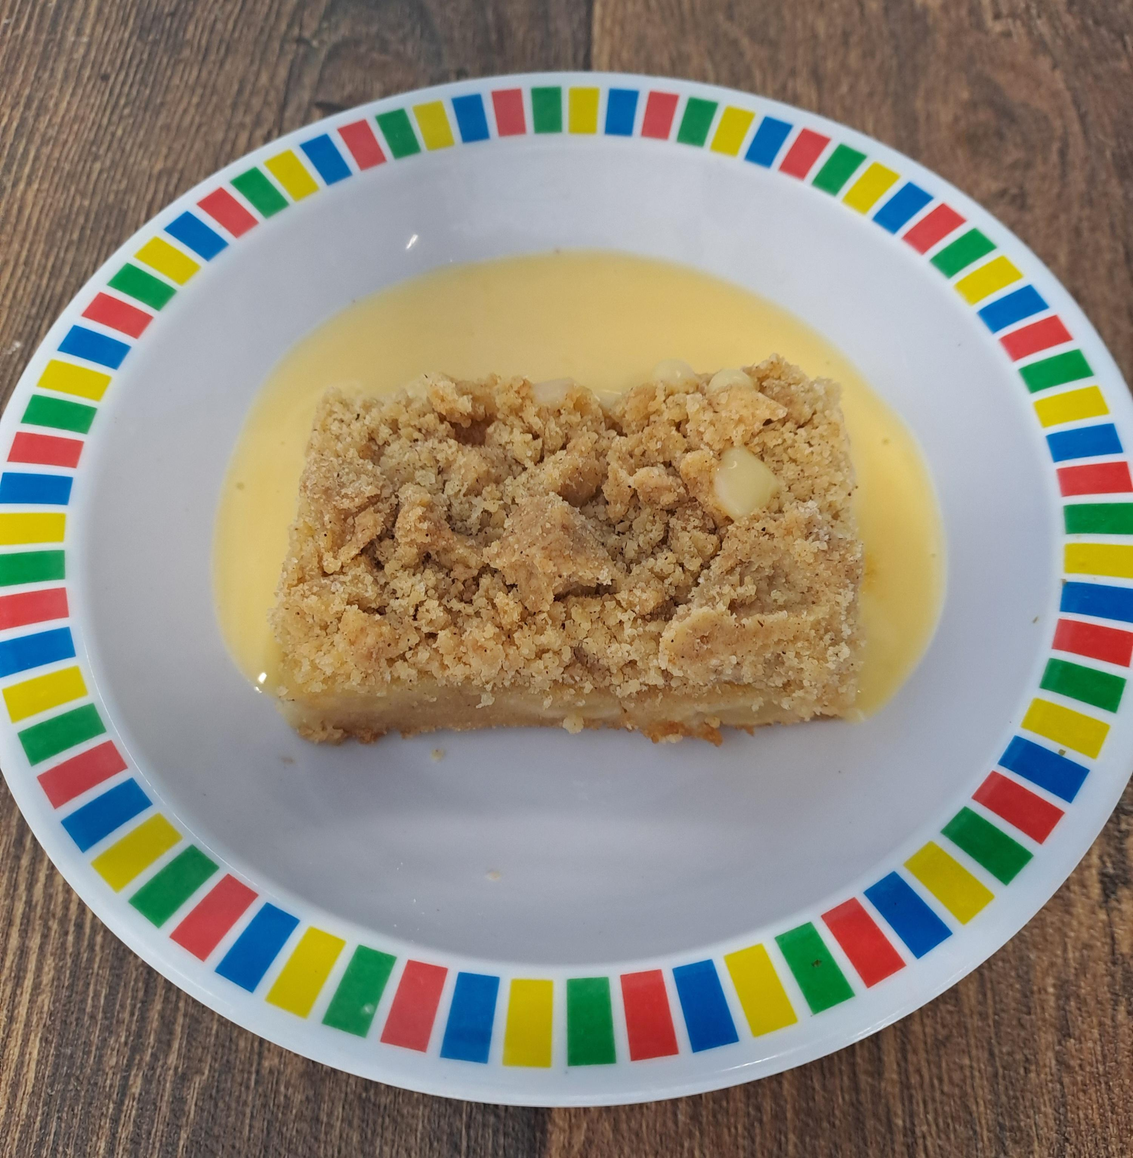
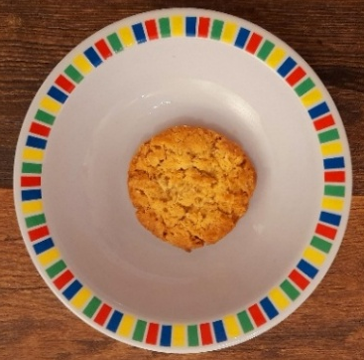
WEEK TWO
 | MONDAY | TUESDAY | WEDNESDAY | THURSDAY | FRIDAY
OPTION 1 09.11.2026 30.11.2026 04.01.2027 25.01.2027 22.02.2027 15.03.2027 | Cheese & Tomato Pizza with New Potatoes | Spaghetti Bolognaise | Roast Gammon, Roast Potatoes & Gravy | Chicken Meatballs in Tomato Sauce with Rice | Fish Fingers with Chips & Tomato Ketchup
OPTION 2 | Mild Mexican Chilli with Rice | Veggie Bolognaise | Quorn Fillet with, Roast Potatoes & Gravy | Chickpea & Coconut Curry with Rice | Veggie Sausage with Chips & Tomato Ketchup
DESSERT | Gingerbread Cookie | Chocolate Brownie with Chocolate Sauce | Freshly Chopped Fruit Salad | Sticky Toffee apple Crumble with Custard | Golden Syrup Snap
*VEGETABLES AND SIDES MAY DIFFER THAN THOSE SHOWN

Slide 3

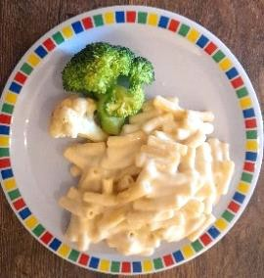
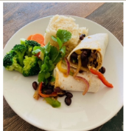
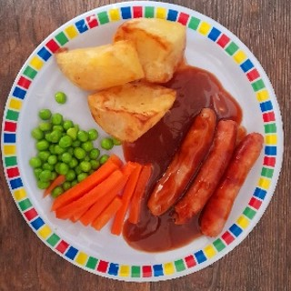
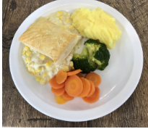
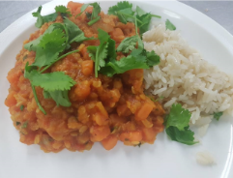

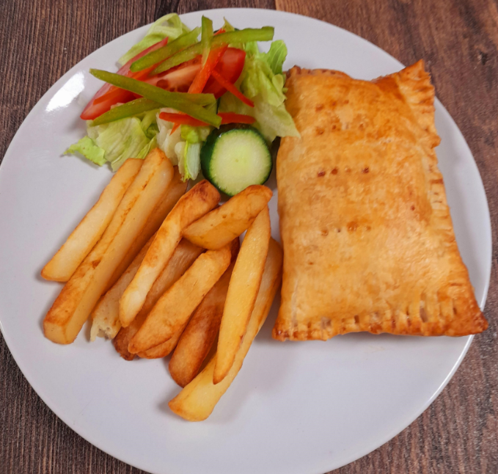
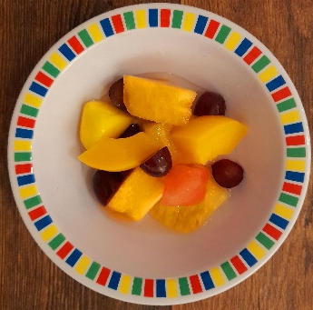
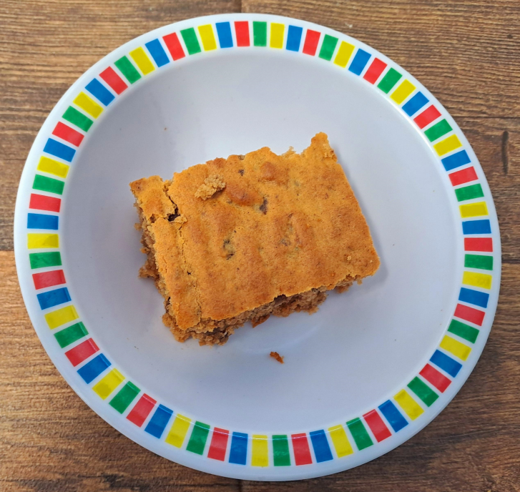
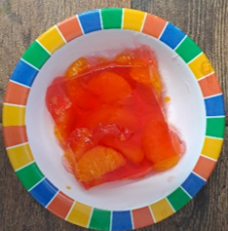
WEEK THREE
 | MONDAY | TUESDAY | WEDNESDAY | THURSDAY | FRIDAY
OPTION 1 16.11.2026 07.12.2026 11.01.2027 01.02.2027 01.03.2027 22.03.2027 | Macaroni Cheese | Chicken Wrap with Wedges | Roast Pork Sausages with Roast Potatoes & Gravy | Chicken & Sweetcorn Pie with Crushed Potatoes | Fish Fingers with Chips & Tomato Sauce
OPTION 2 | Sweet Potato & Lentil Curry with Rice | Vegetable Wrap with Wedges | Veggie Sausage, Roast Potatoes & Gravy | Tomato Pasta | Cheese and Bean Puff with Chips & Tomato Sauce
DESSERT | Oaty Cookie | Fruit Crumble with Custard | Fruit Salad | Ginger Cake with Custard | Jelly with Mandarins
*VEGETABLES AND SIDES MAY DIFFER THAN THOSE SHOWN

