Slide 1
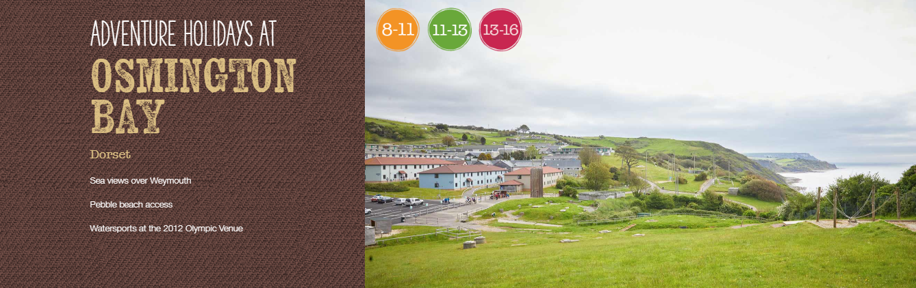
PGL – 6th June – 9th June, 2025

Slide 2
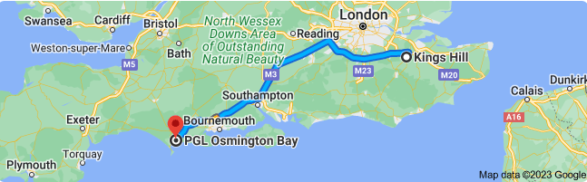
Location
By car – 3 hours and 16 minutes.

Slide 3
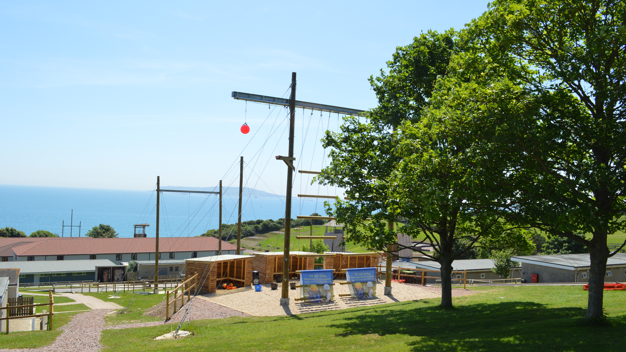
Location
45 acres of grounds with access to the nearby beautiful pebble beach with clifftop views.
Stunning views of Weymouth and Portland
One of the largest centres

Slide 4
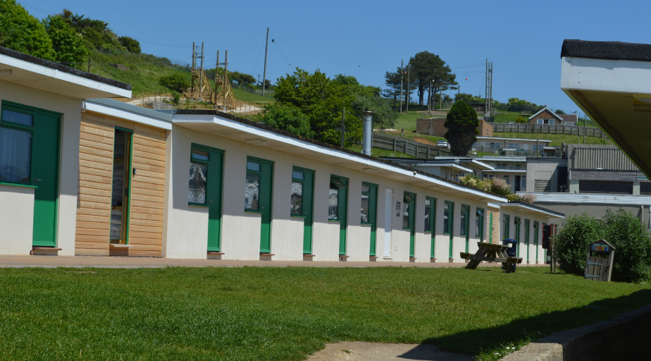
Accommodation
Comfortable 4 -6 bed chalets in newly built accommodation blocks.
All rooms have
en-suite and bathrooms.
Amazing views over the coastline and sea.

Slide 5
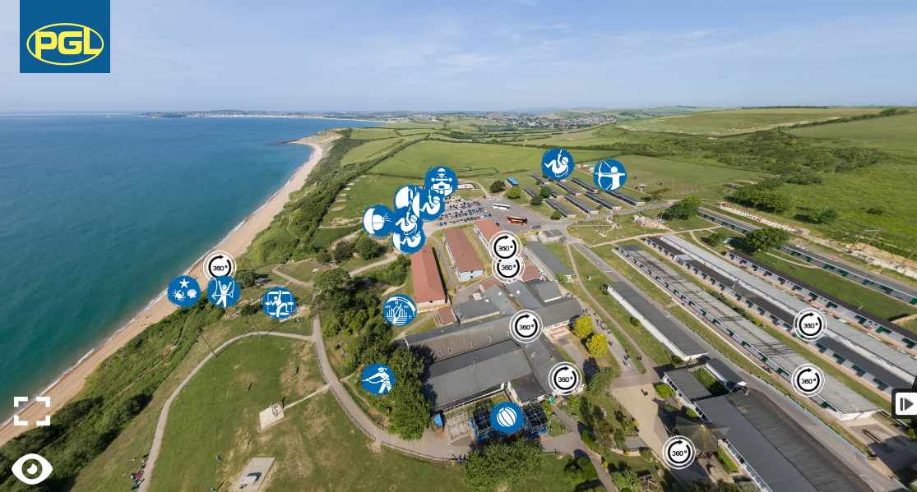
Facilities
Wide range of outdoor and indoor activities including: climbing, water sports, abseiling, laser-tag and archery.
Sports hall
Shop
https://www.pgl.co.uk/en-gb/adventure-holidays/centres/osmington-bay

Slide 6
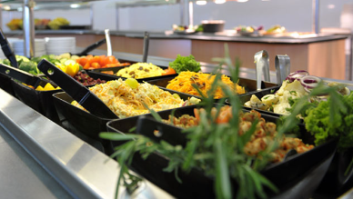
Food
Balanced, freshly prepared meals
A mix of hot and cold meals
with vegetarian options
Self-service salad bar
Fresh fruit with every meal
Allergies, intolerances and
special diets catered for
Support for fussy eaters – support guide

Slide 7
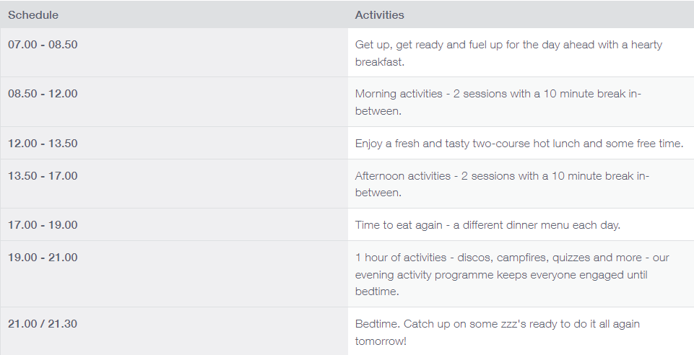
Typical day

Slide 8
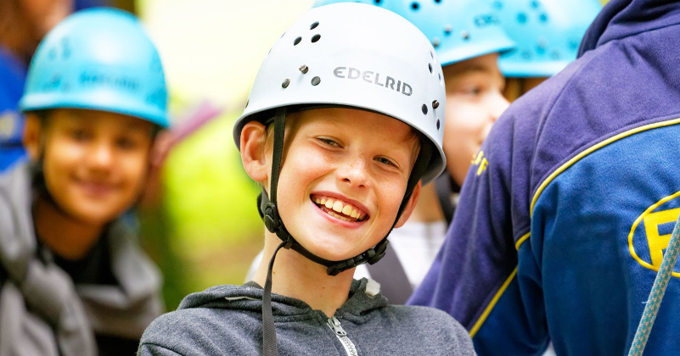
Primary to Secondary Transition
Children are encouraged to face the physical and emotional challenges via the adventure courses.
The activities help children to build stronger relationships, support and encouraging each other.
Dealing with new and unfamiliar
situations
Integration – making new friends
Personal organisation and taking
responsibility
Support and encourage each
other

Slide 9

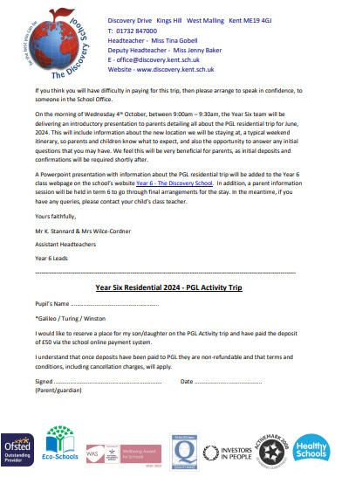
Next steps
Complete the acceptance slip and ensure the £50 deposit is paid via the school online payment system by the 31st October
Check the dates for when each payment instalment is due.
Attend the second PGL talk in the May (9am)
Full balance of £335 is due by the 30th May, 2025.

Slide 10
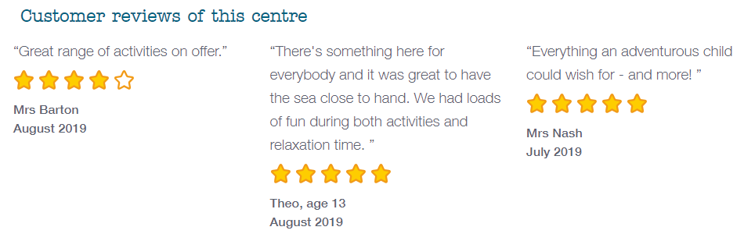
Thank you

