Slide 1
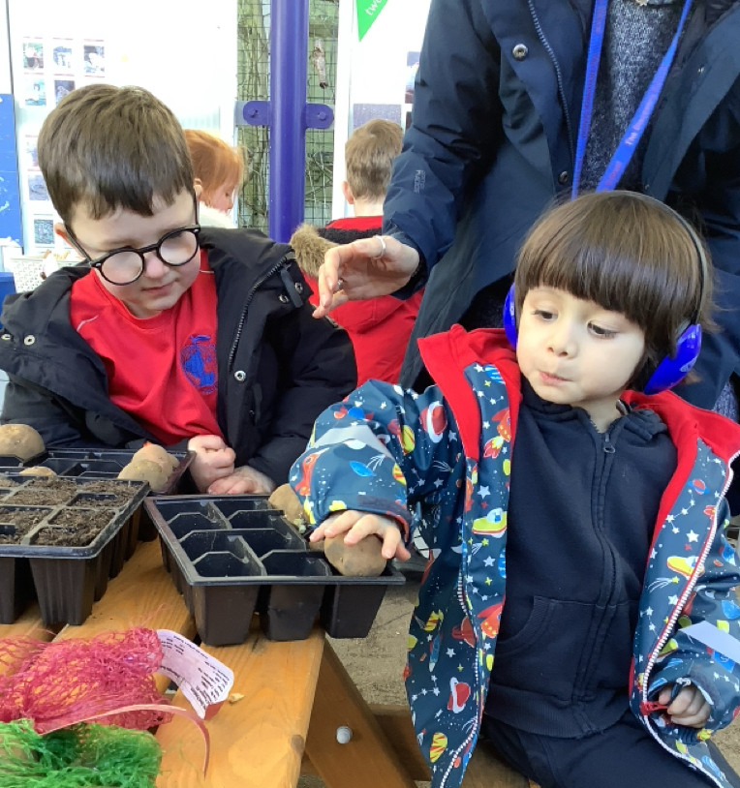
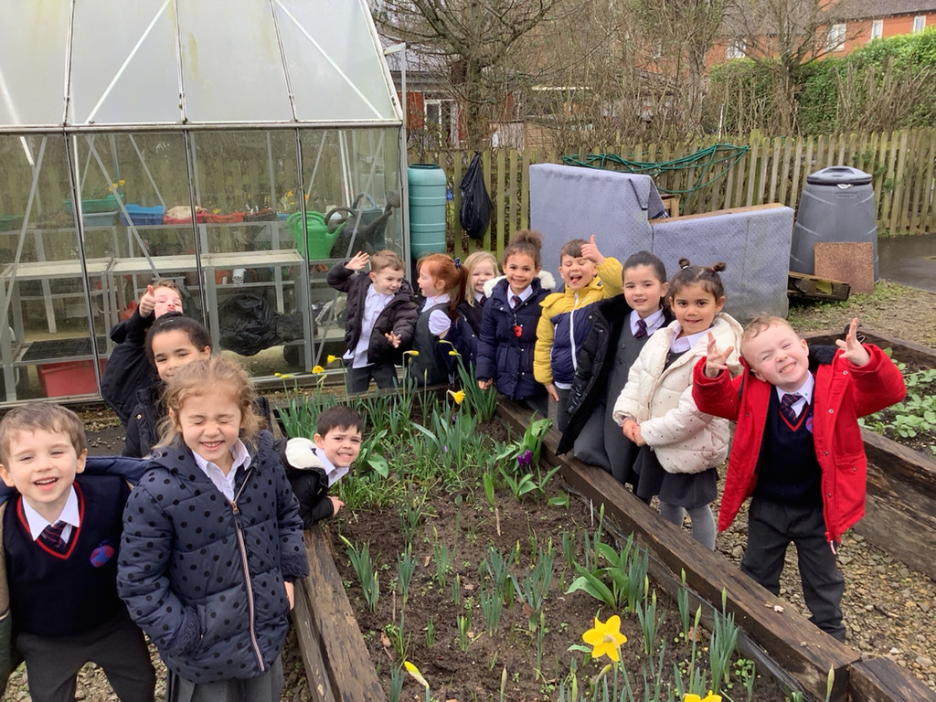
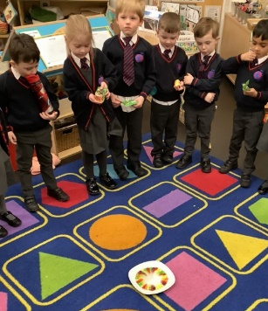
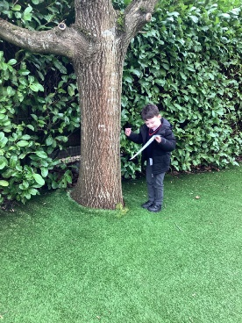
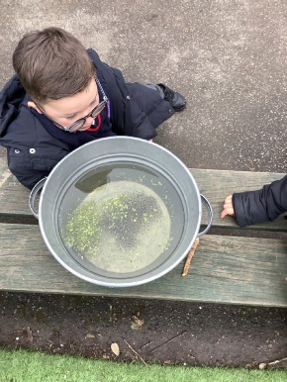
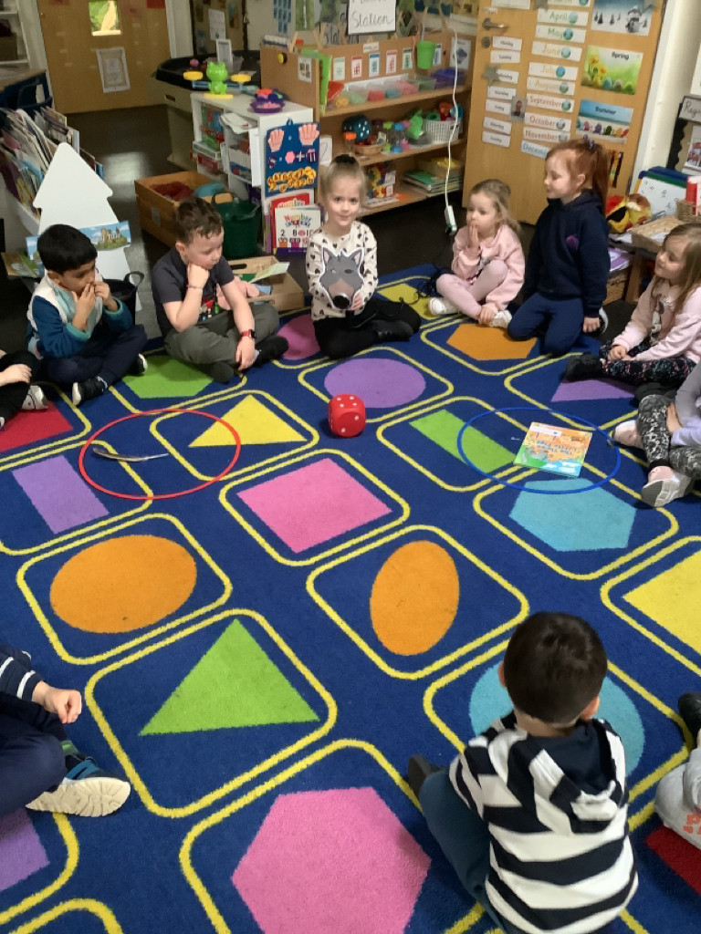
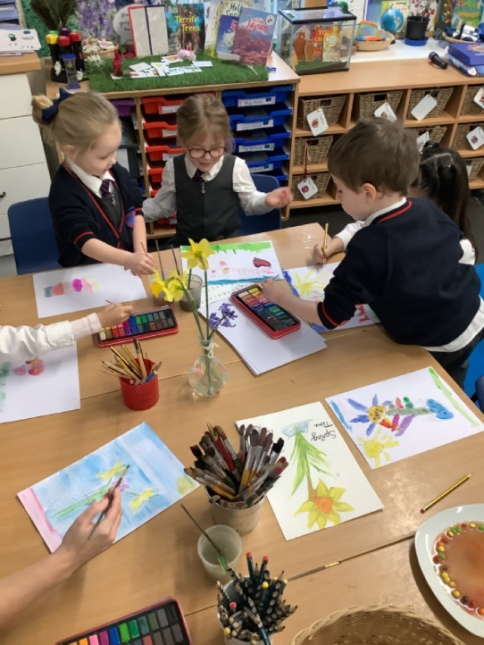
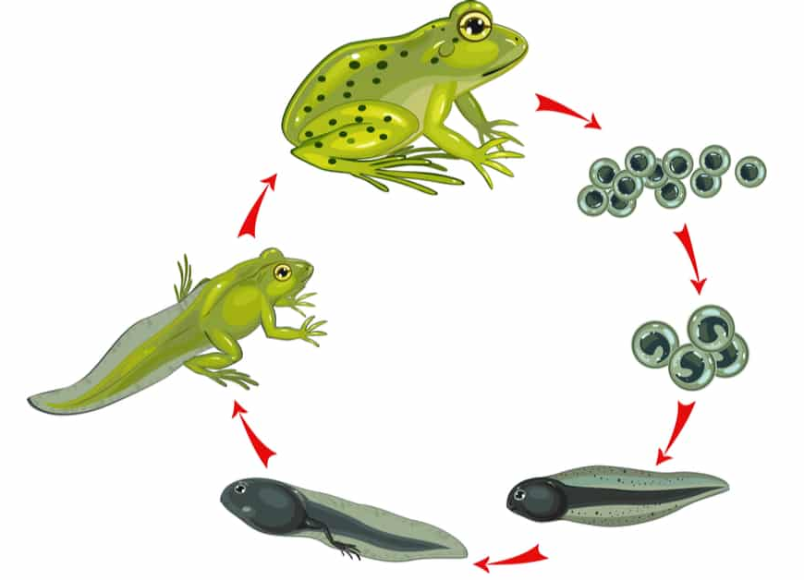
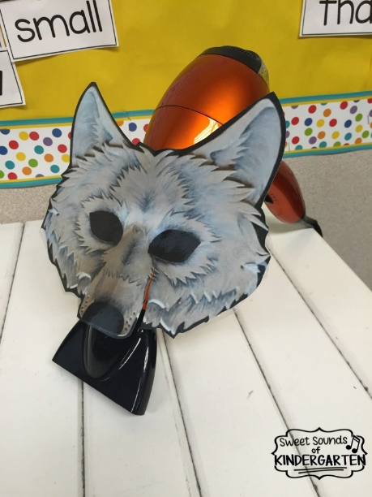
Science Week!
Planting and growth
Material rubbings
Experiments
Nests
Spring time changes
Sink or float?
Frog Spawn - Tadpoles
For Science week EYFS learnt about the word ‘experiment’ and took part in a range of experiments. We linked these to our focus text. We also learnt about the seasonal changes into Spring and how time changes the seasons across a year. We also learnt a song about time!

Slide 2
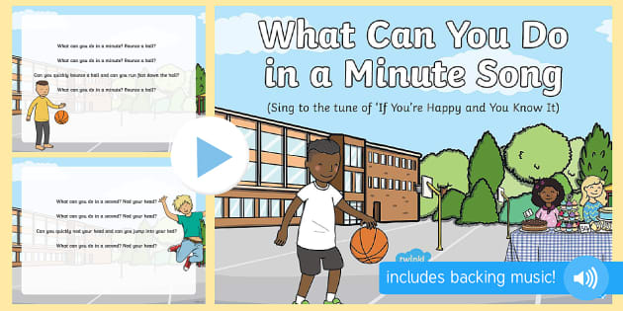
Song about time...

