Slide 1
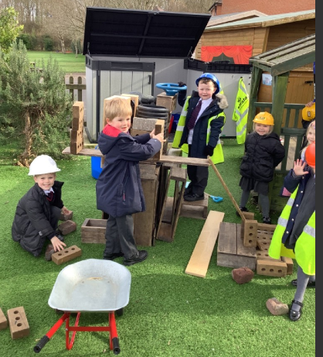

Welcome to the discovery school
Notes:
Tina

Slide 2
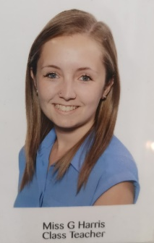
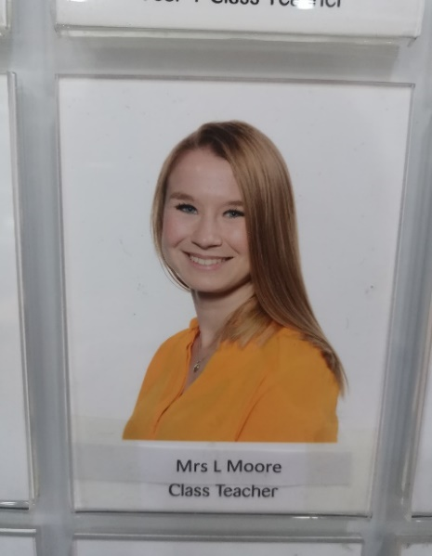
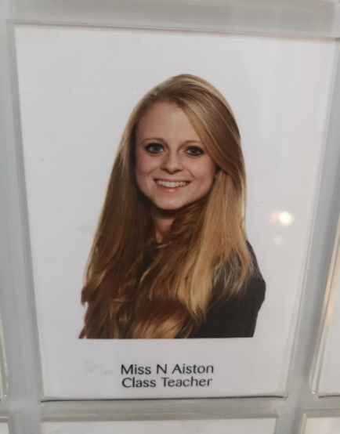
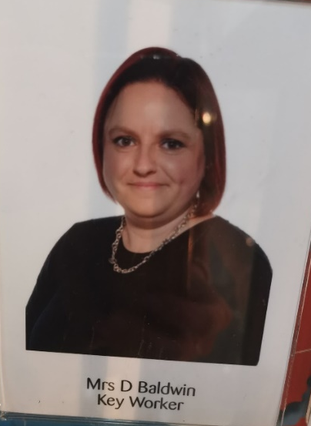
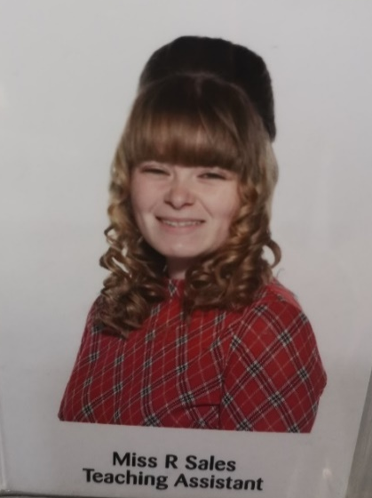
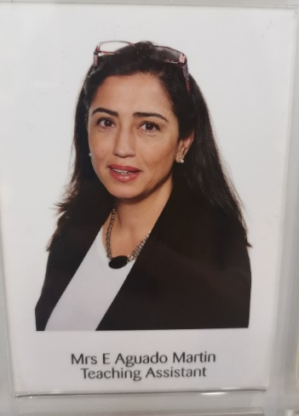
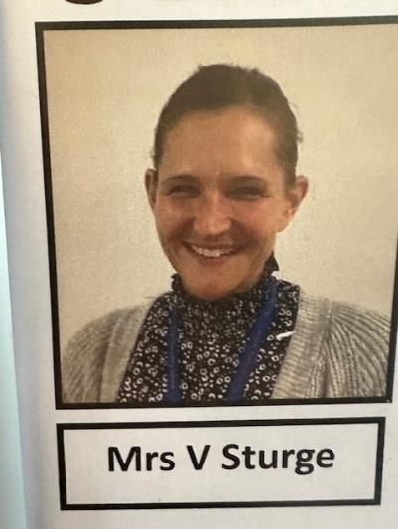
Newton
Jenner
einstein
Notes:
Nicolle

Slide 3
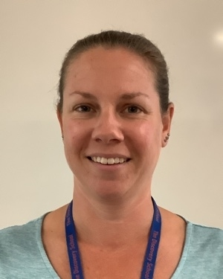
Cover Teachers
Mrs V Sturge
Mrs J Grieve
Notes:
Nicolle

Slide 4
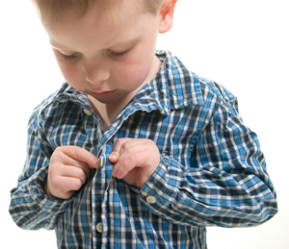
Is my child ready for school?
Mythbusters!
My child should be able to read and write before starting school.
My child can't do this without me.
My child won’t like English/Maths because I didn’t.
Real expectations
Your child can use the toilet independently and understand how to keep themselves clean etc. Wash hands, blow their own nose.
Your child can put their own jumper or coat on.
They can look after their belongings and can carry their own things.
They can use a knife and fork.
They can walk into their classroom independently without a parent or carer.
Your child is read to most days to help support their communication and language skills.
Your child has opportunities to learn about the world around them.
Notes:
Nicolle

Slide 5
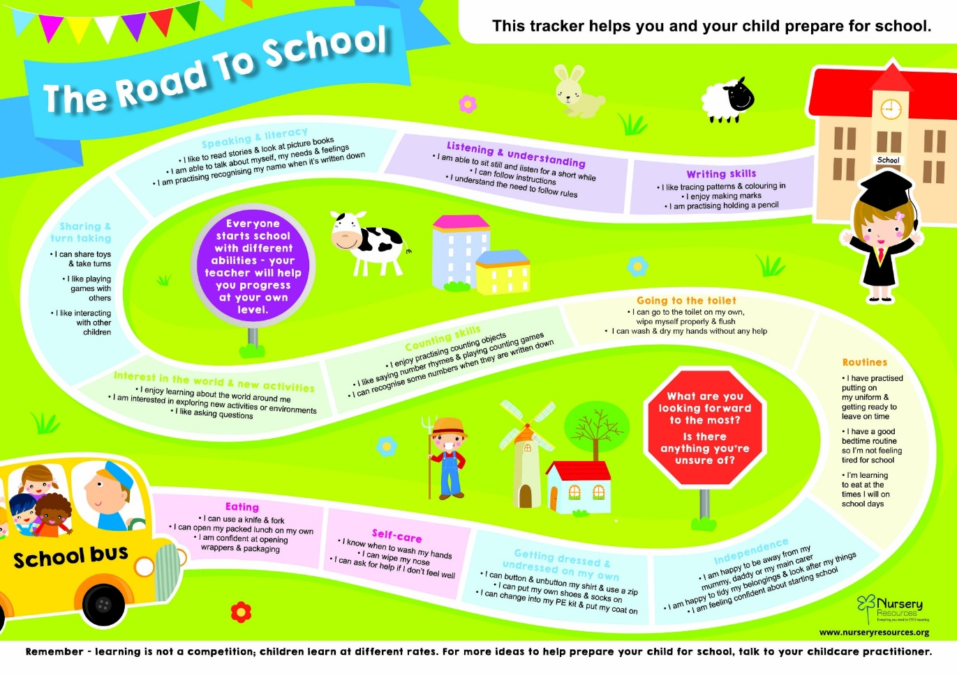
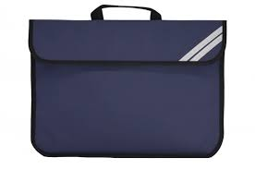
Notes:
Nicolle – sending resources home to support – book bag/email.

Slide 6
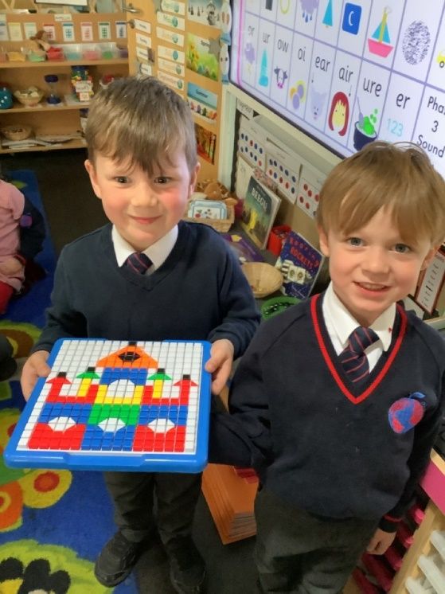
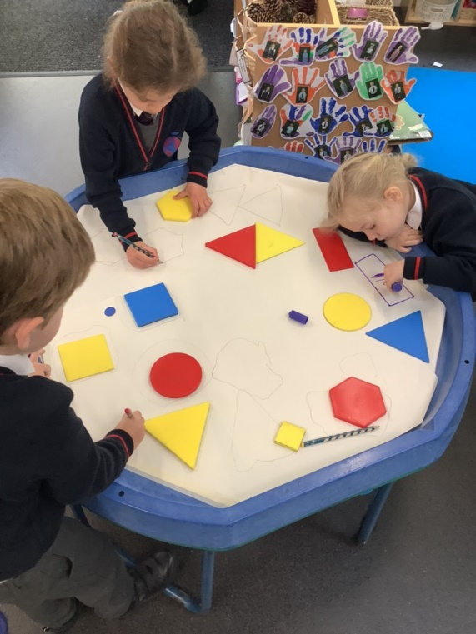
How we learn in EYFS
Follow Development Matters and the Early Years curriculum
Child initiated learning (PLR)
Teacher directed learning – next slide
Outside and indoor learning
Trips and workshops to develop their experiences and engage them in their learning.
Notes:
Leah

Slide 7
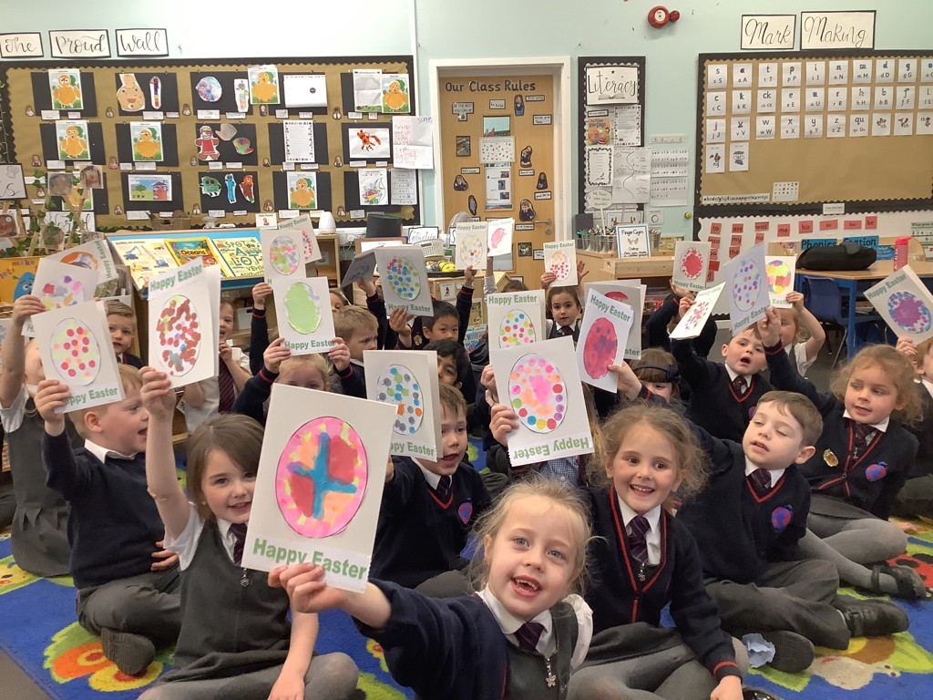
Directed Teaching
Phonics – reading/writing
Guided Reading Sessions
Literacy/Topic
Mathematics
Group Time – independent or supported with an adult
Other areas of the curriculum
Circle Times
Notes:
Leah

Slide 8
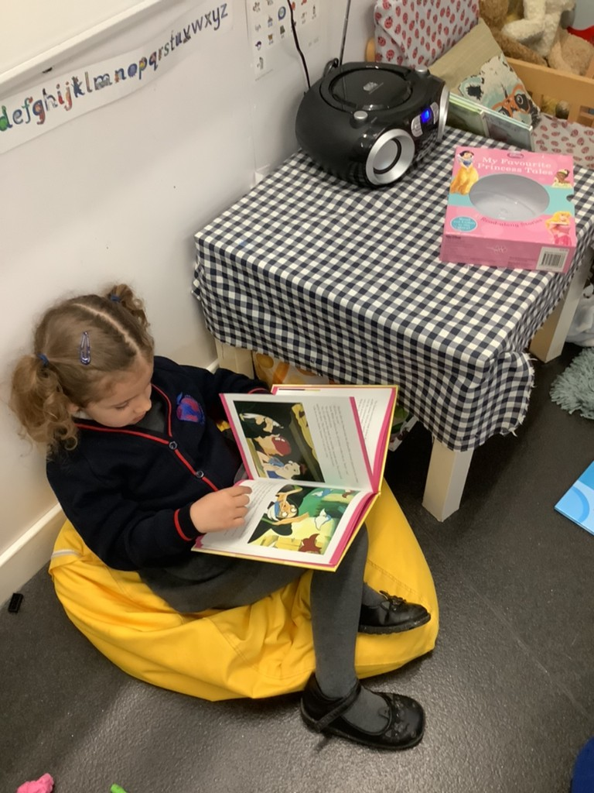
Parent workshops/support
We will be making filmed workshops for Phonics, reading, writing and Mathematics, to support your understanding on how to help your child at home with their learning.
If you do ever have any concerns or questions please do contact your class teacher and we will be happy to help.
Notes:
Vicky

Slide 9

How our day looks…
Timetable:
Every day starts at 8:40 and pick up is at 3:15.
You drop off your child at the KS1 gate and pick up at the classroom door.
Lunch time is at 11:30-12:30 every day. You can choose to have packed lunch or school dinners every day – ordered with register. Caterlink website for the menu.
Please refer to our website for timetables and any other extra information about EYFS.
Notes:
Vicky

Slide 10
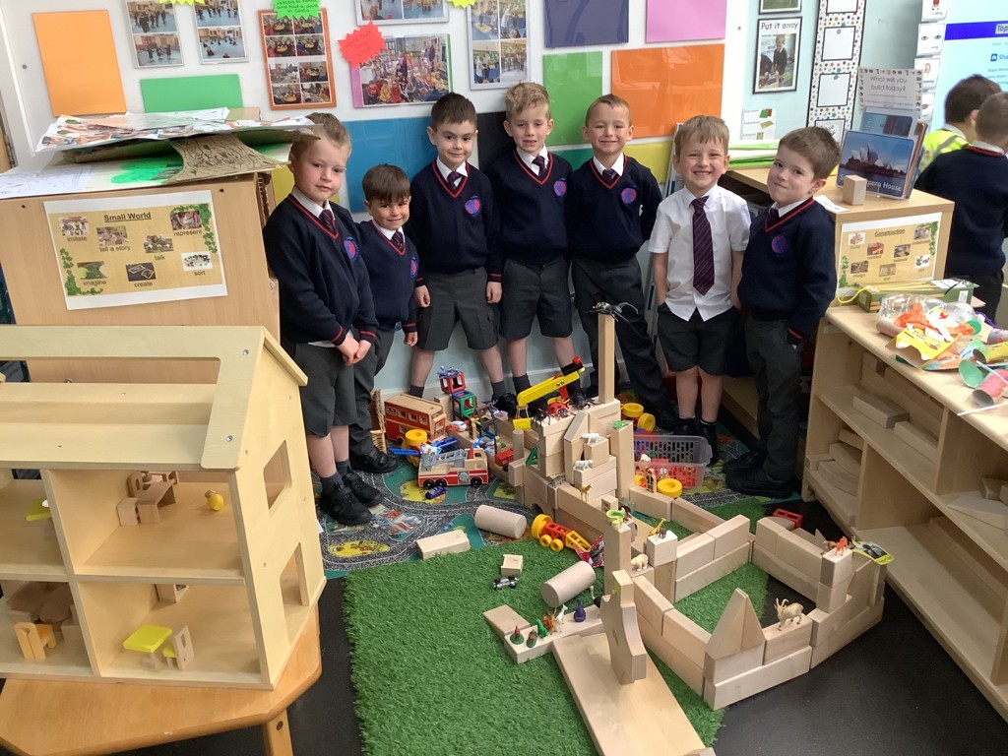
Plan, Learn, review
This is child initiated learning where the children will talk or draw what they would like to do.
Through their activities (play) solidify their learning.
Everyday provision includes role play, drawing, music, computers, building, sand and water.
Enhance the provision with activities linked to the topic e.g. Sewed superhero puppets, built traps for evil characters and collected evil peas from goo!
Teachers will be making a Sway video of the classroom your child will be in (ebook). This will allow your child to get familiar with their new learning environment.
Notes:
Nicolle

Slide 11

Question of discovery
At The Discovery School our learning is based on exploration and discovery so we use a focus question to lead our learning.
Across the year our learning is focussed around a ‘Question of Discovery’. This links to our topic and allows the children to go on a journey of exploration.
We find out what the children already know and what they would like to learn and we use this to support our planning and make learning engaging for the children.
Children use the ‘Question of Discovery’ to build on their prior learning and develop their knowledge and skills further.
Through out each term we also focus on the children’s interests and plan fun and exciting activities linked to these. We value the children’s interests and know how much it supports their engagement.
Notes:
Nicolle

Slide 12

Reading at home
Reading record
Home Readers
FFT Parent Portal – guided reading
Reading home challenges will be sent via Tapestry.
Remember reading is everywhere! Signs, menus, posters.
Reading certificates end of each week
Please do not forget to send your child in every day with their home readers and reading record as someone may read their books with them.
Notes:
Leah

Slide 13

Snack/lunch time
Every day we have a morning snack and an afternoon snack. In the morning, we have a piece of fruit or vegetable which is provided by the school. If you would like to provide an alternative healthy snack you can. The children are entitled to free milk until they turn 5 years old. Once your child has had their fifth birthday, if they would still like to have milk at snack time, you will need to pay via: www.coolmilk.co.uk.
In the afternoon, the children can have a bread stick which is supplied by the school. If you would rather your child did not have a bread stick, please let their class teacher know. You are welcome to supply them with something else if you do not want them to have a bread stick.
Children are entitled to a free school meal, up until the end of Year 2, the menu changes every 2 terms and will be provided to you as soon as we have it.
Notes:
Leah

Slide 14
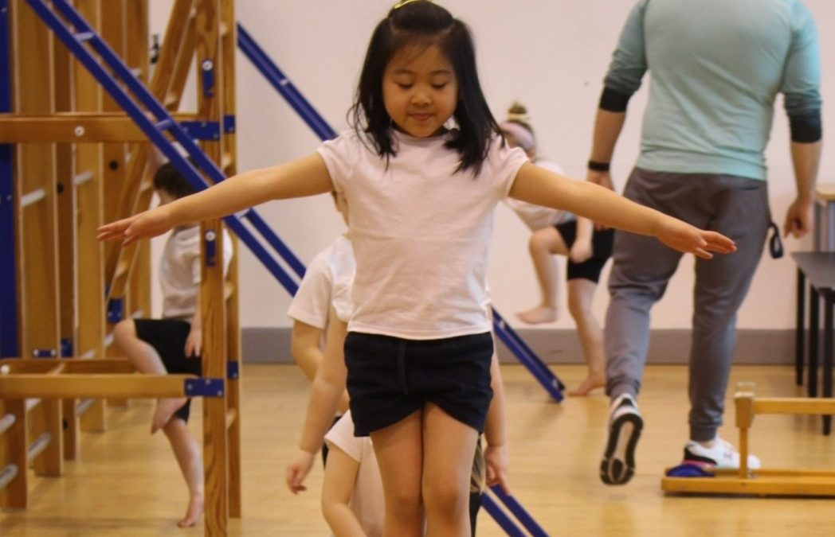
Physical education
PE doesn’t start until Term 2. PE will be indoors for the first two terms (Terms 2/3) -BEAM.
Before Term 2 you will be made aware which day PE will take place. On this day your child will come into school in their PE kits, they do not get changed at school.
Your child will be allocated a coloured house which you will be told about before Term 2. Your child needs to wear the correct coloured t-shirt to match their house, more information about this is in your parent information booklet and on our website.
Notes:
Vicky s

Slide 15
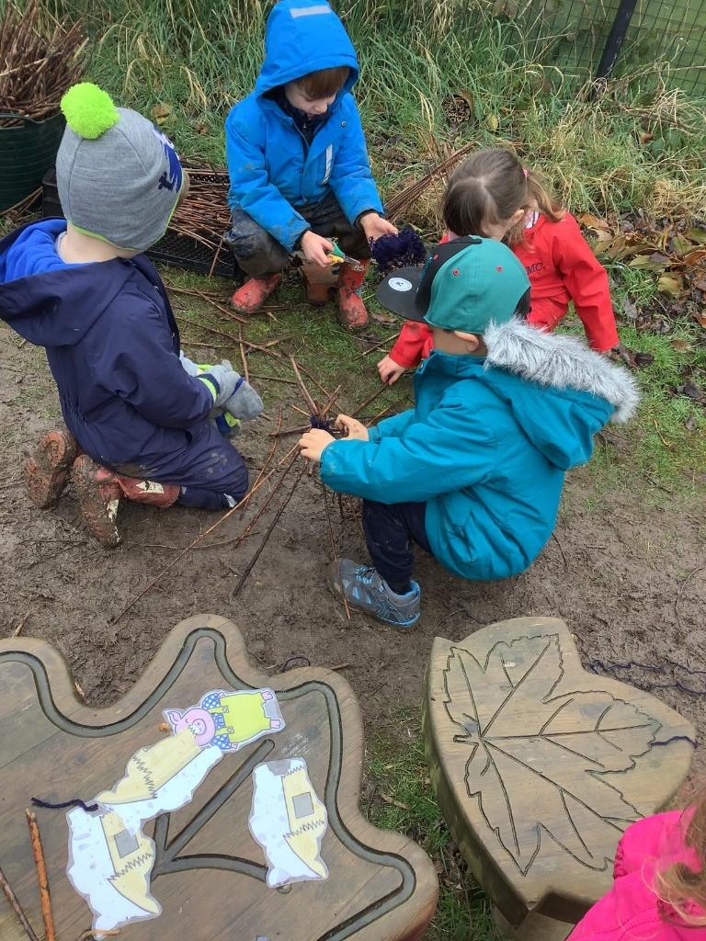
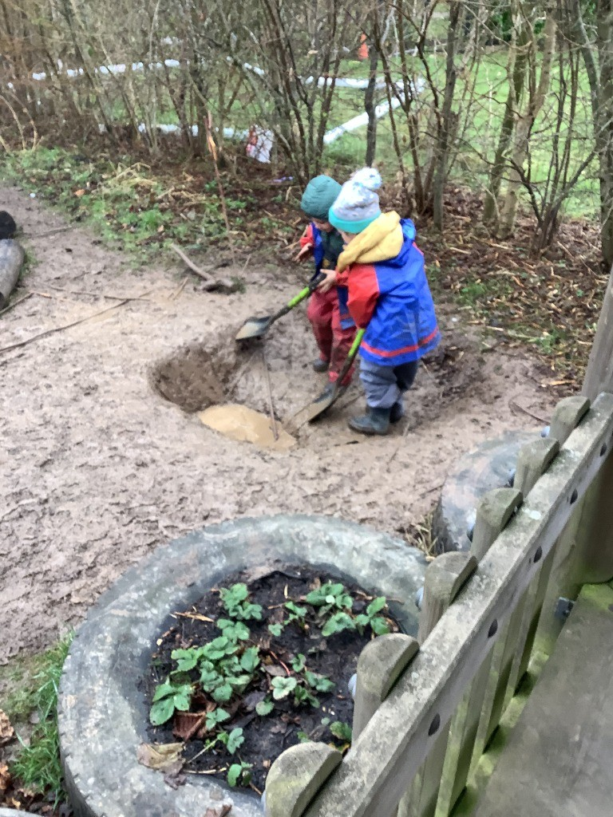
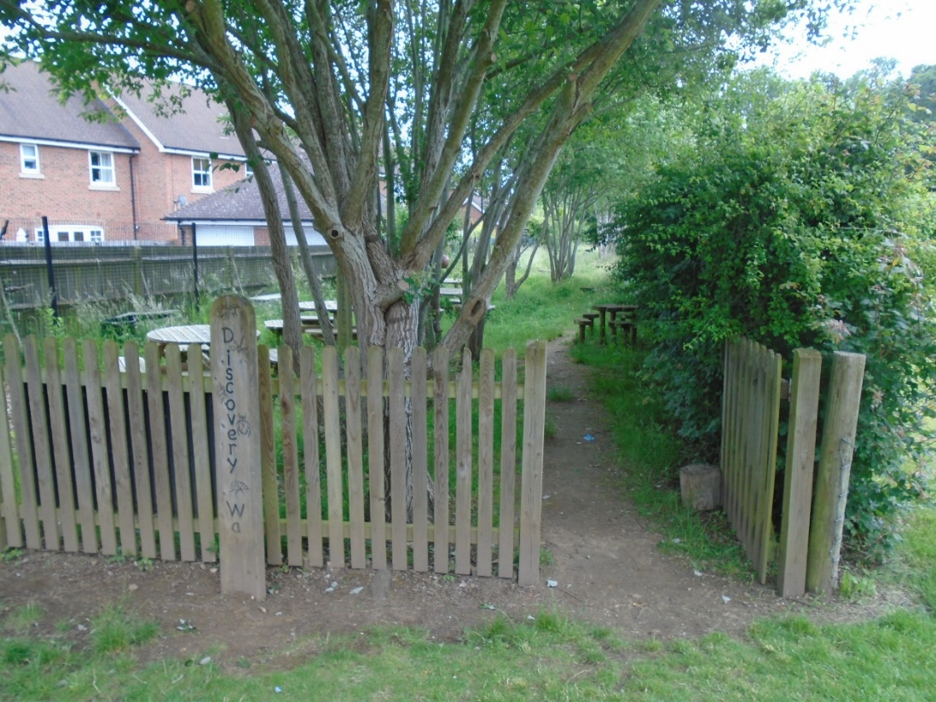
Forest school
Notes:
Vicky s

Slide 16
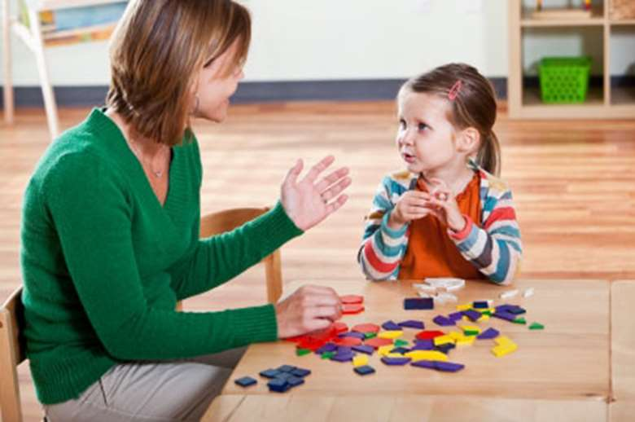
Baseline assessment/speech and language
When your child starts with us in September they will take part in a range of games to assess their skills and allow us to plan for their learning.
Alongside this we also give every child a speech and language assessment to ensure any gaps in their development are addressed at this early stage through lots of fun and engaging games.
Notes:
Tina

Slide 17

Transition dates - September…
Home Visits the week beginning 1st September (Wednesday, Thursday, Friday).
The second week is half days, your child will either have mornings or afternoons. (Week beginning 8th September).
The third week is half days but, all children in, in the morning, including lunch up to 1pm and ONE full day that week, on this day your child will take part in their Baseline Assessment – explained on next slide. (Week beginning 15th September).
For the 4th week they will be in full time (8.40am-3.15pm). (Week beginning 22nd September).
LETTERS REGARDING THIS WILL BE SENT OUT SOON CONFIRMING ALL DATES/TIMES.
HOME VISITS WILL BE OPEN TO BOOK IN JULY.
Notes:
Nicolle

Slide 18
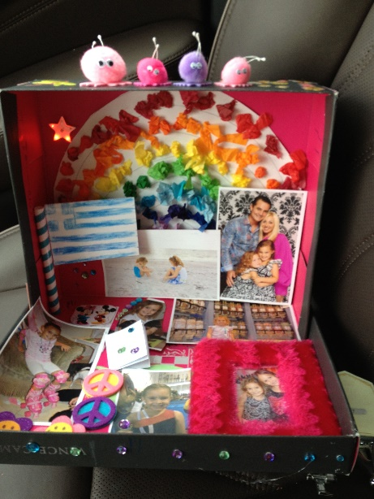
Holiday challenge
Our first term’s question of discovery is: ‘Why is it good to be me?’
Can you make your own shoe box filled with pictures and objects that can teach us all about you! (No more than 6 things please).
These will be kept for display just for Term 1. A letter will be sent out with more information about this.
Notes:
Nicolle

Slide 19

Any questions?

