Slide 1
Welcome to eyfs at the discovery school
Notes:
Nicolle or SLT?

Slide 2
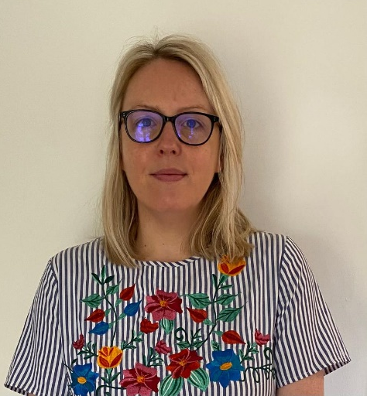
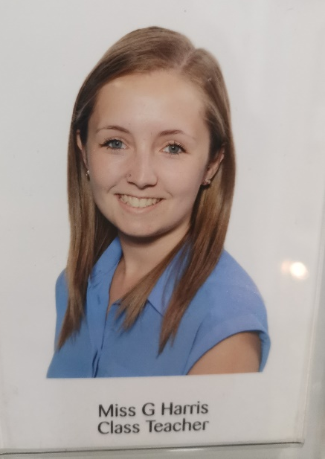
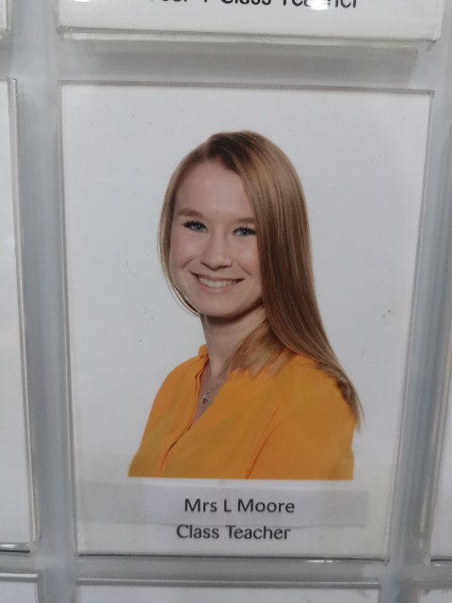
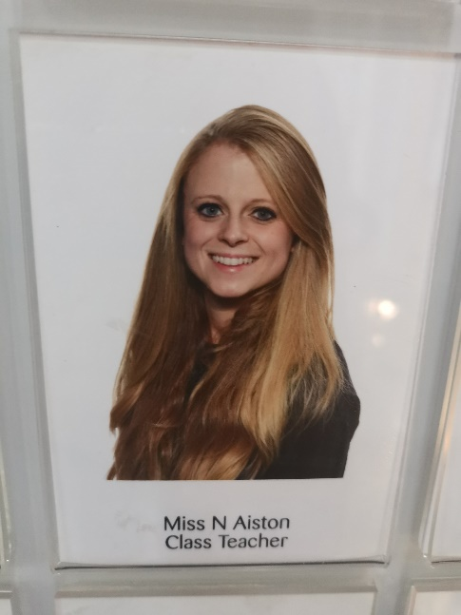
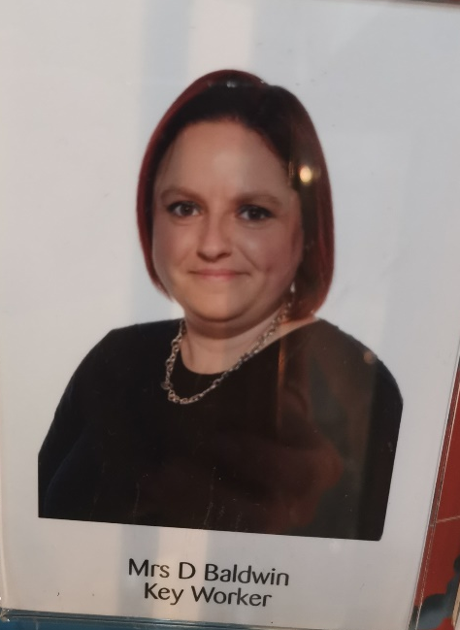
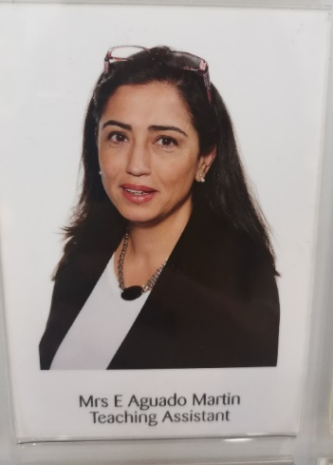
Newton
Jenner
einstein
Maternity swap in November
Notes:
Nicolle

Slide 3
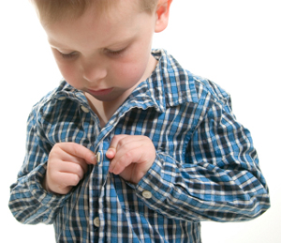
Is my child ready for school?
Mythbusters!
My child should be able to read and write before starting school.
My child needs me for...
My child won’t like English/Maths because I didn’t.
Real expectations
Your child can get dressed by themselves.
They can put on their shoes and coat.
They can carry their own things.
They can use a knife and fork.
Be positive! (Smile even though your heart is breaking)
Be prepared to separate quickly at the gate. (Try separating at the transition dates)
Your child comes to school with the correct equipment.
You read something everyday with your child.
Notes:
Gemma

Slide 4
Notes:
Nicolle – range of resources in your book bag to support your child’s transition into school – real expectations – fine motor, maths, writing, reading.

Slide 5
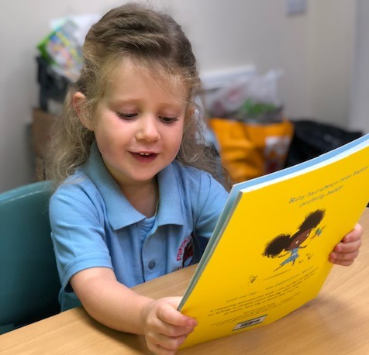
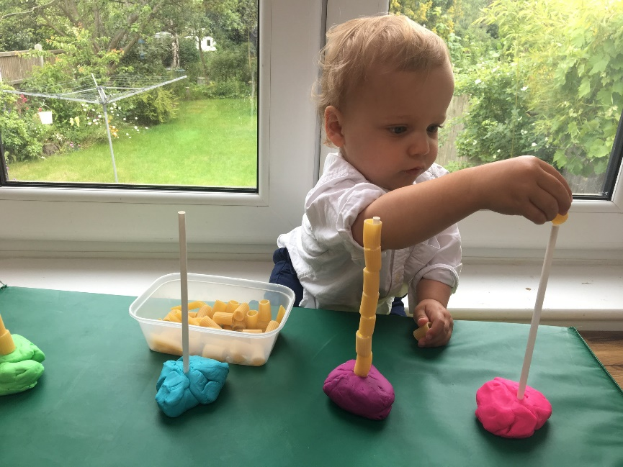
At Stay and Play you will receive a free book bag with lots of resources in to support your child at home.
Notes:
Reading/writing/fine motor/maths packs of ideas to do to support your child into transition - nicolle

Slide 6
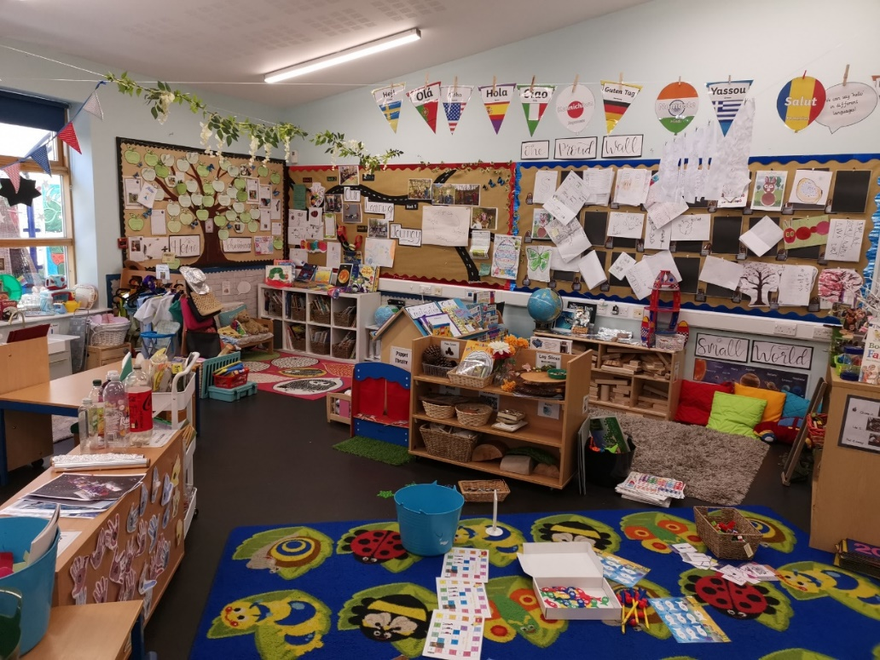
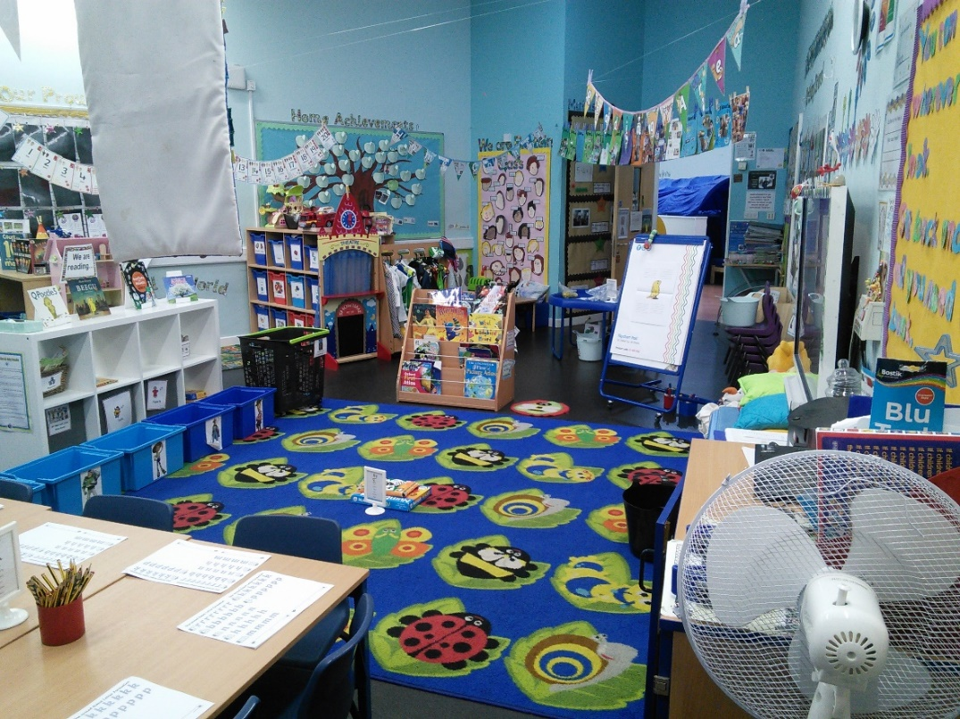
Classrooms
We have three classes of approx. 30 children – each class has the same provision.
Notes:
Leah

Slide 7
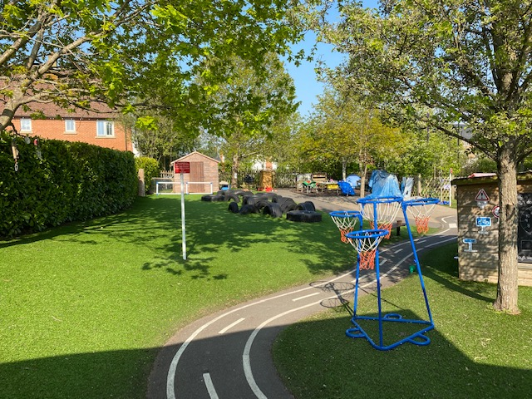
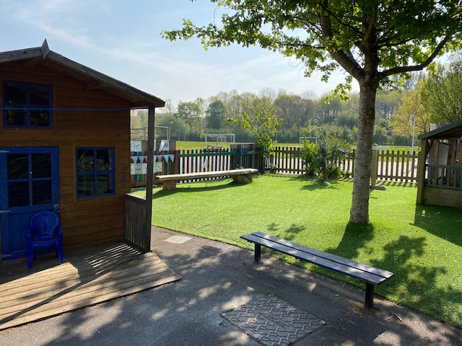
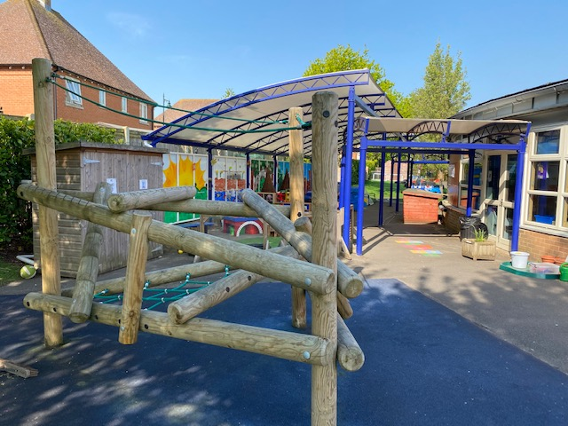
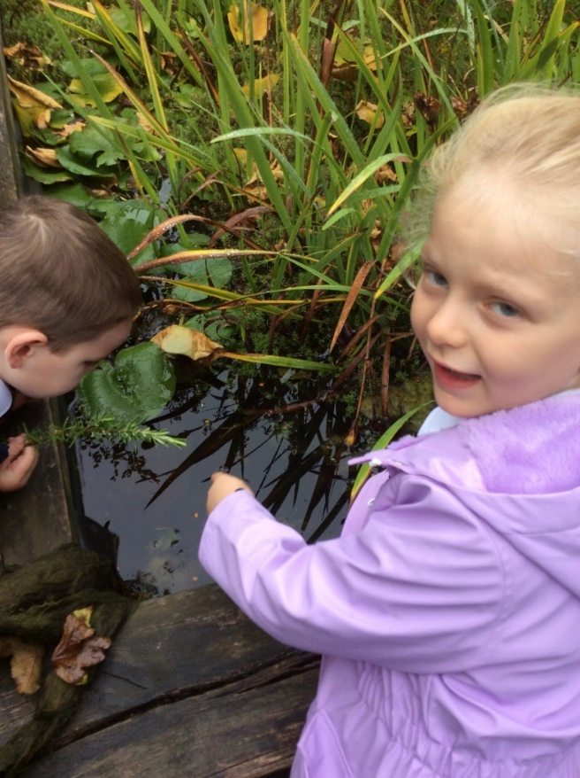
Outside area
We have an outstanding outside area with a range of different areas and resources, the children love being physical, exploring the outdoors and nature in this space.
Notes:
Leah

Slide 8
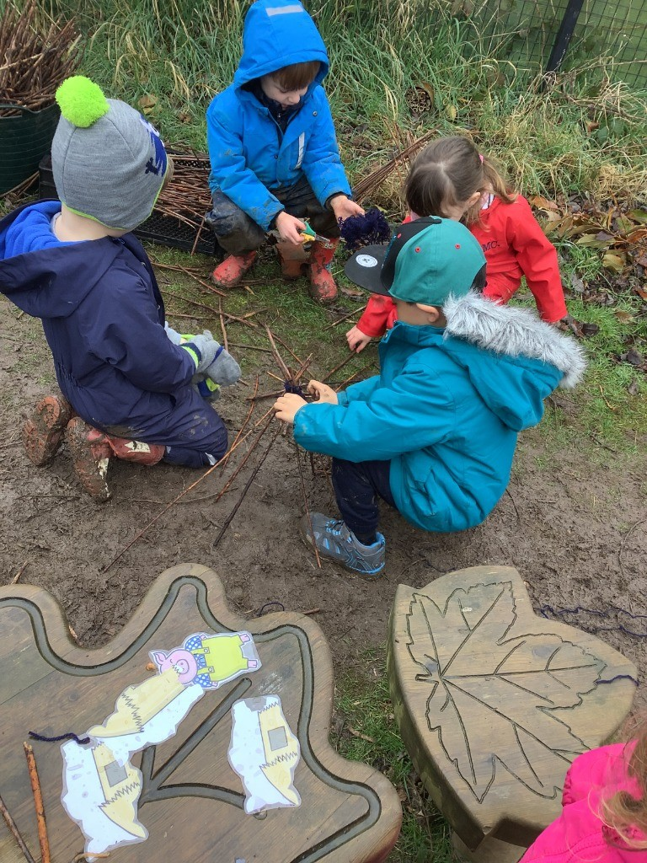
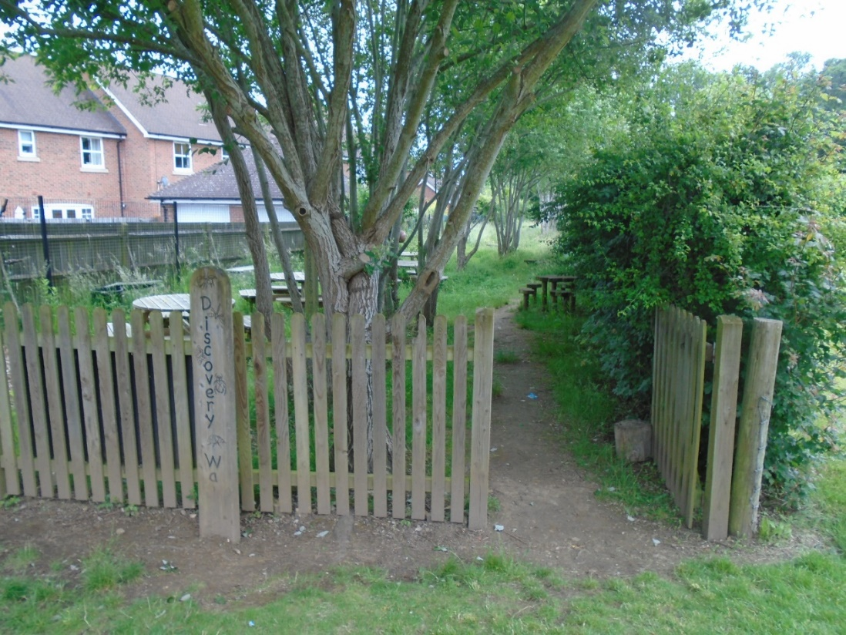
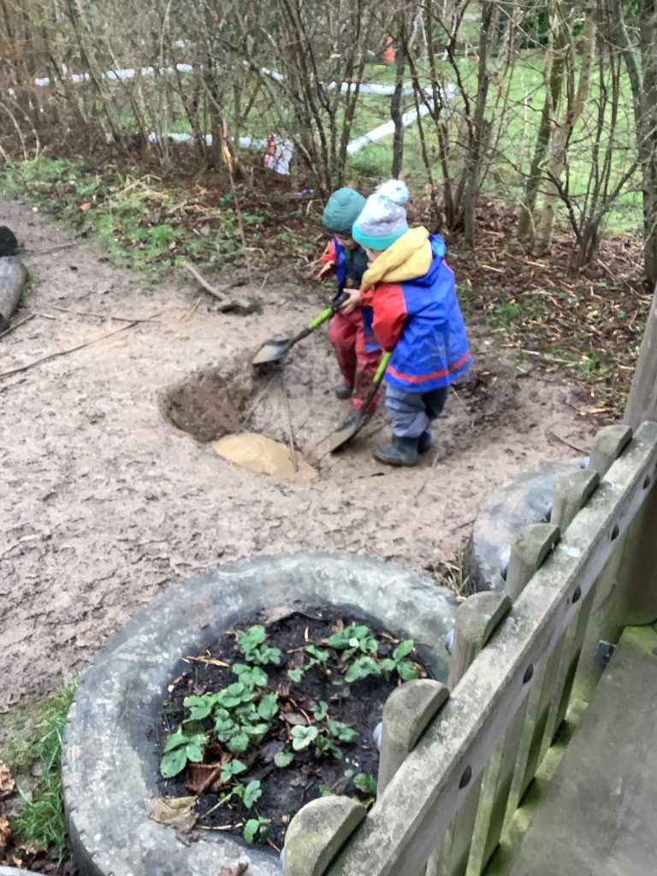
Forest school
We are very lucky to have Discovery Walk where we have amazing forest school sessions across the year. This is taught by our forest school teacher Mrs Chapman.
Notes:
Leah

Slide 9
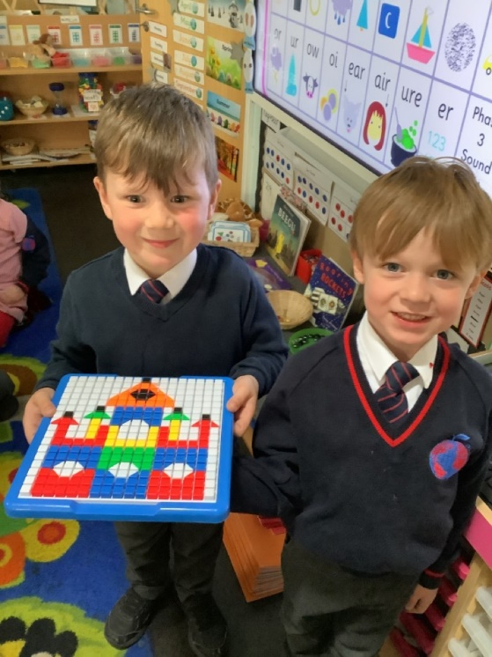
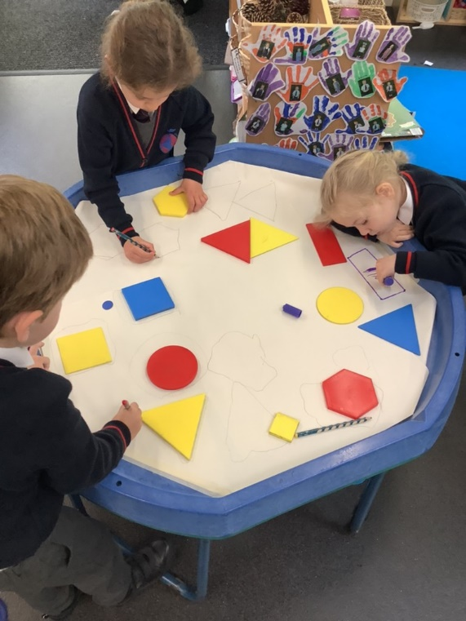
How we learn in EYFS
Follow Development Matters and the Early Years curriculum (these documents can be found online)
Child initiated learning (Plan, Learn, Review)
Teacher directed learning – next slide
Outside and indoor learning any weather!
Trips and workshops (truffle moments – to develop their experiences and engage them in their learning)
Notes:
Nicolle

Slide 10
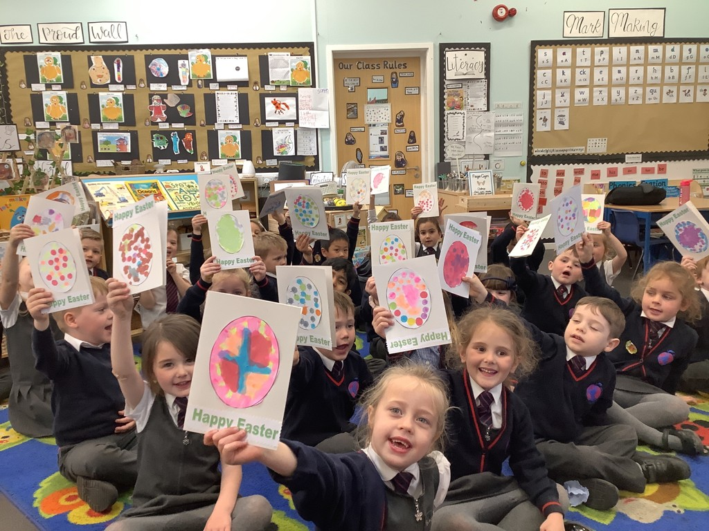
Directed Teaching
Phonics – reading/writing
Guided Reading Sessions
Literacy/Topic
Mathematics
Group Time – independent or supported with an adult
Other areas of the curriculum
Circle Times/Talk times
Notes:
Hannah

Slide 11
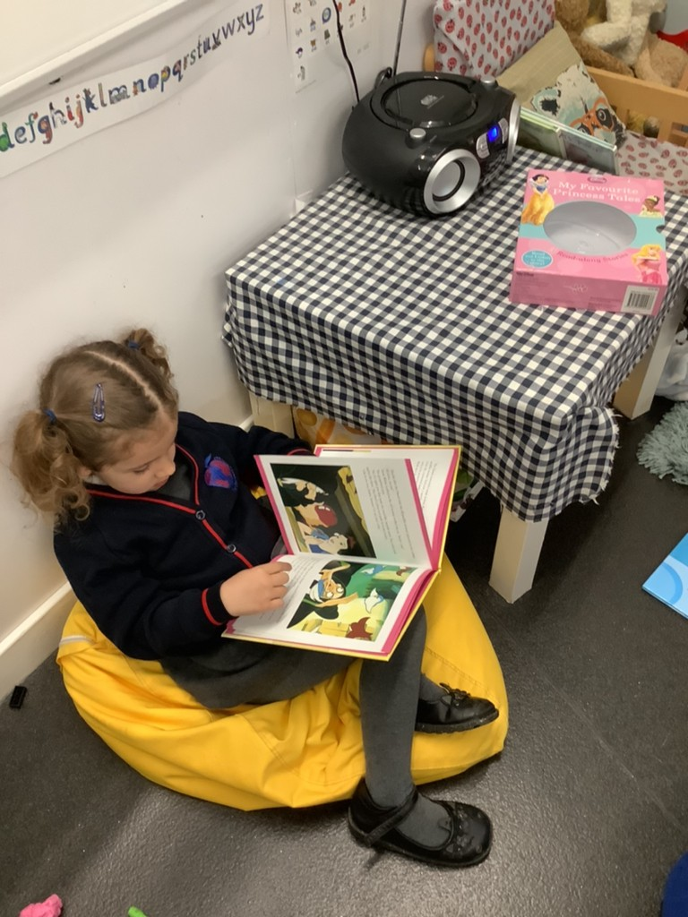
Parent workshops/support
We will be making filmed workshops for Phonics, reading, writing and Mathematics, to support your understanding on how to help your child at home with their learning.
If you do ever have any concerns or questions please do contact your class teacher and we will be happy to help.
Notes:
Nicolle

Slide 12
Timetable:
Every day starts at 8:40 and pick up is at 3:15.
You drop off your child at the KS1 gate and pick up at the classroom door.
Lunch time is at 11:30-12:30 every day. You can choose to have packed lunch or school dinners every day – ordered with register.
Please refer to our website for timetables and any other extra information about EYFS.
Notes:
Hannah

Slide 13
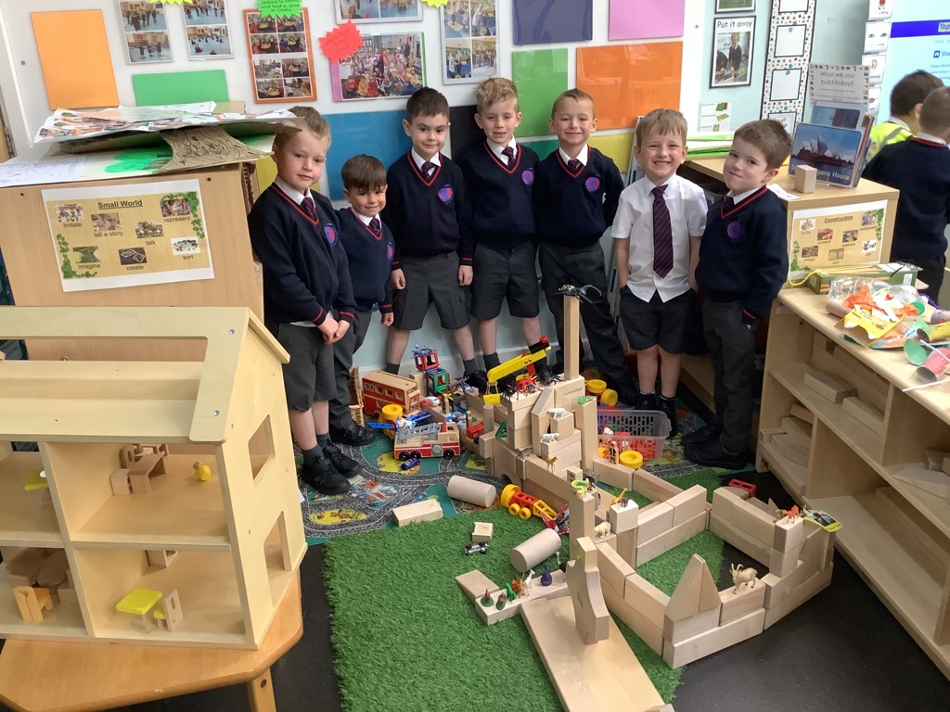
Plan, Learn, review
This is child initiated learning where the children will talk or draw what they would like to do.
Through their activities (play) solidify their learning.
Everyday provision includes role play, drawing, music, computers, building, sand and water.
Enhance the provision with activities linked to the topic e.g. Sewed superhero puppets, built traps for evil characters and collected evil peas from goo!
Teachers will be making a Sway video of the classroom your child will be in (ebook). This will allow your child to get familiar with their new learning environment.
Notes:
Gemma

Slide 14
Question of discovery
At The Discovery School our learning is based on exploration and discovery so we use a focus question to lead our learning.
Across the year our learning is focussed around a ‘Question of Discovery’. This links to our topic and allows the children to go on a journey of exploration.
We find out what the children already know and what they would like to learn and we use this to support our planning and make learning engaging for the children.
Children use the ‘Question of Discovery’ to build on their prior learning and develop their knowledge and skills further.
Through out each term we also focus on the children’s interests and plan fun and exciting activities linked to these. We value the children’s interests and know how much it supports their engagement.
Notes:
Nicolle

Slide 15
Focus texts
Linked to our topics we have focus texts and stories which the children learn to retell and take part in lots of exciting activities. These texts develop the children’s vocabulary and language and support them in becoming story tellers!
Notes:
Nicolle

Slide 16
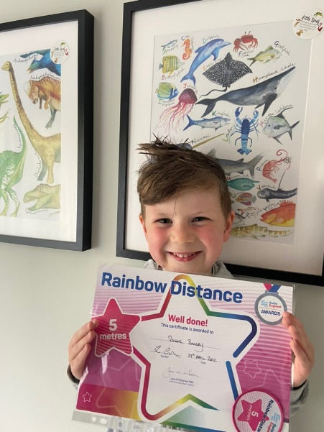
Tapestry/assessments
We use Tapestry, an online learning journal to upload learning that has taken place at school. Parents can enjoy this from home and comment on the pictures.
On Tapestry you can upload home achievements for us to celebrate at school. Home achievements are a very important part of your child’s learning journey.
Assessments are made through observations and questioning. All assessments we do with your child are purposeful and used to help us support their next steps. These will be communicated with you on parents consultations.
Notes:
Gemma

Slide 17
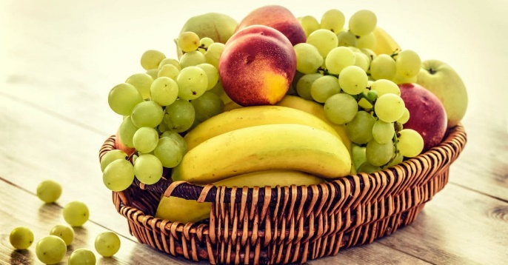
Snack/lunch time
Every day we have a morning snack and an afternoon snack. In the morning we have a piece of fruit or vegetable which is provided by the school. If you would like to provide an alternative healthy snack you can. The children are entitled to free milk until they turn 5 years old. Once your child has had their fifth birthday, if they would still like to have milk at snack time, you will need to pay via: www.coolmilk.co.uk.
In the afternoon the children can have a bread stick which is supplied by the school. If you would rather your child did not have a bread stick please let their class teacher know. You are welcome to supply them with something else if you do not want them to have a bread stick.
Children are entitled to a free school meal, up until the end of Year 2, the menu changes every 2 terms and will be provided to you as soon as we have it.
Notes:
Gemma

Slide 18
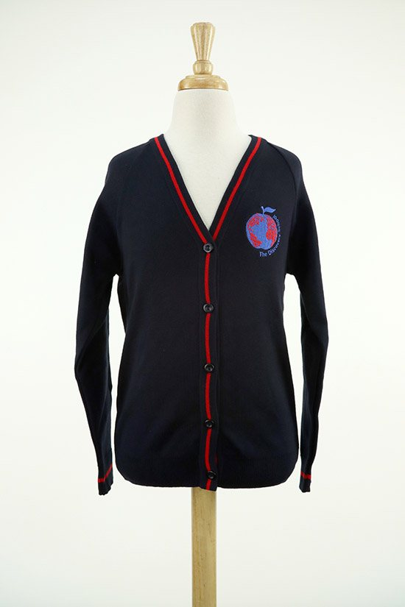
Uniform AND ESSENTIALS
Uniform: if you are unsure about the uniform you child should wear, please refer to our website. Please make sure your child brings in a coat and a jumper or cardigan every day regardless of the weather. PLEASE MAKE SURE ALL YOUR CHILDS ITEMS ARE NAMED. https://www.discovery.kent.sch.uk/about-us/starting-school/uniform/
Book bags, NO rucksacks – free book bag at stay and play.
Please provide your child with a change of clothing in case of accidents.
Wellies and wet weather gear in a plastic bag to hang on their peg.
Please provide a named water bottle for your child to bring into school with them every day, these must only have water in, not squash or juice.
Medicines – office - forms
Illnesses – please phone or email the office to let them know.
Notes:
Hannah

Slide 19
Reading at home
You will receive your own reading record – please try and read at least five times a week – your children’s books will link to their phonetic knowledge.
Home Readers – you will receive three home readers a week and our onlined guided reading books from FFT parent portal (our phonics scheme).
Reading home challenges will be sent via Tapestry.
Remember reading is everywhere! Signs, menus, posters.
Reading certificates end of each week in celebration assembly.
Please do not forget to send your child in every day with their home readers and reading record as someone may read their books with them.
Notes:
Nicolle

Slide 20
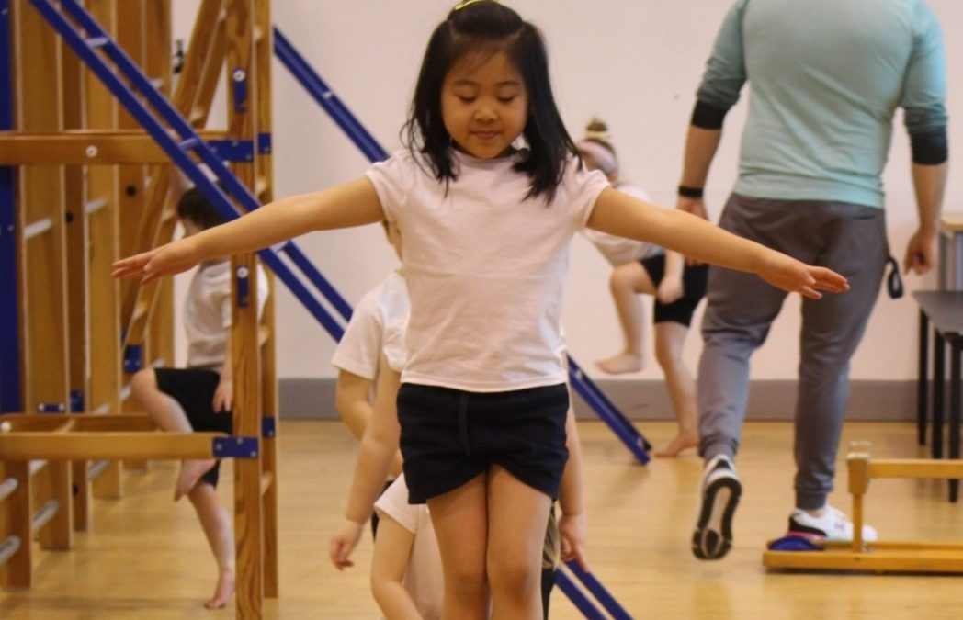
Physical education
PE doesn’t start until Term 2. PE will be indoors for the first two terms (Terms 2/3) -BEAM.
PE will be on Friday’s – children come into school in their PE kits, they do not get changed at school.
Our PE kits and what your child needs to bring for PE.
Notes:
Gemma/Leah

Slide 21
Celebrations
Year group celebration assembly every Friday: celebrations in school and outside school.
Star of the week award
Reading rewards
Post cards
Parents evening
Please refer to our school learning updates page on our website to keep up to date with our learning!
Stickers
Certificates
House points
Notes:
Gemma

Slide 22
Communication
Termly News Letter by Miss Aiston
Learning Updates on Website
Email/phone call/Tapestry
Open door policy – when you drop off or pick up.
Please refer to our EYFS page on our website.
Notes:
Nicolle

Slide 23
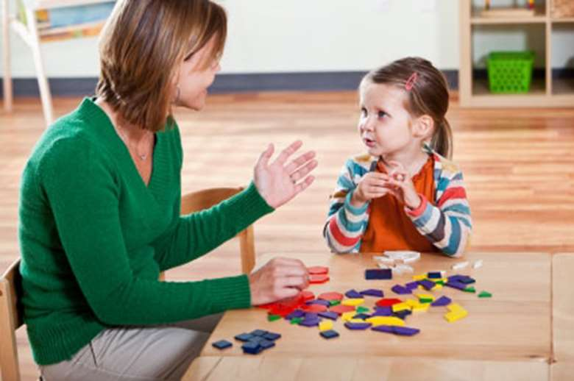
Baseline assessment/speech and language
When your child starts with us in September they will take part in a range of games to assess their skills and allow us to plan for their learning. Miss Gobell will be sending out a letter with more information about this assessment soon.
Alongside this we also give every child a speech and language assessment to ensure any gaps in their development are addressed at this early stage through lots of fun and engaging games.
Notes:
Gemma

Slide 24
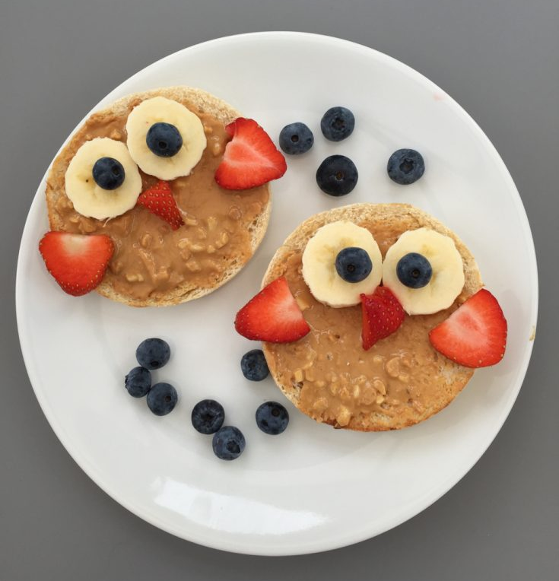
Breakfast club and afterschool club
Breakfast club starts at 7:30am and after school club runs until 6pm.
Book 48 hours in advance via online booking system on our website, please call or speak to our office staff if you would like to use this service.
Notes:
Gemma

Slide 25
Transition into eyfs
Slow transition – 1st week, 2 days of half days, 2nd week half days with lunch/one full day till 3pm, 3rd week full time.
Two ‘Stay and play’ sessions in July – date on your letter not the day.
Home visits in September (Monday 4th – Wednesday 6th)– please book – separate letter will be sent out regarding this.
Notes:
Gemma

Slide 26
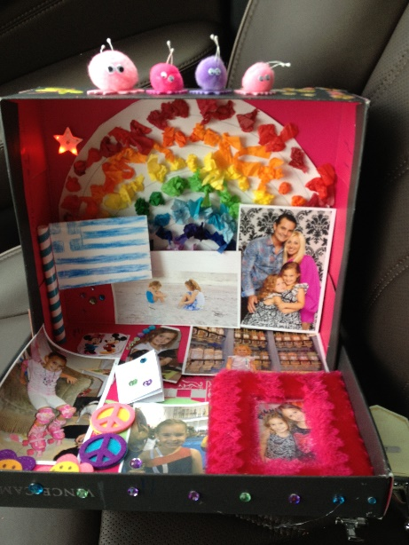
Holiday challenge
Our first term’s question of discovery is: ‘Why is it good to be me?’
Can you make your own shoe box filled with pictures and objects that can teach us all about you! (No more than 6 things please).
These will be kept for display just for Term 1. A letter will be sent out with more information about this.
Notes:
Nicolle

Slide 27
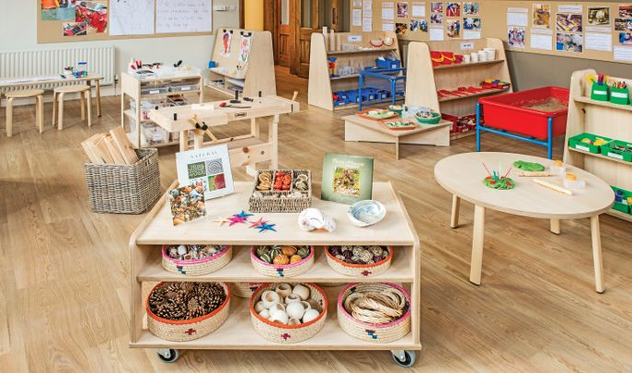
If you have any questions please ask your class teacher
Let’s go to the classrooms ☺
Notes:
Nicolle

