Slide 1
Diversity council
What is our mission?

Slide 2
Our mission
We want ….
every child in the school to feel welcome and happy here, and know that everyone can be the best that they can be.

Slide 3
What have achieved so far this year?

Slide 4
Diversity Council mission
Design and make Diversity Council badges or lanyards.

Slide 5
Mission accomplished

Slide 6
Diversity Council mission
Make sure that all children know about their class namesakes. We would like all classes to learn about them this term and display their learning in the classroom or on the class digital knowledge floor book.

Slide 7
Mission accomplished

Slide 8
Diversity Council mission
Create a Diversity Council display board to make our mission clear to the school and its visitors.

Slide 9
Mission accomplished

Slide 10
Diversity Council mission
Make sure that the books that we read in school have good representation, including the ones used in our English lessons and our class readers.

Slide 11
Mission accomplished

Slide 12
Diversity Council mission
Have more opportunities in our curriculum to learn about different cultures through exciting lessons, themed days or weeks, visits and trips.

Slide 13
Mission accomplished

Slide 14
Diversity Council mission
Recruit some new voices on the Diversity Council.

Slide 15
Mission accomplished

Slide 16
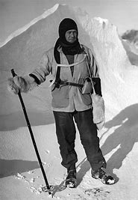
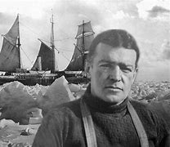
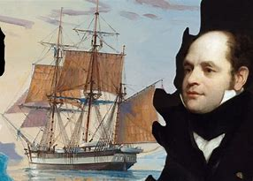
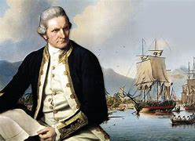
Diversity Council mission
Change our house names to represent our school values.
Scott
Shackleton
Franklin
Cook

Slide 17
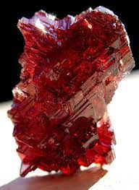
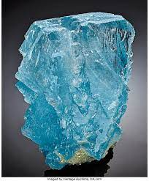
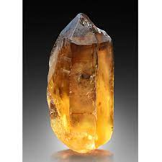
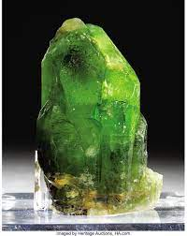
Our new House names are…
Gemstones!
Garnet
Topaz
Citrine
Peridot

Slide 18
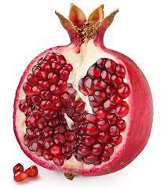
Our new House names are…
Gemstones!
A garnet is kind of mineral that forms spectacular crystals.
Their most common colour is red.
The name "garnet" comes from the Latin granatus, possibly in reference to malum garanatum (pomegranate) a plant with red seeds similar in shape, size and colour to some garnet crystals.
Red garnet is associated with the heart, representing kindness, friendship and honesty.
Garnet

Slide 19
Our new House names are…
Gemstones!
Topaz is one of the hardest naturally occurring minerals.
It occurs in many places in the world.
It comes in different colours but blue is the most popular for jewellery making.
Blue Topaz is associated with wisdom, communication, and success.
Which of our school values does this relate to?
Topaz

Slide 20
Our new House names are…
Gemstones!
Citrine is a yellow quartz stone.
Appreciation for the crystal goes back to at least 300 and 150 BC in ancient Greece and has carried on throughout the ages.
17th-century Scottish men used citrine to decorate their weapons.
The Victorians and 1920s socialites also wore elaborate citrine jewellery.
Citrine promotes motivation, activates creativity and encourages self-expression.
Which of our school values does this relate to?
Citrine

Slide 21
Our new House names are…
Gemstones!
Peridot (pronounced "pair-uh-dot" or "pair-uh-doe") is one of the few gemstones that comes in only one colour.
The name of the gemstone is believed to come from either the Arabic word faridat meaning "gem" or the French word peritot meaning "unclear."
The darkness of the green depends on how much iron there is.
Peridot is believed to bring good health, peace and good relationships.
Which of our school values does this relate to?
Peridot

Slide 22
Mission accomplished

Slide 23
NEXT STEPS…
How could we use our Houses more?
Let your Diversity Council Representative know your ideas so they can bring them to their next meeting.

